Slide 1
Water and Environmental Programs
2023 Update for HRWA Conference
Rural Utilities Service

Slide 2
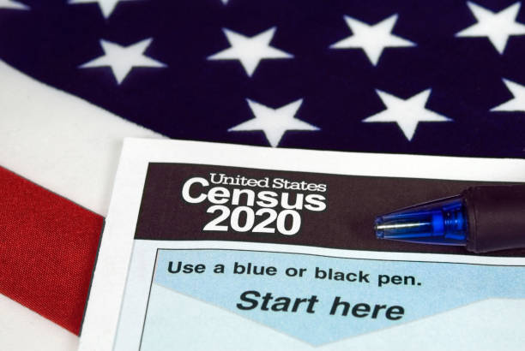
Eligibility – 2020 Census Data
Population
Census Designated Place (CDP) and Service Area
Median Household Income
Does not factor into Loan Eligibility
Income Survey can be conducted if census data not an accurate reflection of CDP income.
*Implementation on October 1, 2023
Notes:
AIS requirements are outlined here which started under Section 746 of Title VII of the Consolidated Appropriations Acts of 2017, and has been included in each Consolidated Appropriations act ever since

Slide 3
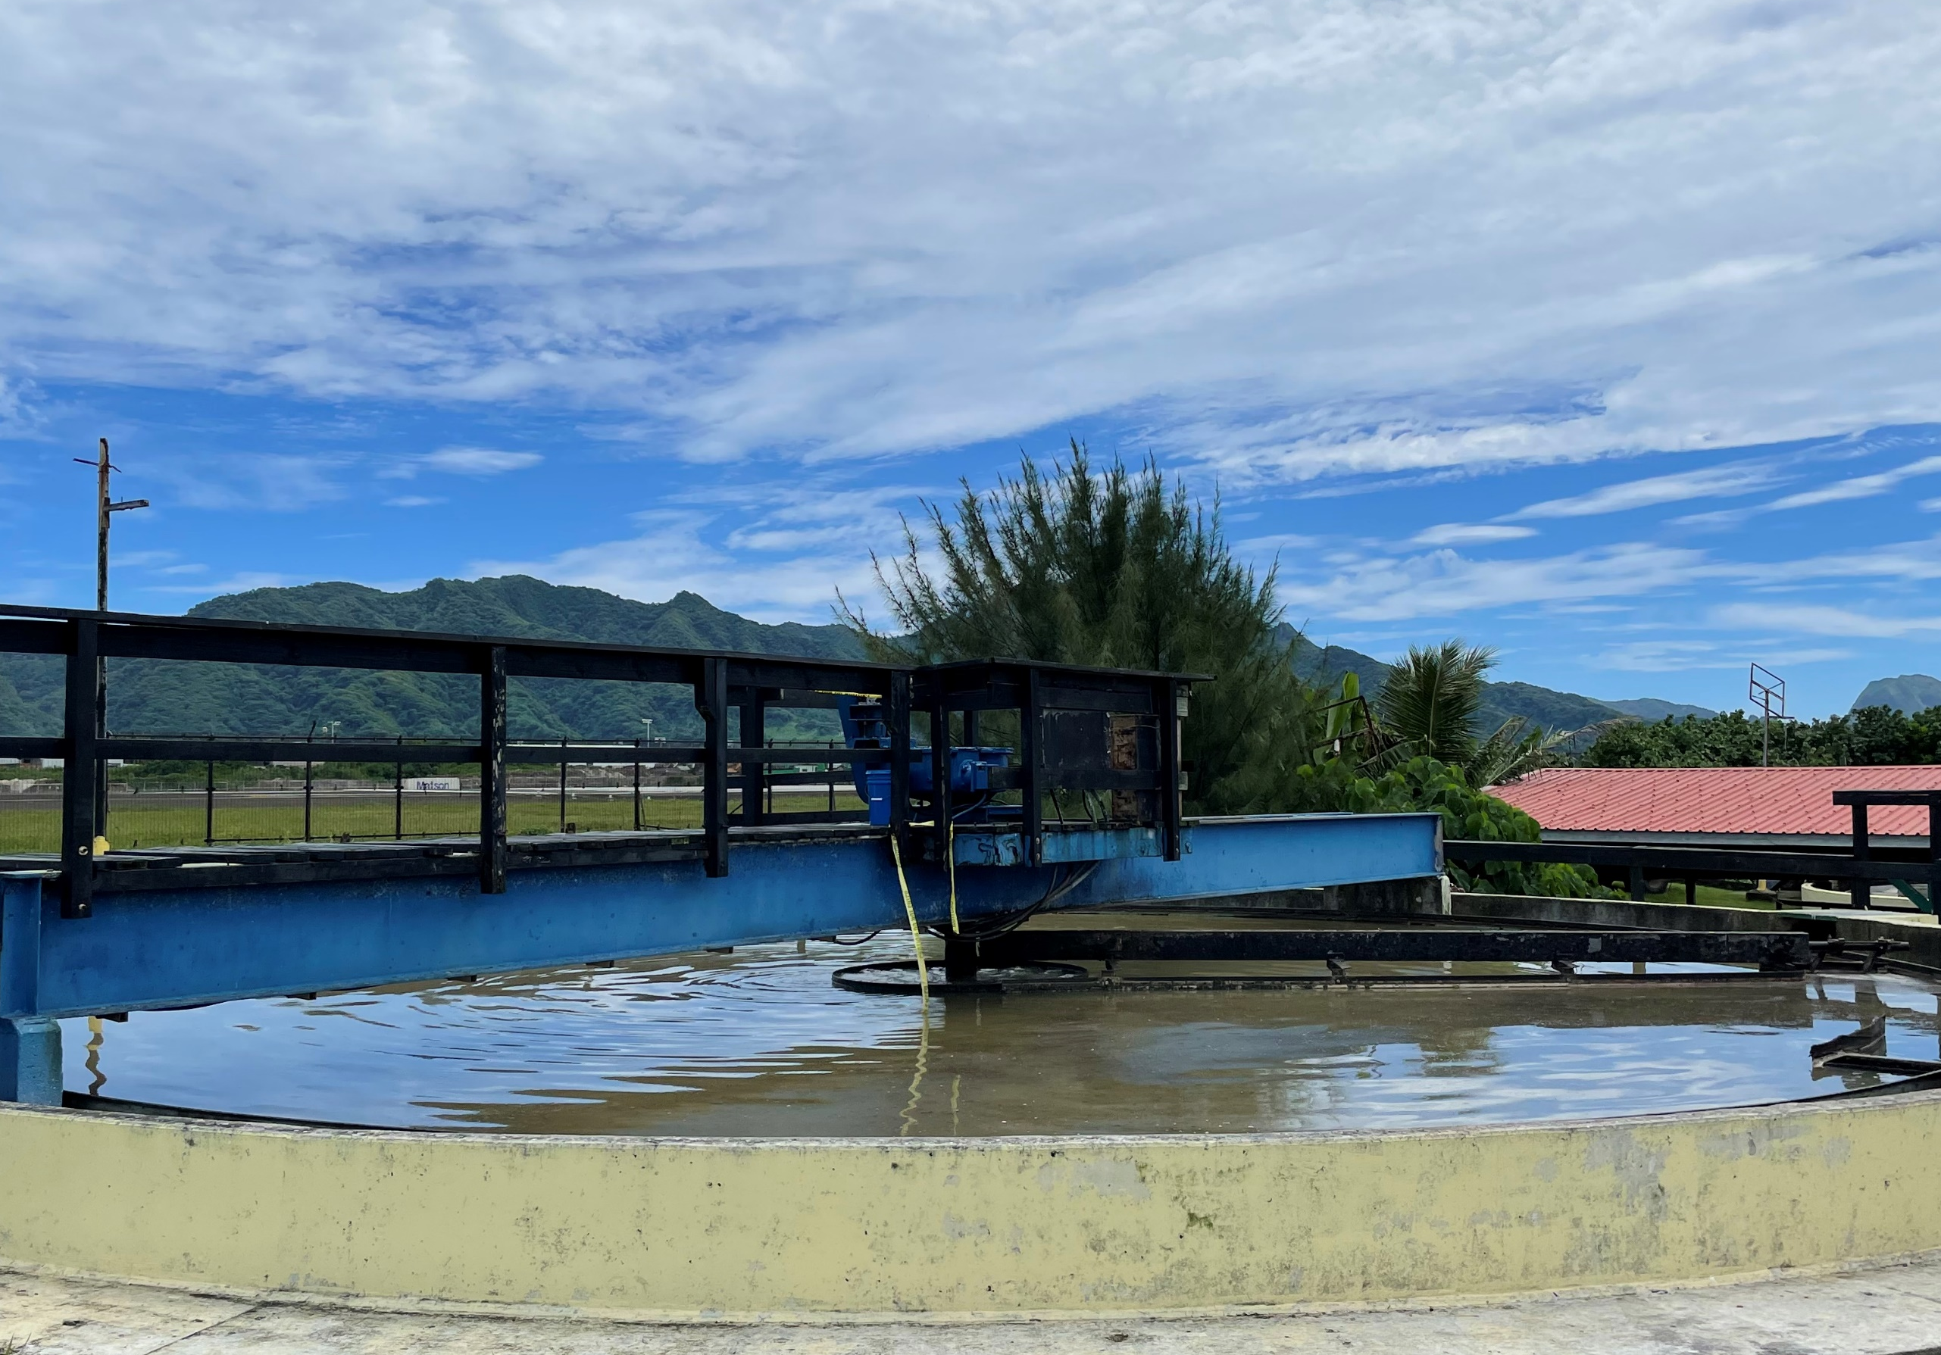
Water and Waste Disposal Loans & Grants
Guaranteed Loans
Direct Loans
Eligible populations of 10,000 or less
No Fees; Loan term not to exceed 40 years
Grants
Eligible populations of 10,000 or less
Project is necessary to alleviate a health or sanitary problem
Maximum 75% of project cost if MHI is below the higher of the poverty line or 80% of the state nonmetropolitan median income
Maximum 45% of project cost if MHI exceeds the 80% requirement but is not more than 100% of the state nonmetropolitan median income

Slide 4
Popular Congressional and Other Set-Aside Funds for Special Programs and Populations
Emergency Community Water Assistance Grants (ECWAG)
Assists rural, low-income communities with a population of 10,000 or less prepare, or recover from an emergency (drought/flood; earthquake; hurricane; disease outbreak; chemical spill; leak or seepage; other disasters) that threatens the availability of safe, reliable drinking water
Water transmission grants up to $150,000; water source grants up to $1,000,000
Predevelopment Planning Grants (PPG)
Assists rural, low-income communities with a population of 10,000 or less with initial planning and development of applications
Grants up to $60,000 with matching requirement (25% minimum)
Special Evaluation Assistance for Rural Communities & Households (SEARCH)
Assists financially distressed communities with a population of 2,500 or less with initial planning and development of applications
Grants up to $30,000 with no matching requirement

Slide 5
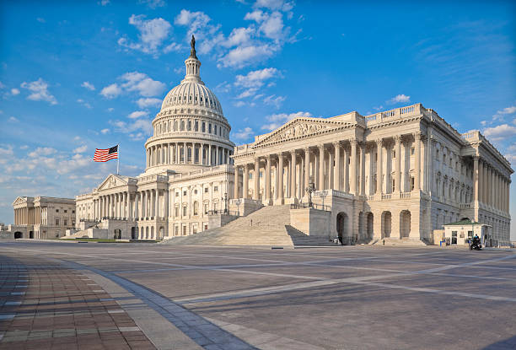
Community Project Funding FY24 (Congressionally-Directed Spending)
Agricultural appropriation funding request for a specific governmental or other eligible entity to carry out a specific community project
Water and Waste Disposal Loan and Grant Program – same project eligibility
Rural areas and towns with populations of 10,000 or less; and 25% non-federal cost share
Members prioritize and able to submit up to 15 proposals

Slide 6
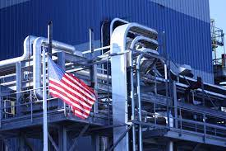
Project Compliance / Regulations
National Environmental Policy Act (NEPA)
Categorical Exclusion (CatEx)
Minor or no new disturbance(s)
CatEx with Environmental Report (ER)
New disturbance(s)
Environmental Assessment (EA)
Environmental Impact Study (EIS)
Build America, Buy America Act (BABAA) and American Iron and Steel (AIS)
Federal infrastructure programs to provide for the use of materials produced in the United States
Iron; Steel; Manufactured Products
Notes:
AIS requirements are outlined here which started under Section 746 of Title VII of the Consolidated Appropriations Acts of 2017, and has been included in each Consolidated Appropriations act ever since

Slide 7
Funding Partnerships
Other Federal Agencies
Environmental Protection Agency (EPA)
Federal Emergency Management Agency (FEMA)
State and Local Agencies
Department of Health (State Revolving Funds)
Housing and Urban Development (Infrastructure)
Private Entities
Philanthropic Organizations
Environmental Foundations
Notes:
AIS requirements are outlined here which started under Section 746 of Title VII of the Consolidated Appropriations Acts of 2017, and has been included in each Consolidated Appropriations act ever since

Slide 8
Water and Environmental Programs Contacts
Statewide
Alton Kimura
Community Programs Director
154 Waianuenue Avenue, Room 311
Hilo, HI 96720
(808) 933-8308
alton.kimura@usda.gov
Statewide
Lennie Okano-Kendrick, P.E.
Engineer / Environmental Coordinator
154 Waianuenue Avenue, Room 311
Hilo, HI 96720
(808) 933-8304
lennie.okano-kendrick@usda.gov
Oahu & Kauai
Kylie Ojiri
Community Programs Specialist
300 Ala Moana Blvd., #1-340
Honolulu, HI 96850
(808) 600-2937
kylie.ojiri@usda.gov
Hawaii Island & Maui County
Scott Sakakihara
Community Programs Specialist
77 Hookele Street, Suite 201
Kahului, HI 96732
(808) 214-1734; Cell (808) 495-3614
scott.sakakihara@usda.gov

Slide 9
End Slide
USDA is an equal opportunity provider, employer, and lender.

