Slide 1


Building a More
Seismically Resilient Water System
Presented by Steve K Donovan PE

Slide 2
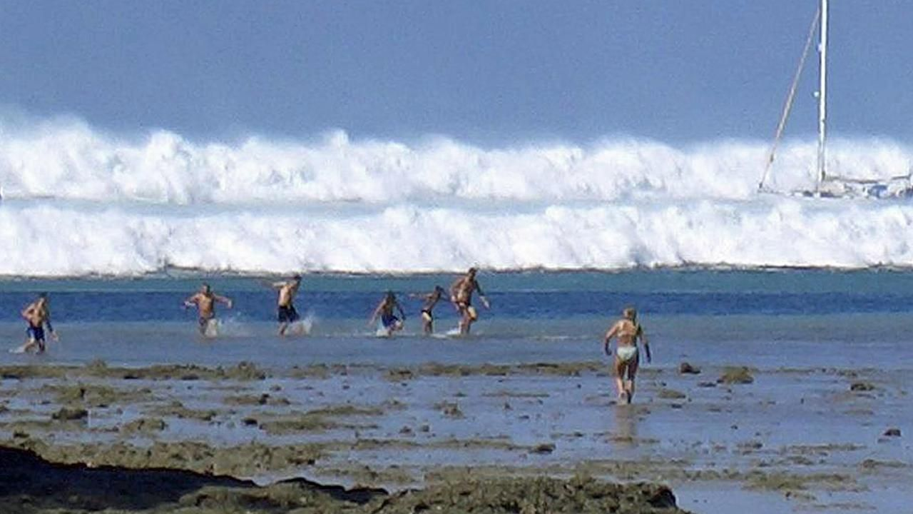
Thailand 2004 - Oregon Plan
Thailand Changed Everything
Witness to Tsunami
Similar to Cascadia Event
Emergency Services Emerged
  Cascadia Subduction
  Tsunami Zones
  OSU modeling
  Grab & Go Plans
  Evacuation Zones
Oregon Plan

Slide 3
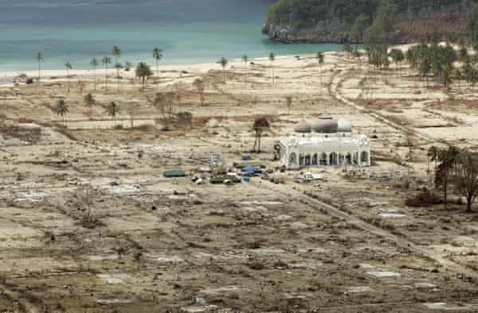
Oregon Plan - Redmond OR
Inland Evacuation Center
  Air Guard Station
  Rescue Focus I - 5 Corridor
  Forget Coastal Oregon
    Roads, Bridges, Access gone
    Potential Wildfires Raging in Forests
    Coastal “Refuges” must fend for themselves for Weeks to Months without Assistance
  Make Neighborhood Plan
  Get Inland ?

Slide 4
Oregon Plan for Cascadia Event
Coastal Water Systems - Ill Prepared
  Wiped Out by Cascadia – Severe Ground shaking followed by mega Tsunami
  If you survive get to higher ground-schools , fire stations, community centers fail.
Smart Purveyors began to Examine System
  Source – Dam survivability – Supply Redundancy
  Treatment Plants, Fire and Police Station Locations
  Transmission Main Vulnerability
  Storage Tank Survivability
  Communications

Slide 5
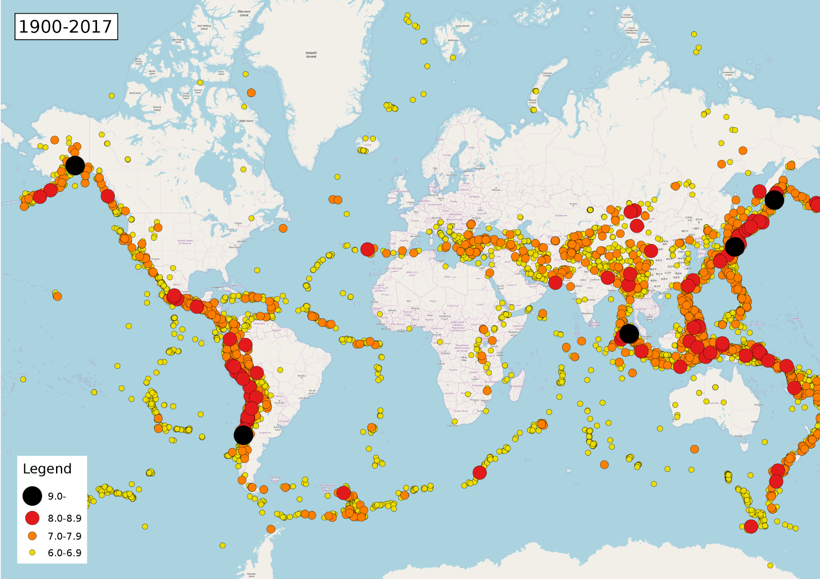
Where

Slide 6
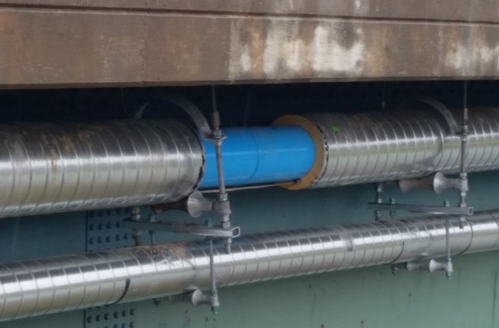
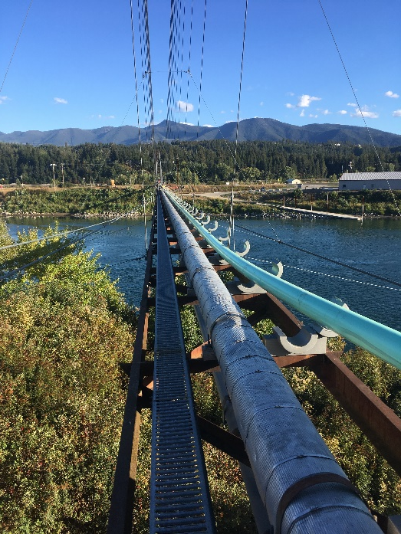
Understanding the Risk
Get Prepared
ASCE Manual of Practice
Risk Assessment
  Earthquake Source
  Soils
  Subsidence/Sliding Concerns
  Tsunami Run up
  Assess Components in Hazard Areas
  Design for Resiliancy

Slide 7
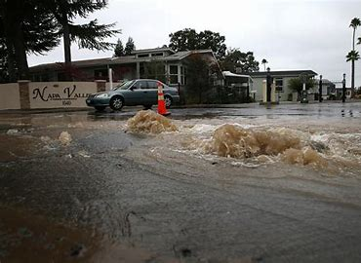
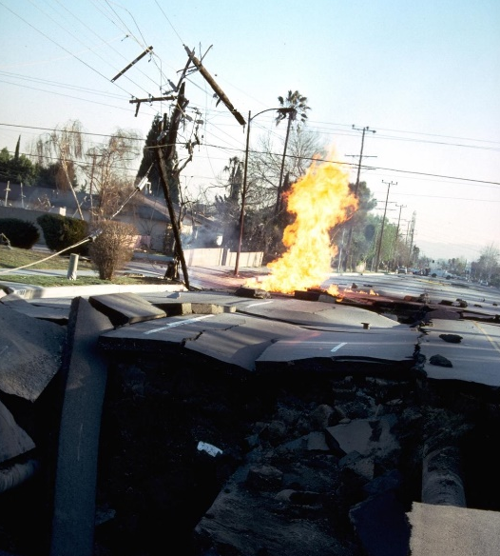
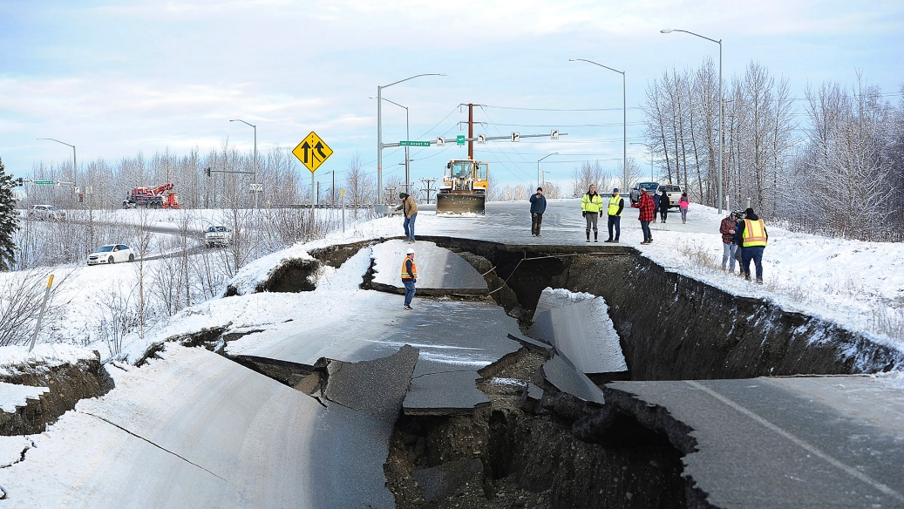
Suitability of Structures in Areas Prone to Ground Movement
Earth Movements Create Forces on Structures, Landforms, Pipelines.
  All structures can fail from seismic events.
  Some Structures Perform Better than others
  Failure Modes can Impact Water Infrastructure
Factors Affecting Seismically Induced Forces
  Magnitude of Quake
  Location to Epicenter
  Type of Wave
  Soils
  Orientation of Wave Propagation
  Resiliency of Design

Slide 8
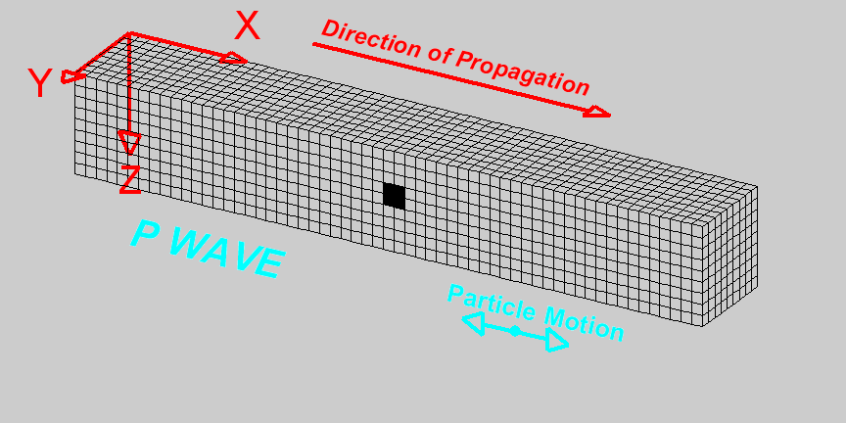
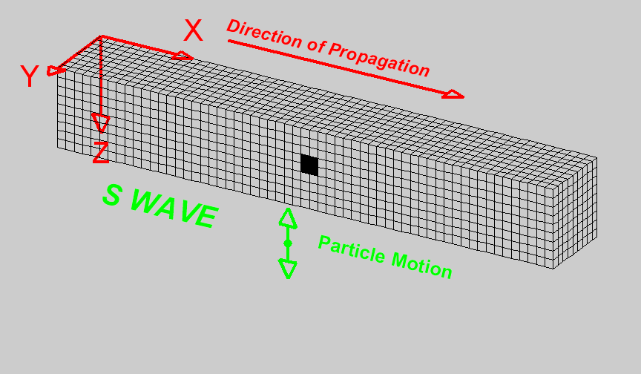
Earthquake Propagation
Not all Earthquakes are created equal - It is not just magnitude, but direction and soils
Two examples below : Seismic P(Primary) and Seismic S(Secondary)
Consider pipelines that are parallel and perpendicular to the propagation
Most damage occurs due to Surface wave parallel to water line

Slide 9
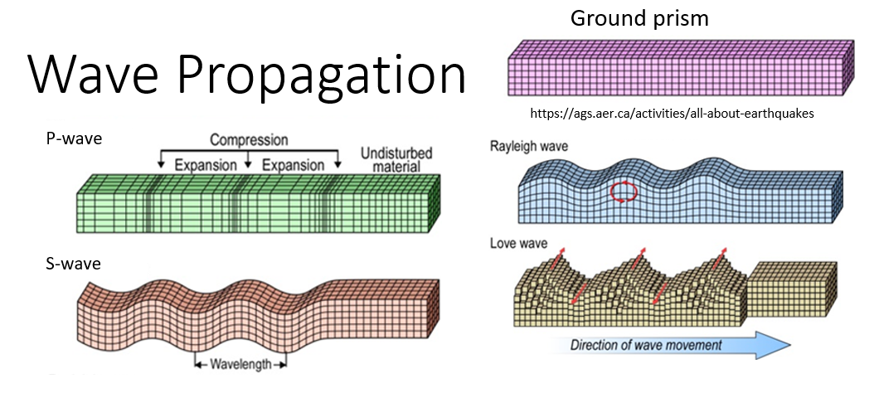
Seismic Resiliency = Wave Propagation Survival
Seismic

Slide 10
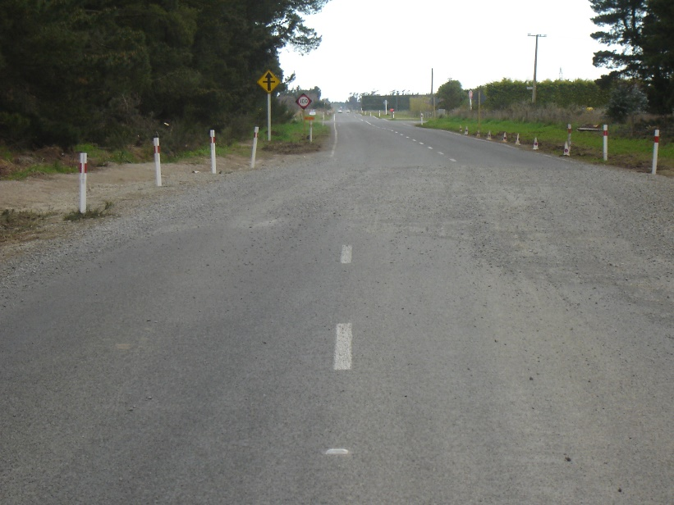
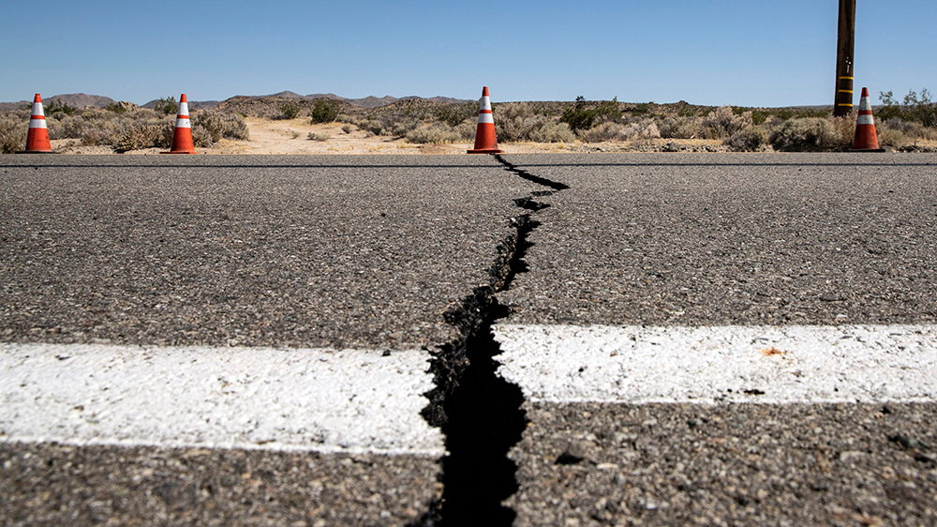
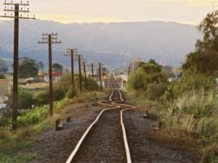
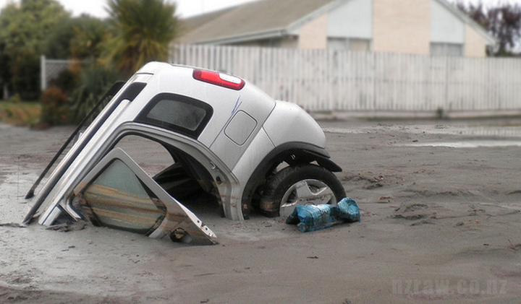
Above Ground Effects – Ground Deformation

Slide 11
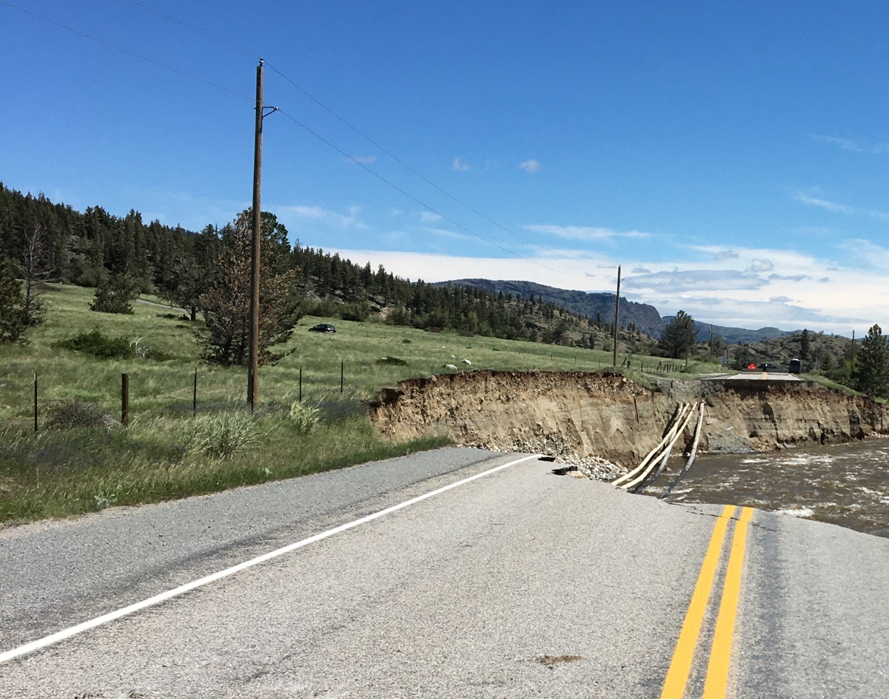
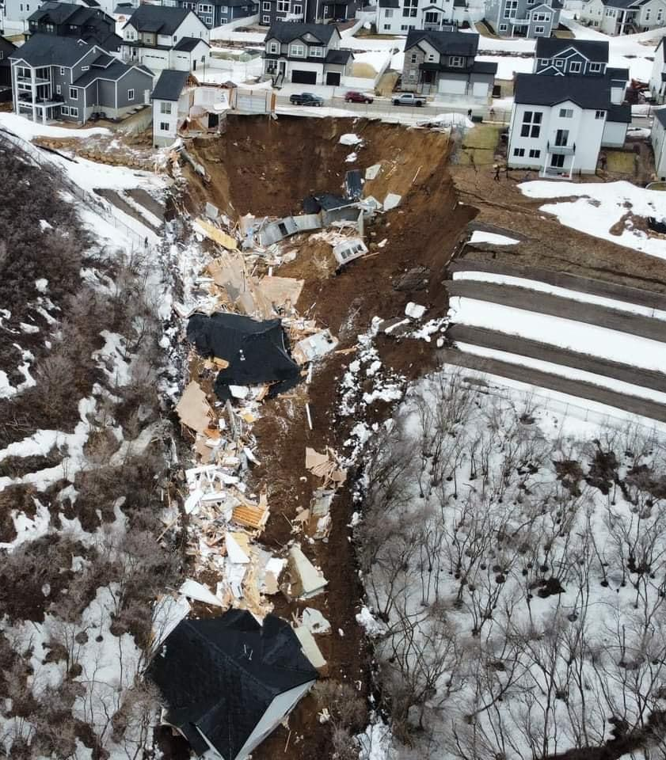
Above Ground Effects - Collapsing Slopes

Slide 12
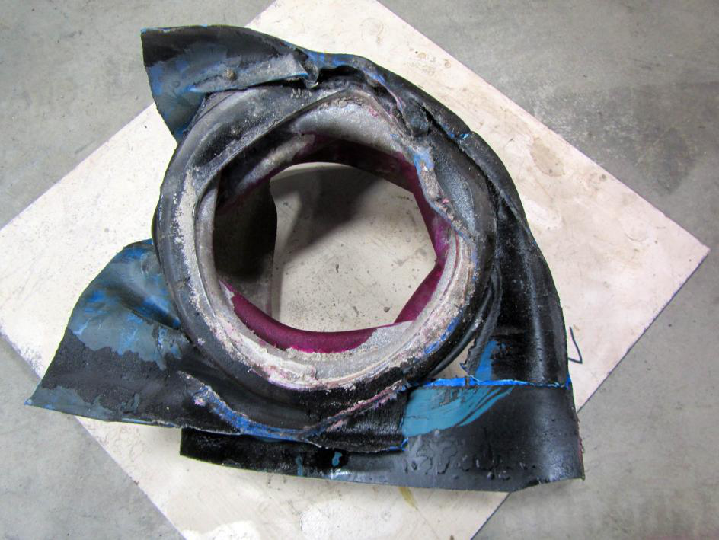
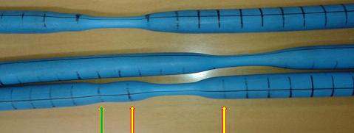
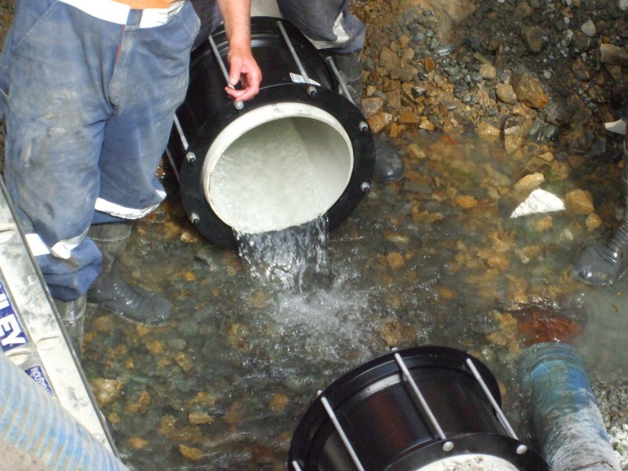
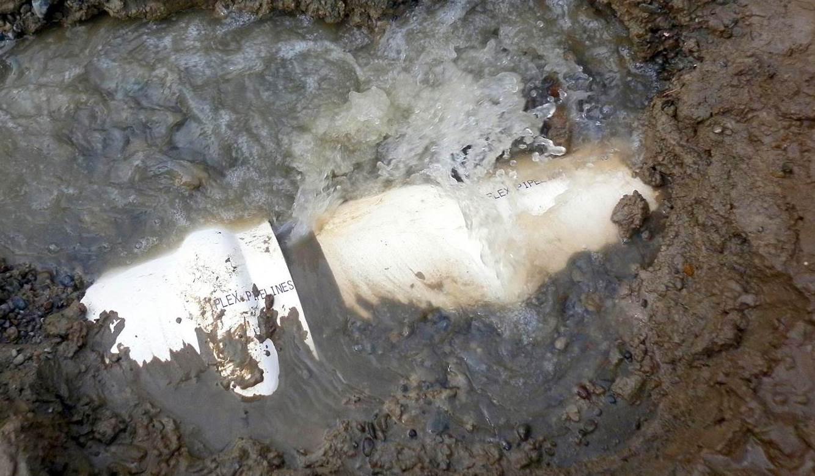
Underground Effects/ Pipelines Failure Modes*
HDPE Pipe Elongated
Buckled Steel Pipe – Compression Failure
PVC Pipe requiring mechanical restraints due to Tensile Failure
Gasketed PVC Pipe – Joint Failure
* “Research Findings on the Seismic Response of Underground Utilities.” Jonathan Morris, Rosslyn McLachlan, Jasmin Callosa Tarr, and Padmanathan Kathirgirtham.

Slide 13
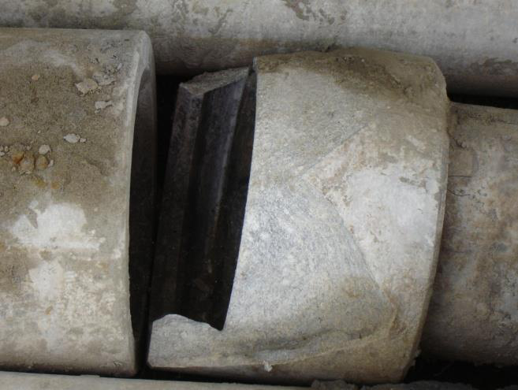
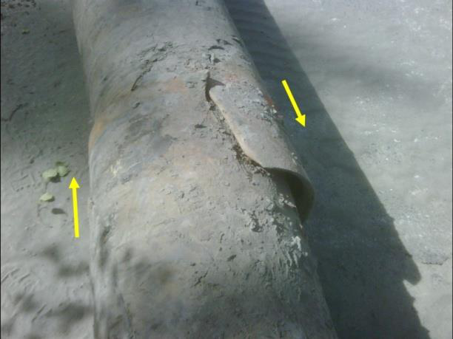
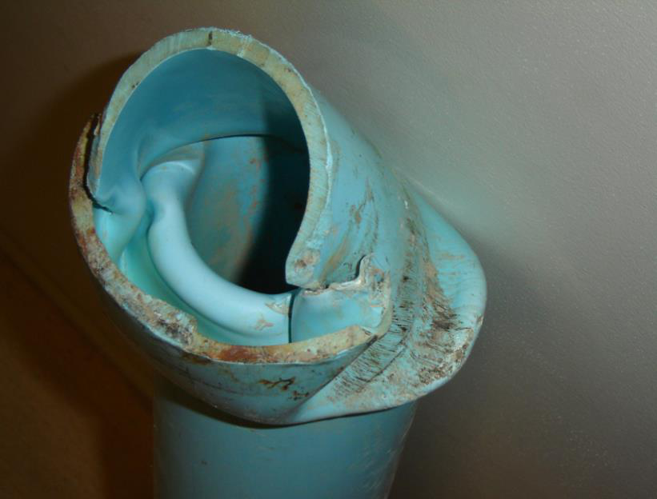
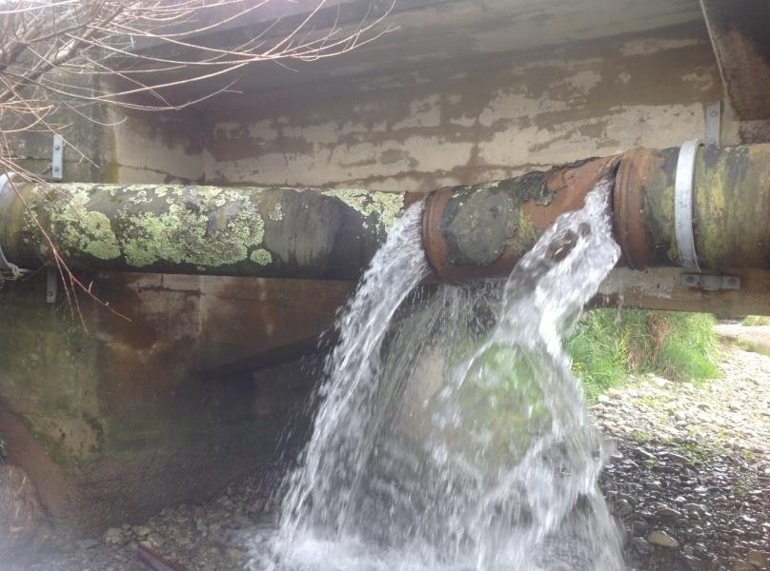
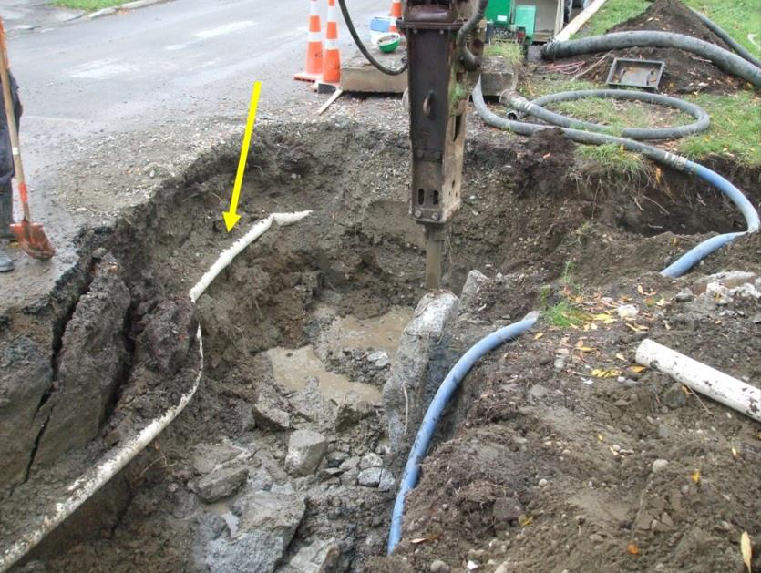
Underground Effects/ Pipelines Failure Modes *
AC Pipe Compression Failure
Sheer Failure DI Pipe
Axial Compression PVC Pipe
Distortion Failure DIP
Distorted, PVC pipe
* “Pipelines Performance Experiences During Seismic Events in New Zealand over the last 27 Years.” Proceedings of the 17th Plastic Pipe Conference, September 22-24th, 2014. Frank W. O’ Callaghan.

Slide 14
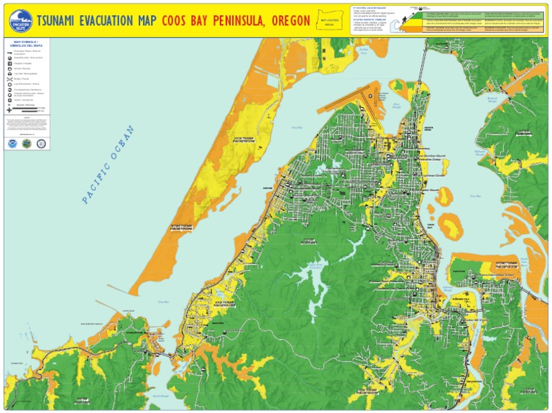
Understanding Vulnerabilities
Get Prepared
  Set Goals/Timeframe to resiliency
  50 years?
  Resiliency Priority
    Chain of Command
    Dam safety
    Tank Upgrades
    WTP Upgrades
    Transmission Upgrades
    Distribution
  Plan for Failure
  Frequency, Magnitude, & Locations
  Size to survive
  Inter-Agency Planning FEMA = $$$$
  Plan for first hours, days, weeks

Slide 15
Understanding Vulnerabilities
Tsunami Run-up Mapping
Distant Source
Western Pacific
Alaska
Near Source - Cascadia
Moderate
Severe
Mega

Slide 16
Prepare a Plan
Get Prepared
Critical Water System Elements
  Coordination
  Source
  Treatment
  Storage
  Transmission/Distribution

Slide 17
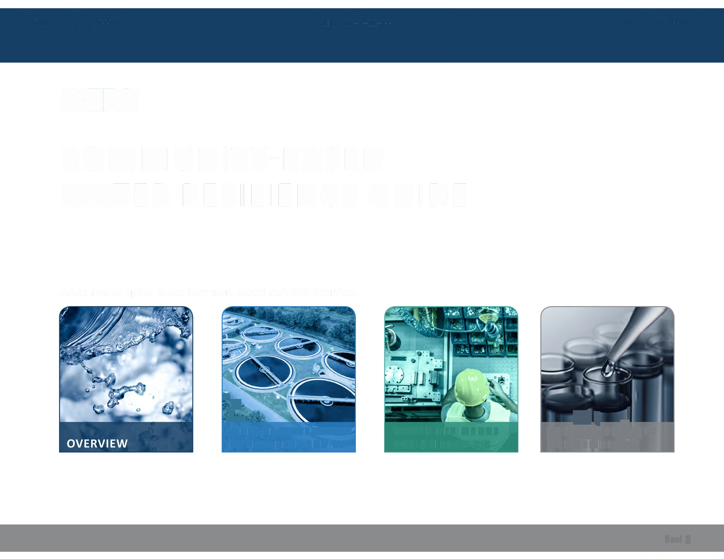
Prepare a Plan
<EPA
COMMUNITY-BASED
WATER
RESILIENCY
GUIDE
~:.
.N
g" ig
•i.
.o0u^{A}s.^{L}esouices
•
T
1l
EXPLORE WATER
lNTERDEPENDENCIES
WATER RESILIENCE
ACTION PLAN KIT
AND TEMPLATES
Next )>

Slide 18
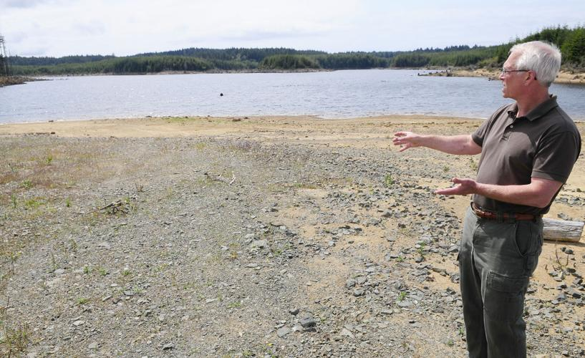
Develop Hardening Plan – Dam Safety Treatment Upgrades
Critical Water System Elements
  Source of supply
    Dam Safety
    Redundancy of Supply
    Inter-tie Agencies
  Treatment Plant Upgrades
    Seismic Upgrades
    ASCE 7 Section 1.5
    Treatment Technology
  Provide Localized Storage
    Clearwell Isolation
    Security Enhanced

Slide 19
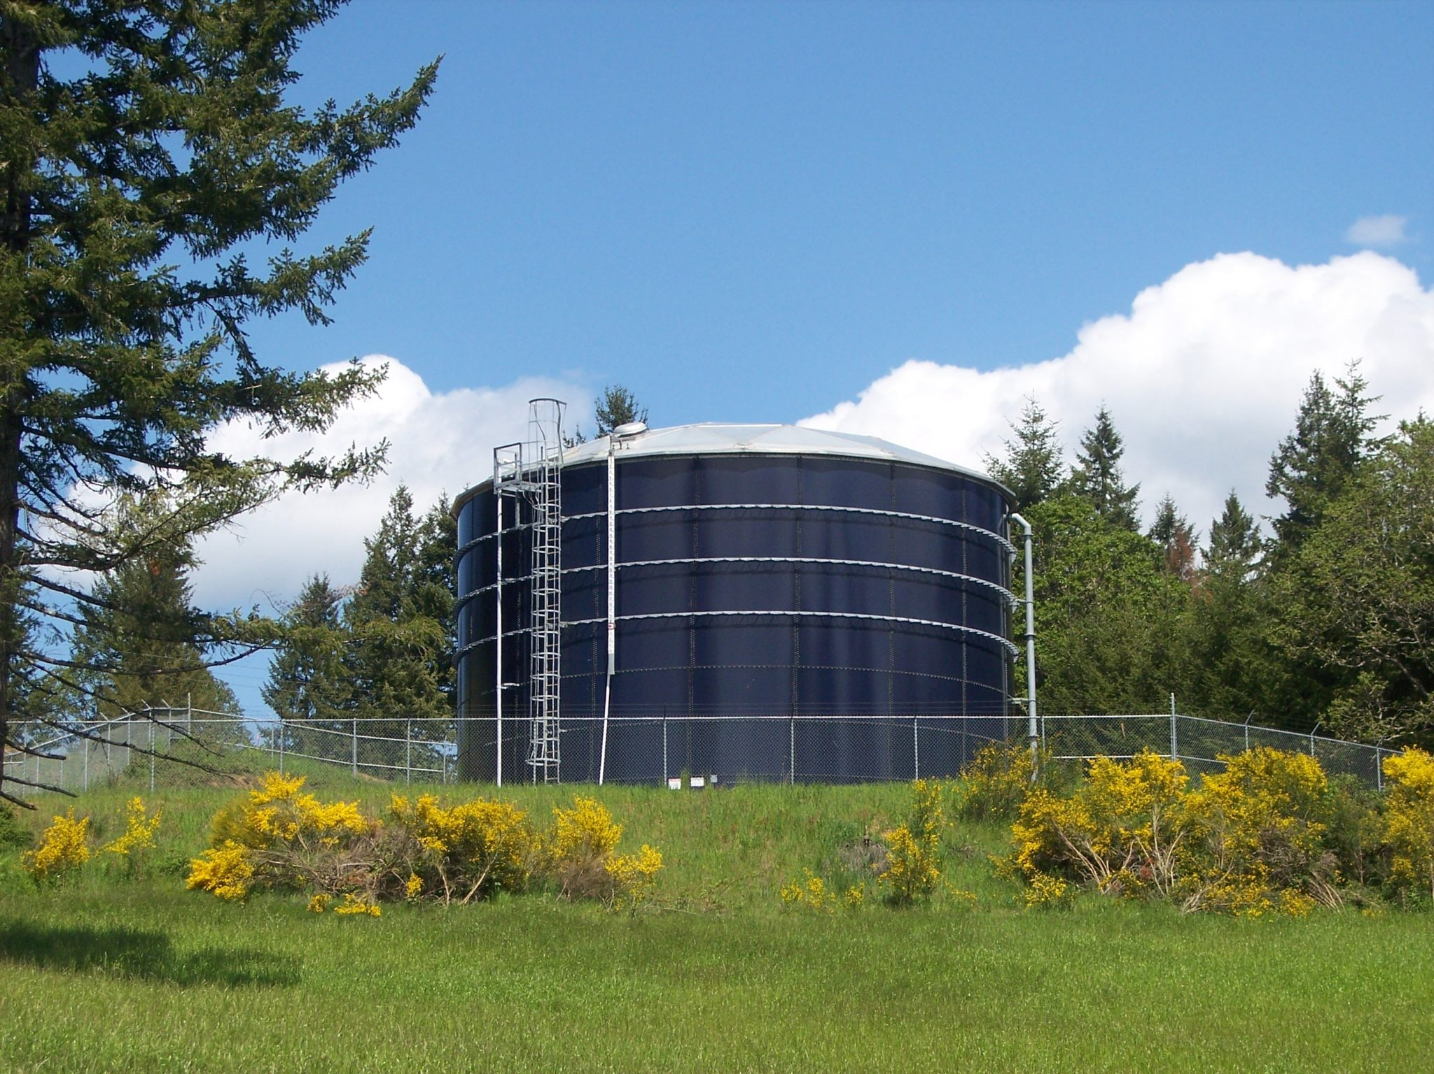
Develop Hardening Plan – Seismic Retrofit WTP
Critical Water System Elements
  Storage Tanks
  Site Assessment
  ASCE 7, Section 1.5
  Seismic Upgrade
  Retrofits
  Solar w Radio Telemetry
  Flex Tend Connection
  Security
  Considered
  High Flow Shut off Valves
  *Seismic Notification
  Image courtesy Aquastore Tanks

Slide 20
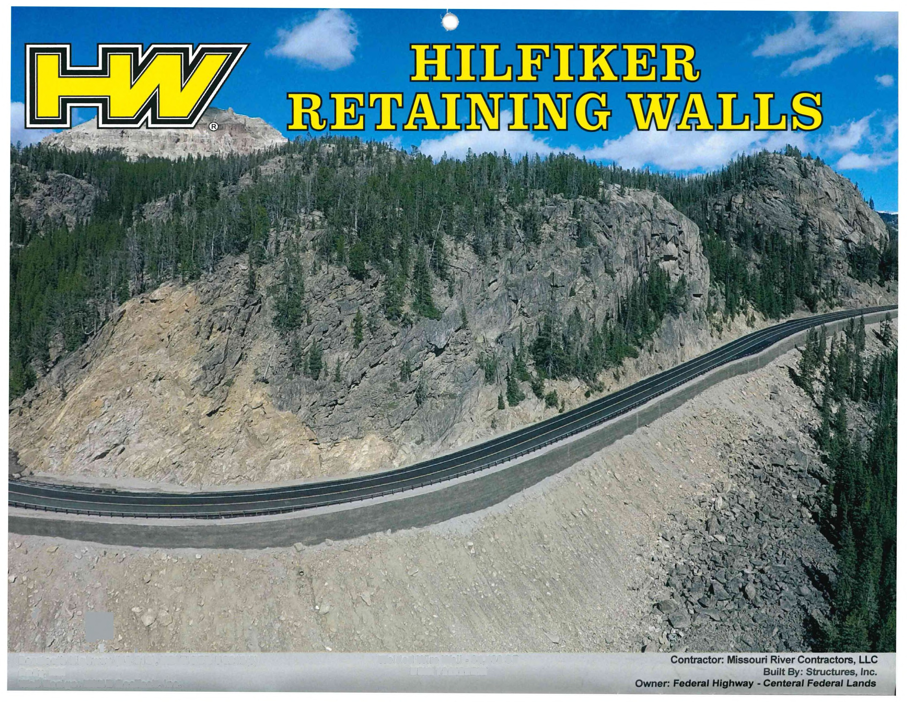
Develop Hardening Plan – Protecting Source
Critical Water System Elements
  Assess Roadways Prone to Slide
  Focus on Supply & Intake Pipe Routes
  Rebuild using MSE Retaining Structures
  Relocate pipelines using HDD
  Deeper
  Remove WL From Bridges
  Scour Analyses on channel crossings
  Infiltration Gallery in wild & Scenic Rivers
  Image courtesy Hilfiker Corporation

Slide 21
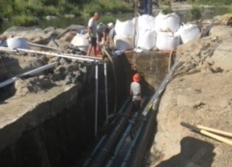
Develop Hardening Plan – Redundant Source
Critical Water System Elements
  Secondary Water Supply Source
  Scour Proof Wells
  Develop Mountain Springs
  Sand Dune Wellfield
  Infiltration Gallery

Slide 22
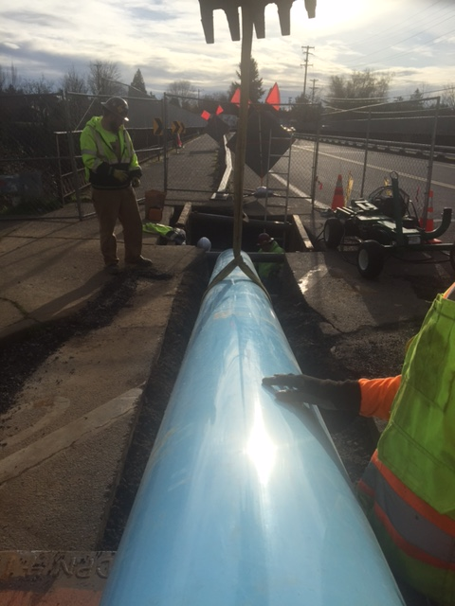
Develop Hardening Plan - Pipelines
Piping Systems
Identify Survivable Components
Transmission Mains
Main Supply
Tank Supply
Inter-ties
Build in Fire Fighting Fill Ports
Isolate Bad Soil Zones
Replace Piping w Resilient Pipe Material

Slide 23
ASCE MOP
American Society of Civil Engineers is working on a MOP (Manual of Practice) for seismic resiliency of buried pipelines
Multiple pipe products have been tested
  From the Cornell research, the key performance criteria for pipelines in a seismic event are tensile, compressive, and bending capabilities
  The UC-Boulder testing was done under operating conditions with an Internal Pressure of ~65 psi required in each test protocol

Slide 24
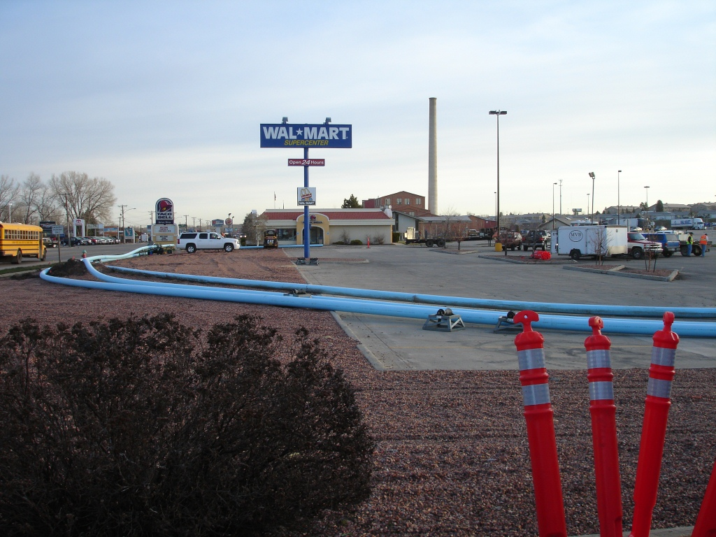
Considerations for a Resilient Pipeline
Pipe Material Performance
No Piping Materials are Immune to Failure
Restrained Pipes > Unrestrained Pipes
Flexible/Plastic Pipes > Metal/Rigid Pipes
Monolithic Pipe > Restrained pipe

Slide 25
Considerations for a Resilient Pipeline
Design to Manage Failure
  Isolation Plan based on soils/ground condition/run up zone
  Design for repair
  Utilize best performing materials in worst locations, i.e. near/crossing faults, proximity to structures, most difficult to access
  Assume some level of risk and plan accordingly per the location
  Stock Extra Repair Systems & Surplus Pipe

Slide 26
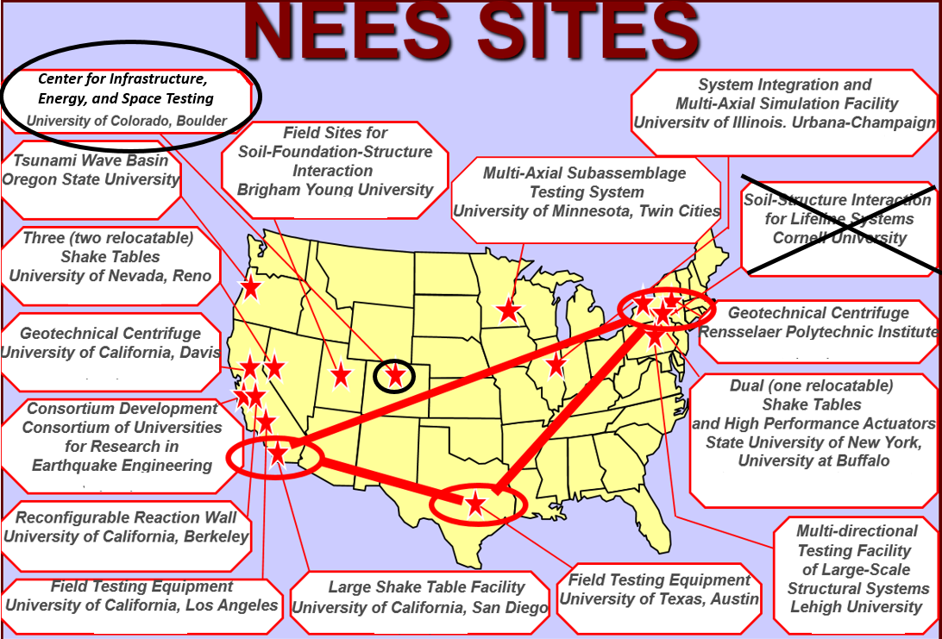
National Earthquake Engineering Sites
Testing of Pipe materials has moved from Cornell to UC- Boulder

Slide 27
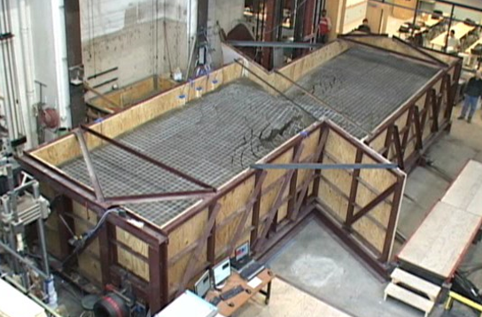
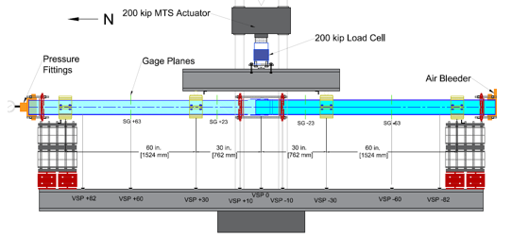
Pipe Material Seismic Testing Background
~2010– large scale soil box testing of pipe materials at Cornell
(Work scope completed and facility repurposed)
2017– CIEST (Center for infrastructure, Energy, and Space Testing)
established at University of Colorado-Boulder by former Grad assistant at
Cornell to build upon research done there
Research and testing at CIEST is being used to develop seismic guidance
for pipe materials that will be part of the ASCE Manual of Practice for
seismic resiliency

Slide 28
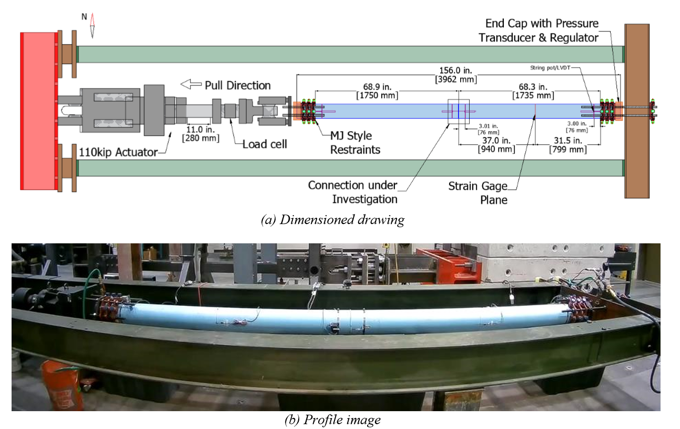
Tensile Load Test (6” DR 18)

Slide 29
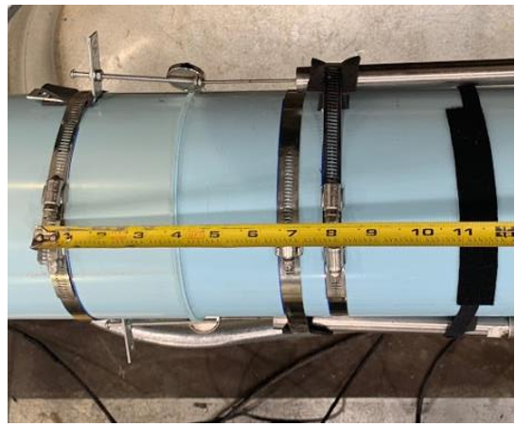
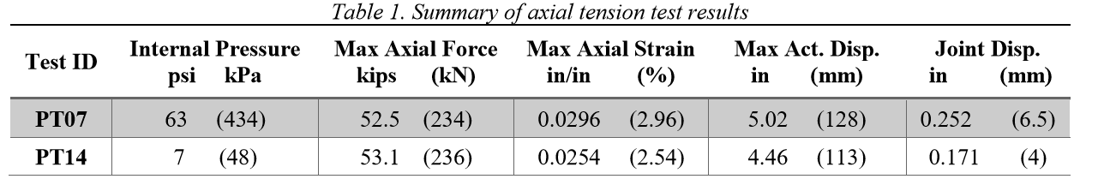
Tensile Load Testing Results
Fusion Joint
*
*Allowable Tensile Force =21,600#

Slide 30
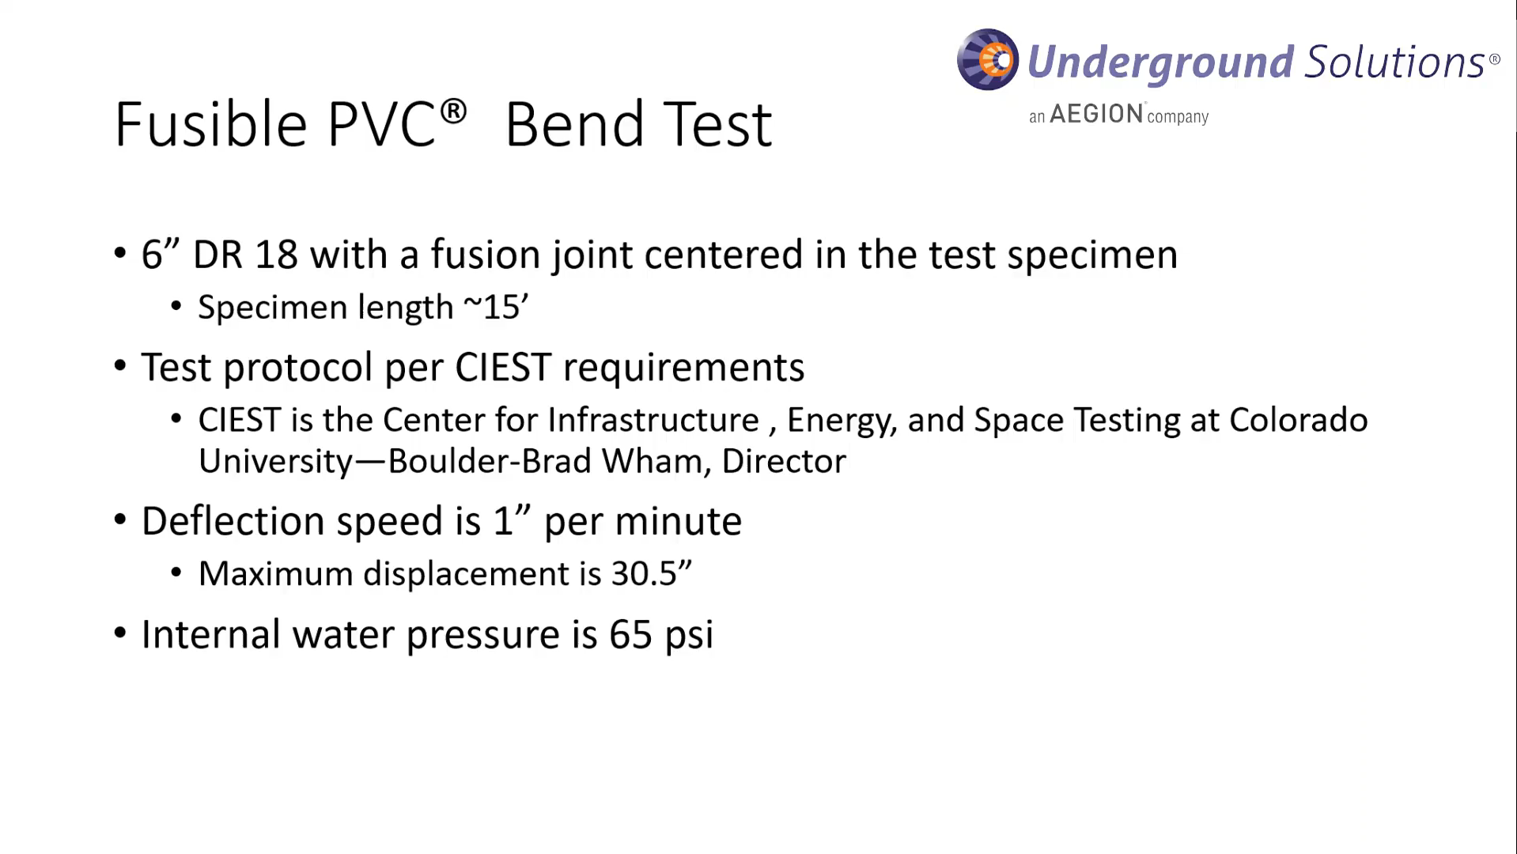
Four Point Bend Test

Slide 31
Four Point Bend Test

Slide 32
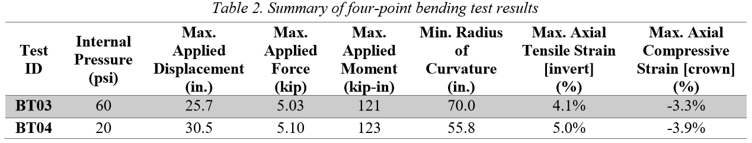
Four Point Bending- Results
*
(ft.)
* 2X Field Allowable of 144’ for 6” DR 18

Slide 33
Case Studies
Fusible PVC Continues to be a Leader in Laboratory Testing Results designed to Demonstrate Seismic Resiliency.
Real World Experience Demonstrates Fusible PVC Survivability and Resiliency
Napa
Salt Lake City
Guam

Slide 34
Napa 6.0 Earthquake on 8/24/14
Fusible PVC Installations prior to Earthquake (4” – 24”)
Project | Pipe Size | DR | Length | Service | Installation | Utility/Owner | Installation Date
St. Helena WL | 12” | 14 | 2,640 | Potable Water | Pipe Burst | City of St. Helena | April 2010
Walnut Drive WM | 4” | 14 | 4,000 | Potable Water | HDD | City of Napa | November 2008
2013 Hwy Crossings (Salvador Avenue) | 16” | 18 | 600 | Potable Water | Slipline | City of Napa | September 2013
 | 24” | 18 | 600 | Casing | HDD
2013 Hwy Crossings (Sierra Street #1) | 16” | 18 | 500 | Potable Water | Slipline
 | 24” | 18 | 500 | Casing | HDD
2013 Hwy Crossings (Sierra Street #2) | 12” | 14 | 1,100 | Potable Water | HDD
2013 Hwy Crossings (F Street) | 12” | 14 | 500 | Potable Water | Slipline
 | 16” | 18 | 500 | Casing | HDD
Lincoln Avenue SL | 12” | 18 | 800 | Potable Water | Slipline | City of Roseville | May 2010
Gasser Infrastructure Improvements | 12” | 18 | 810 | Potable Water | Slipline | Gasser Foundation | August 2014
 | 16” | 18 | 810 | Casing | HDD
Napa State Hospital RWM | 24” | 18 | 6,000 | Reuse Water | Open Cut & Slipline | Napa Sanitation District | December 2010
Highway 221 WM | 24” | 18 | 7,400 | Potable Water | HDD | City of Napa | February 2012
American Canyon FM | 18” | 18 | 2,900 | Force Main | Open Cut & HDD | City of American Canyon | May 2007

Slide 35
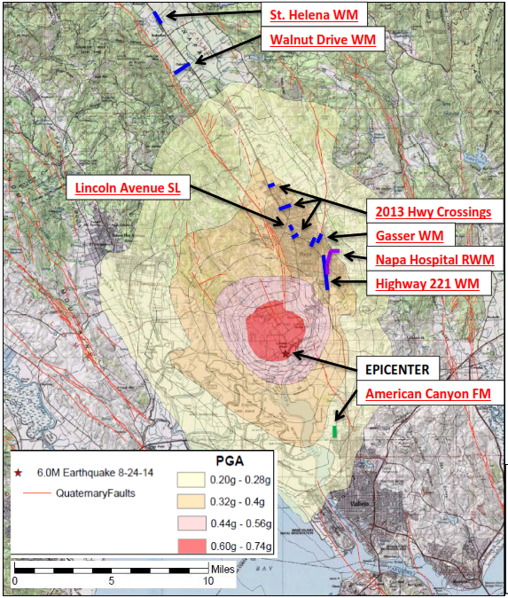
Napa 6.0 Earthquake on 8/24/14
Fusible PVC Installations prior to Earthquake
No Fusible PVC Failures Reported
Over a dozen Fusible PVC Pipe installations in the area
“All other Pipe Materials in the System Failed in some manner or another except Fusible PVC.” Napa Public Works
Over 60 Failures of other piping materials reported
Developing Longterm Supply Replacement Plan
PGA = Peak Ground Acceleration

Slide 36
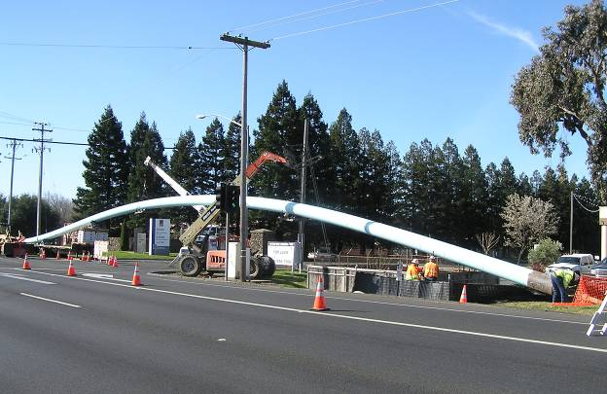
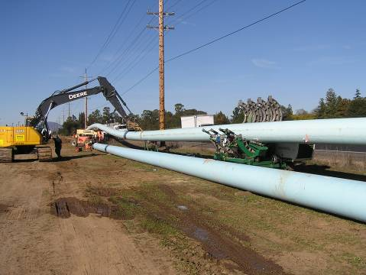
Critical Water Main Installed in California Earthquake Country via Directional Drilling
Horizontal
Directional
Drilling
Client: City of Napa, CA
7,400 LF of 24” installed via HDD
Pipe installed over 20’ deep in some locations
Installed Prior to 2014 Earthquake

Slide 37
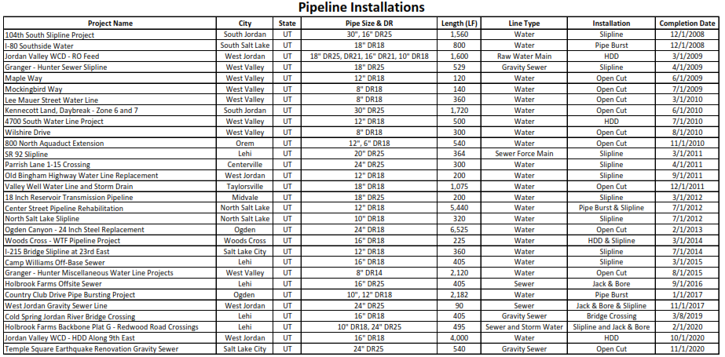
Salt Lake Valley 5.7 Earthquake on 3/18/20
Fusible PVC Installations in Salt Lake Valley prior to Earthquake (6” – 30”)

Slide 38
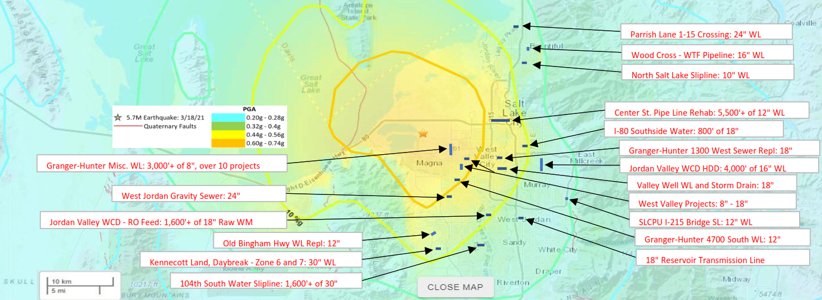
Salt Lake Valley 5.7 Earthquake on 3/18/20
Fusible PVC Installations in Salt Lake Valley prior to Earthquake
No Fusible PVC Failures Reported
Over 50 Installations in Salt Lake Valley in the “Orange” Zone

Slide 39
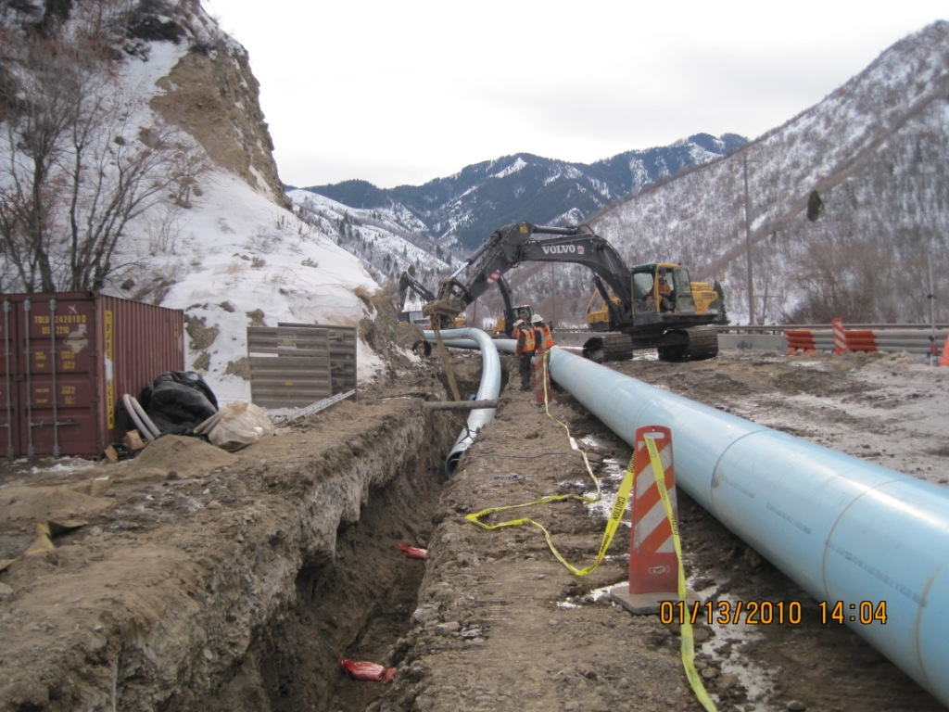
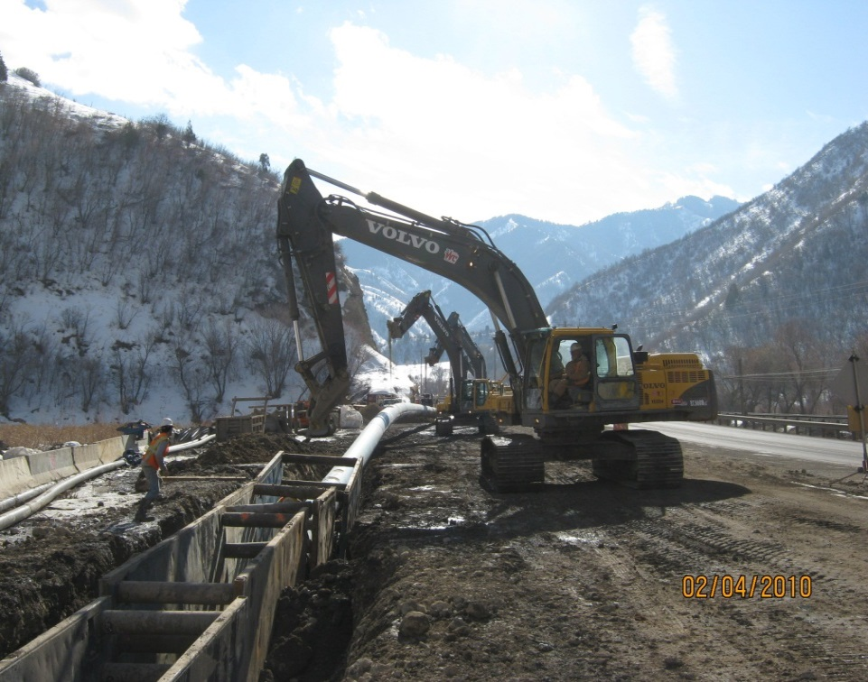
Historical Earth Movement required a Fused/Restrained Joint
Open-Trench/
Direct Bury
Client: City of Spanish Fork
Canyon had major landslide in 1983, buried the town of Thistle
1,600 LF of 30” installed in 2010
Pipe selected for earth movement resiliency and thermal expansion properties
Engineer = Horrocks

Slide 40
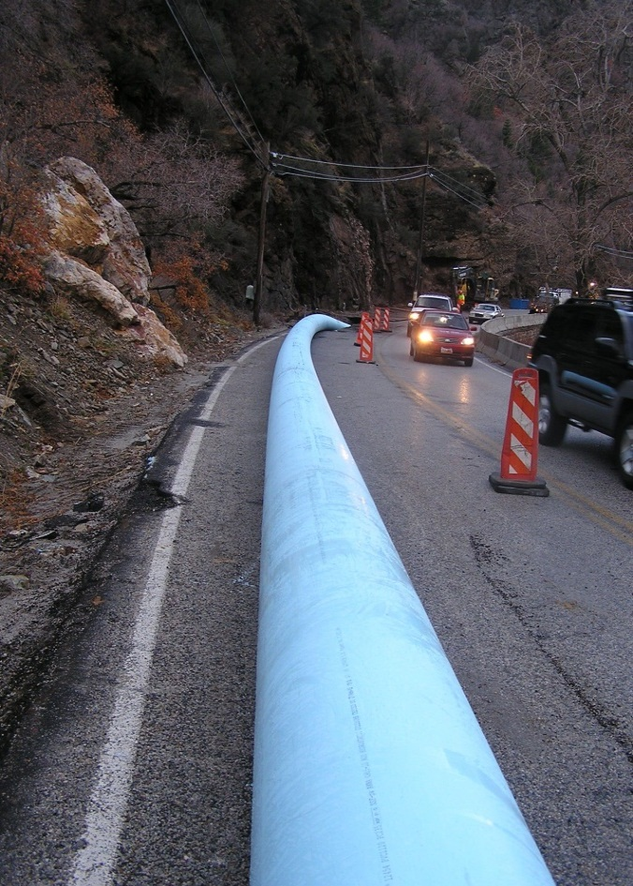

Direct Bury with Most Sustainable Piping Solution
Open-Trench/
Direct Bury
Client: City of Ogden
7,000 linear feet of 24” Fusible PVC installed in 2012
Restrained Line Required due Topography
Desire for “Most Sustainable” system – Do not want to dig this up for another 100 years
Design Build – Whitaker Construction/Horrocks Engineers
Installed at Night and in Winter

Slide 41


Earthquake Resilience required Fused/Restrained Joint Pipe
Open-Trench/
Direct Bury
Client: Salt Lake City, UT
~500 LF of 24” Gravity Sewer attached to wall (underground parking garage)
Part of a much larger earthquake renovation project
Pipe selected due to earthquake resistance and lowest thermal expansion/contraction property
Engineer = Bowen Collins

Slide 42
Conclusions
Not all Earthquakes are Cascadia
Can your system supply water after moderate ground shaking, after rumblings?
Most systems – Predicted to Fail During Moderate Disaster
  WTPs in Inundation Zones
  Old out-dated pipe
  Transmission lines in land slide areas
  Source subject to Tsunami Impacts
  Storage tanks need upgrade to Seismic Zone Standards
  No site suitability studies
  Lack of Survivability
Oregon Plan – Understandable Least Loss of Life = Forget the Coast
Coastal Communities Must Implement Along Generations to Survive

Slide 43
Building a More
Seismically Resilient Water System
Presented by Steve K Donovan PE

