Slide 1
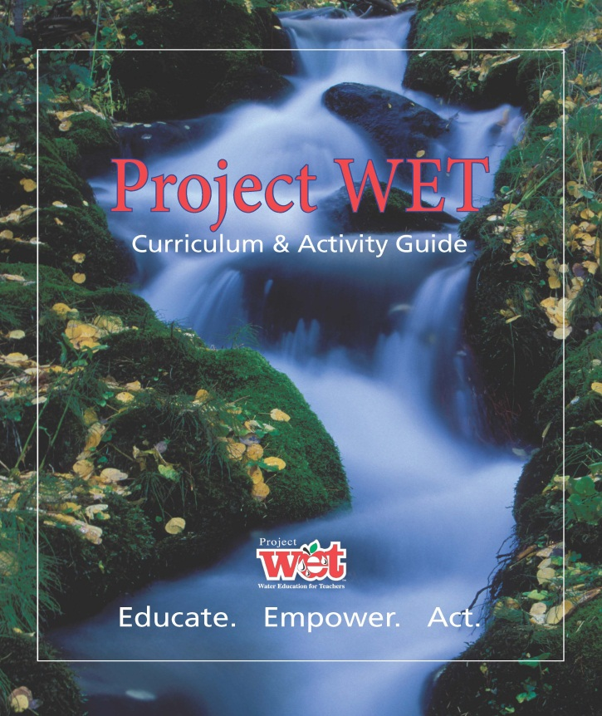
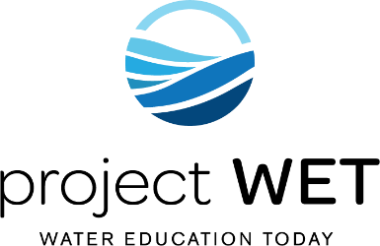
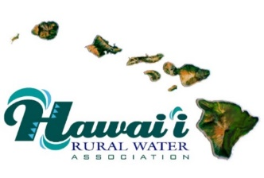
Project WET
(Water Education Today)
HAWAII RURAL WATER ASSOCIATION and PROJECT WET HAWAII
Presented by:
Daniel Chang
Source Water Protection Specialist
Hawaii Rural Water Association (HRWA)

Slide 2

Who is Hawaii Rural Water Association?
Hawaii Rural Water Association, known as HRWA, Incorporated as a 501c3 non-profit association.
Provided training and on-site assistance in Hawaii since 2010.
>10,000 hours of instruction/formal classroom training
>23,000 hours of on-site assistance/training in all areas of
governance, management, operations, finance, and
regulatory compliance.

Slide 3
Who is Hawaii Rural Water Association?
Also completed formal training programs in Guam, Saipan, and American Samoa.
As an NRWA State Affiliate, HRWA is connected to resources and expertise throughout the Nation and can draw upon the knowledge and expertise of other State Affiliates.

Slide 4
Who is Hawaii Rural Water Association?
Services provided by HRWA:
Classroom training
Continuing Education Units (CEUs) Specialized Safety, Equipment and Technology
Upper Management Classes Virtual & Live Classes in Various Topics
On-site Assistance
Leak Detection Energy & Water Audits
Pipe & Valve Location Source Water Protection
Compliance Monitoring Pump Vibration Analysis
Mock Sanitary Surveys Generator Load Bank Testing
Rate Analysis Backflow Preventor Test Gage Verification
System Mapping (ArcGIS) USDA RD Apply
Security Assessment AND MORE …………..
Emergency Response Plans

Slide 5
Who is Hawaii Rural Water Association?
HRWA STAFF:
Juanita Reyher-Colon, Executive Director
Christine Dochin, Financial Administrator
Hunter Liftee, Office Administrator
Malia Lightner, CEU Coordinator
Dan Chang, Source Water Specialist
Greg DeVito, Technical Specialist
Ted Johns, Wastewater Circuit Rider
Bessie Lee, Water Circuit Rider
Mike Ogata, Water Circuit Rider
Kamalani Uehara, Apprentice Coordinator & Technical Trainer

Slide 6
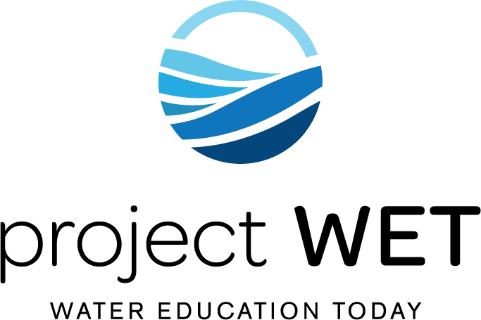
What is Project WET?
A 501(c)(3) not-for-profit organization founded in 1984 by Dennis Nelson, while working at the North Dakota State Water Commission.
A compilation of the most extensive series of water resource education materials in the world!
An award-winning water education curriculum Guide 2.0
A world-wide network that offers educational training, specialty publications and water themed festivals.
Notes:
In 1984, a man named Dennis Nelson founded Project WET while working at the North Dakota State Water Commission.
It was developed because he saw a need for water education to help educate and address local water issues they were facing.
- Through extensive partnerships and successful fundraising efforts, Dennis developed the small hometown program into the global leader in water resource education we have today.
Dennis himself has authored and co-authored over 300 original water science and education activities.
The Project WET foundation continues to develop and deliver the world's most extensive water education resources, water festivals, manages a worldwide network of partners and advocates for the role of water education in solving the world's most pressing water issues.
The curriculum is correlated with the Common Core State Standards for English/Language Arts and Literacy in History/Social Studies, Science and Technical Subjects.
The Project WET USA foundation is continuously developing resources and partnerships around the world to pursue their mission statement.

Slide 7
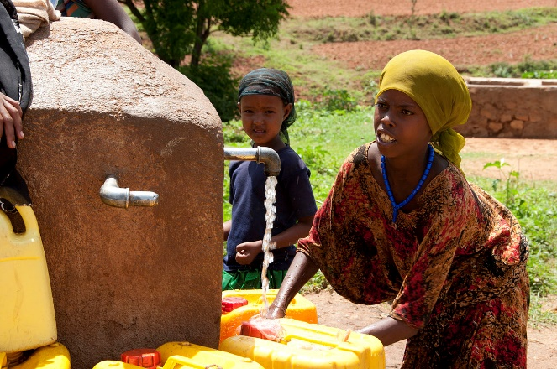
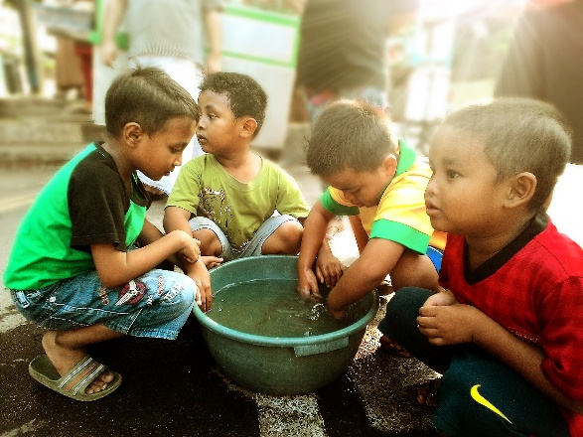
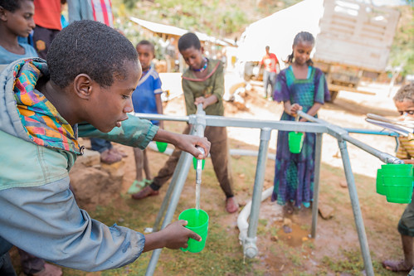
Project WET’s Mission is…
Advancing water education to understand global challenges and inspire local solutions
Our Mission
Notes:
Project WET believes that informed people are more likely to participate in the decision-making process to make a difference through their actions.

Slide 8
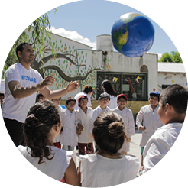

Project WET is Active in More Than 60 Countries around the World
Notes:
Project WET now has a presence in more than 66 countries around the world and has an active program in all 50 of the United States.
It has the world’s largest water education resources network!

Slide 9
Art
Social Studies
Health/PE
Math
Science
Language Arts
Music
Interdisciplinary and Supplemental
Notes:
Project WET activities are designed to supplement and enhance programs that are already being used.
It is not meant to replace or take over DOE’s education initiatives for any one subject.
The activities build and engages existing knowledge and skills across multiple subject areas. In a classroom setting, educators value these activities because it is also incorporated in Common Core and Next Generation Science standards.
9

Slide 10

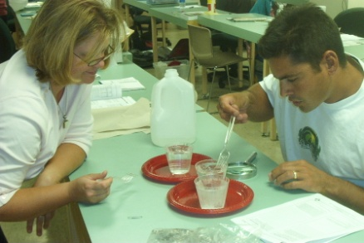
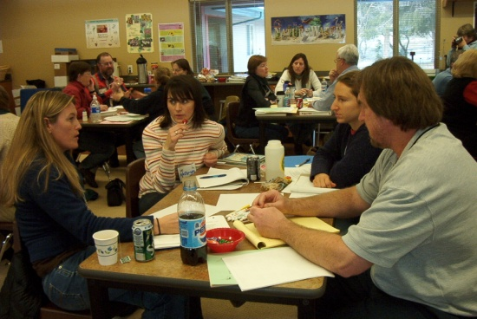
Educational Stages
SOLUTIONS
TO WATER
RESOURCE PROBLEMS
PARTICIPATION
(acquire
experience and
take action)
ATTITUDE
(values &
feelings)
SKILL
(identify problems)
KNOWLEDGE
(understanding)
AWARENESS
(appreciation)
Notes:
Project WET activities introduce water topics in stages– meaning knowledge and skills gained in activities continues to grow as the lesson gets more complex through an activity or a combination of activities in the guide.

Slide 11
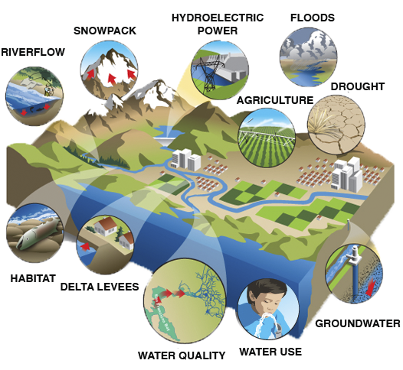
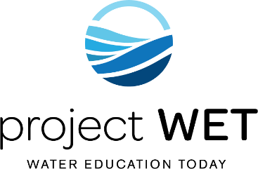
Integrate Knowledge of Complex Water Issues
Notes:
There are Project WET activities addressing all water issues faced around the world, like those depicted in this photo – and quite a few that address the same issue from multiple angles.

Slide 12
Teaching students HOW to think not WHAT to think
Present Facts ∙ Maintain Objectivity ∙ Provide Guidance
Evaluate Choices
Make Informed Decisions
Notes:
Throughout today’s training, as you begin to experience the Project WET activities, you will learn that the activities are designed to teach students HOW to think, not what to think.
The activities are designed to provide educators and students with factual, objective information and let the learner form their own decisions.

Slide 13
HRWA and Project WET
HAWAII RURAL WATER ASSOCIATION (HRWA) believes that environmental education and community outreach are important part of achieving out mission of technical assistance and training.
The Goal of PROJECT WET (Water Education for Today), formerly known as PROJECT WET (Water Education for Teachers) is to promote the awareness, appreciation, and knowledge of Hawaii’s water resources.
PROJECT WET is also an excellent community outreach tool for many water utilities to use. Concepts can be applied to community groups, homeowners’ associations, utility customers, youth groups and many more.

Slide 14
HRWA and Project WET
In 2021, Executive Director Juanita Reyher-Colon made the commitment to train all HRWA staff in the Project WET (Hawaii) program.
As of December 23, 2021, 8 of the 9 HRWA staff were training as Project WET facilitators.
Today, 6/10 current HRWA staff are trained as Project WET facilitators.
The remaining 4 HRWA staff are expected to be trained as Project WET facilitators by September 2023.
Notes:
In 1984, a man named Dennis Nelson founded Project WET while working at the North Dakota State Water Commission.
It was developed because he saw a need for water education to help educate and address local water issues they were facing.
- Through extensive partnerships and successful fundraising efforts, Dennis developed the small hometown program into the global leader in water resource education we have today.
Dennis himself has authored and co-authored over 300 original water science and education activities.
The Project WET foundation continues to develop and deliver the world's most extensive water education resources, water festivals, manages a worldwide network of partners and advocates for the role of water education in solving the world's most pressing water issues.
The curriculum is correlated with the Common Core State Standards for English/Language Arts and Literacy in History/Social Studies, Science and Technical Subjects.
The Project WET USA foundation is continuously developing resources and partnerships around the world to pursue their mission statement.

Slide 15
HRWA and Project WET
Services provided by HRWA:
Classroom training
Continuing Education Units (CEUs) Specialized Safety, Equipment and Technology
Upper Management Classes Virtual & Live Classes in Various Topics
On-site Assistance
Leak Detection Energy & Water Audits
Pipe & Valve Location Source Water Protection
Compliance Monitoring Pump Vibration Analysis
Mock Sanitary Surveys Generator Load Bank Testing
Rate Analysis Backflow Preventor Test Gage Verification
System Mapping (ArcGIS) USDA RD Apply
Security Assessment AND MORE ………….. OUTREACH & EDUCATION!!!
Emergency Response Plans

Slide 16
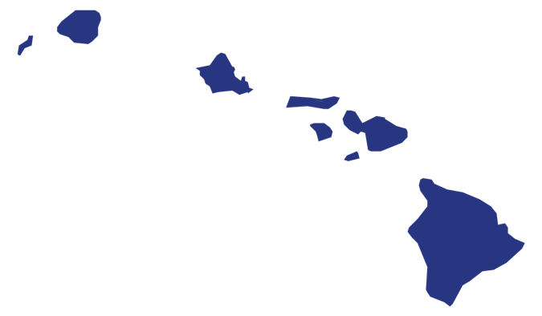
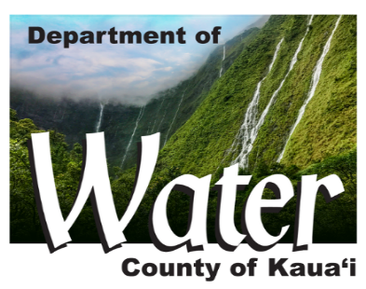
PROJECT WET HAWAII
Notes:
Project WET has networks in all 50 states. Each network is made up of water-industry leaders, natural resource specialists and educators just like you!
In Hawai’i, we have 16 Facilitators and over 150 Project WET educators.
16

Slide 17
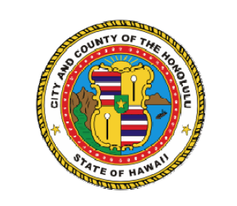



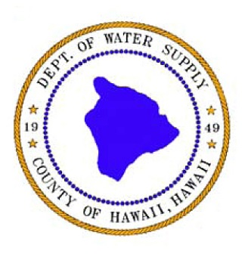

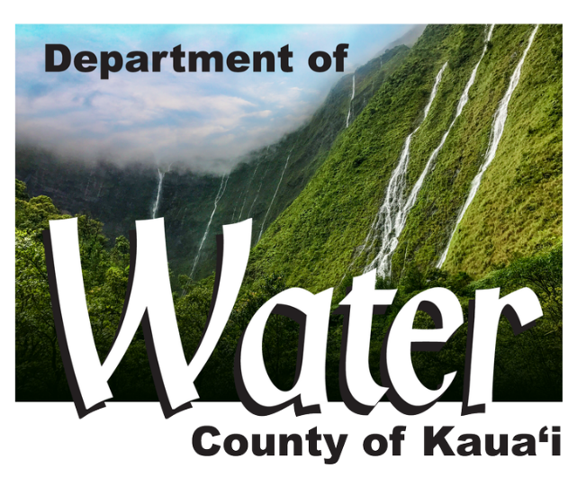
Project WET Hawai’i State Partners
Project WET Hawaii’s Host Institution:
Notes:
Our existing partners include the following agencies and county departments who have trained PWET staff within their personnel.
We are also seeking additional partners throughout the state and within various Departments to help expand our Project WET Facilitator network.

Slide 18

Kaua`i Department of Water
Project WET in Hawaii for 19 years
Host Institution for Project WET USA
Annual Make a Splash with Project WET Festival
Incorporates PWET into KDOW’s public relations efforts:
    School educational programs
    Community event presentations
    KDOW’s annual Signature Event, MAS
    Customer educational outreach efforts
Notes:
The Project WET Hawaii has been a part of the Kauai Department of Water’s educational outreach efforts for about 19 years.
We currently host the state’s largest and only Make a Splash with Project WET- Water Education festival!
We incorporate Project WET activities and curriculum into our public relations and conservation efforts in various community outreach programs that help
to educate our current and future customers about the importance of water education and Hawaii’s sustainable future.

Slide 19
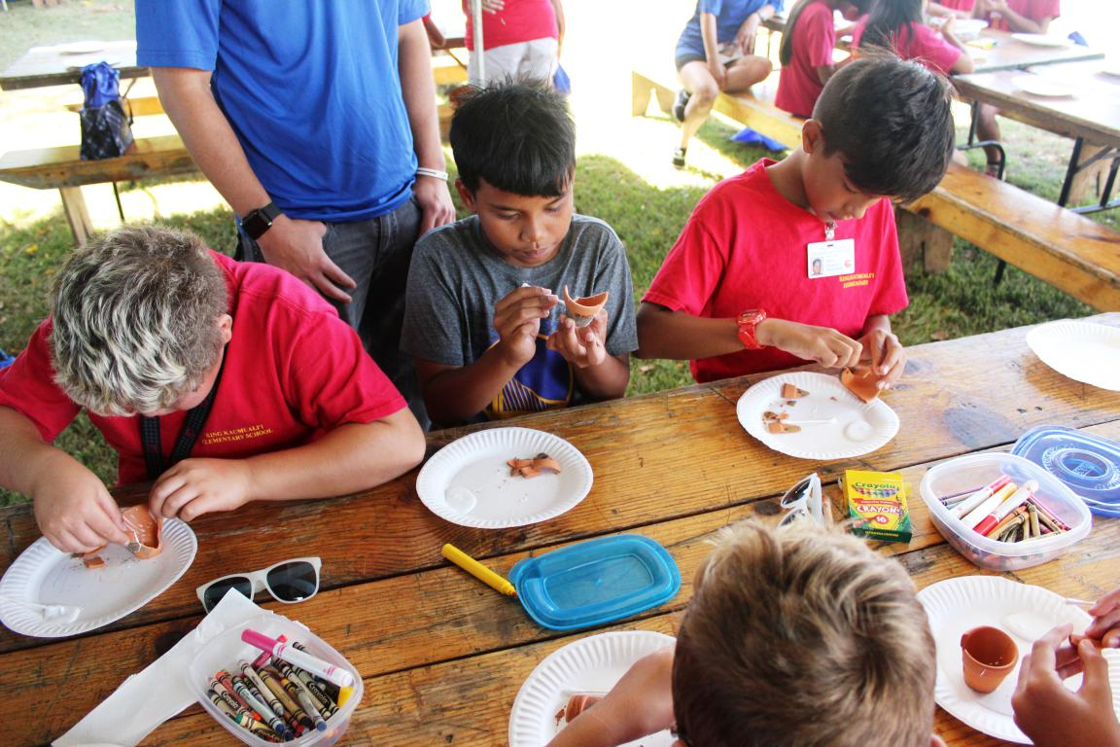
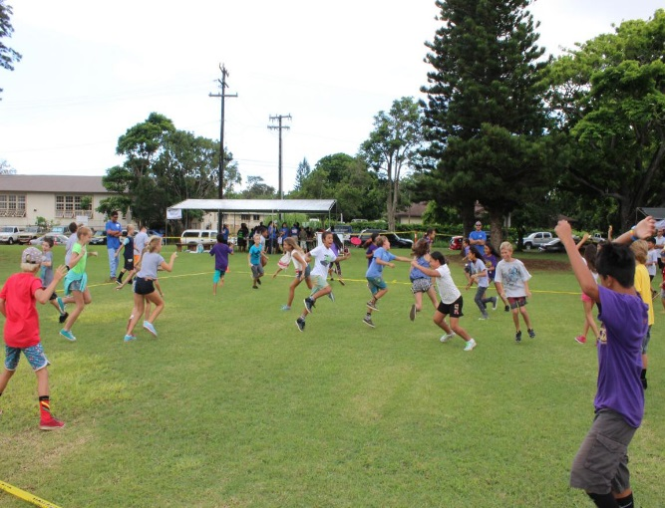

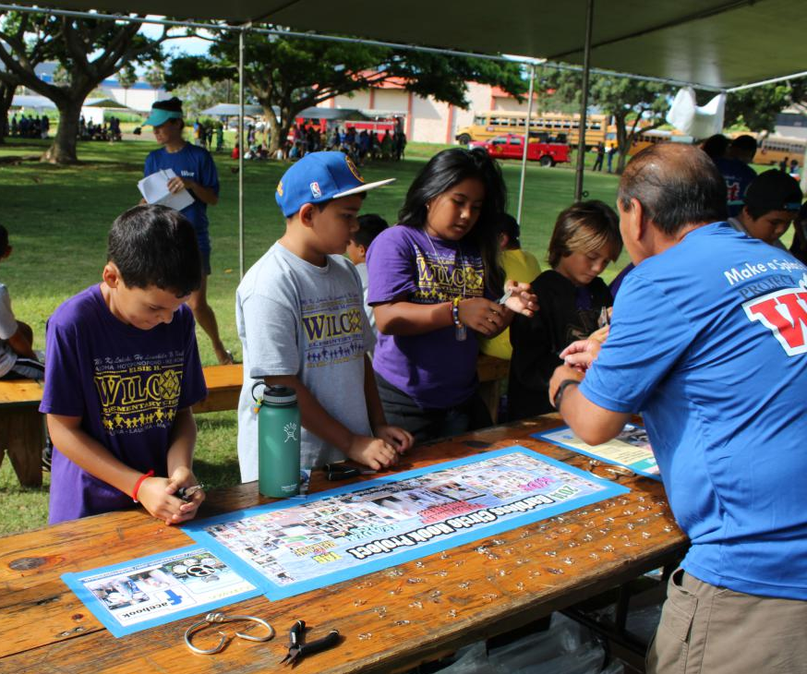

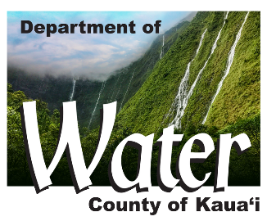
KDOW’s
Make a Splash w/ Project WET Festival
----------------------------------
11-12 activity stations
Reached approx. 12,000 fifth graders since 2003
community partners
200+ volunteers, including staff each year
KDOW’s Make a Splash w/ Project WET Festival
Notes:
The Make a Splash with Project WET Festival is our Department’s Annual signature event and the biggest Project WET event in the state.
Together with our staff and community partners, we host 11 water education stations for students to experience water education.
We’ve partnered with local and state agencies such as DLNR’s –Aquatic Resources division, Dept. of Health, Aqua Engineers, of course Hawaii Rural Water Association as well as local landowners and development companies.
Next slide – MAS pics

Slide 20
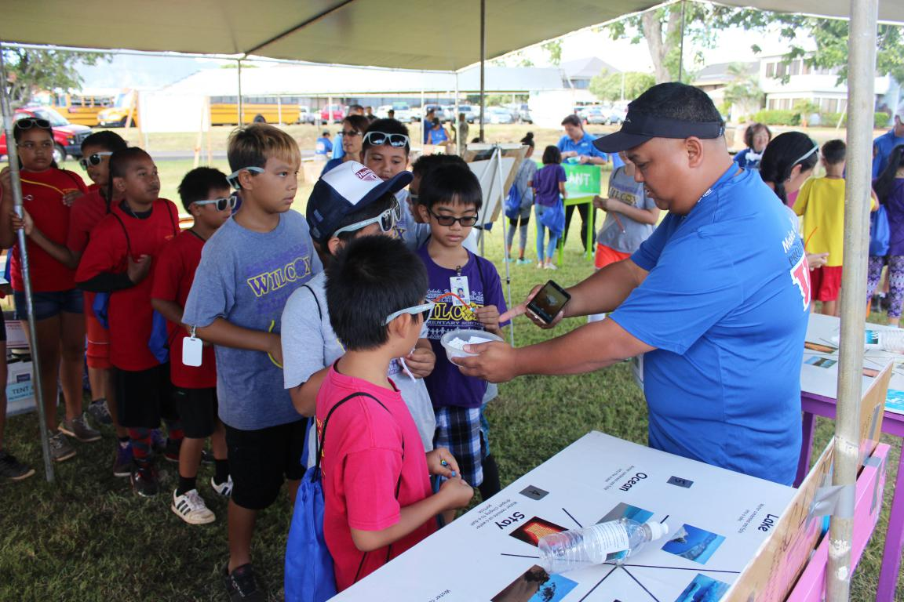
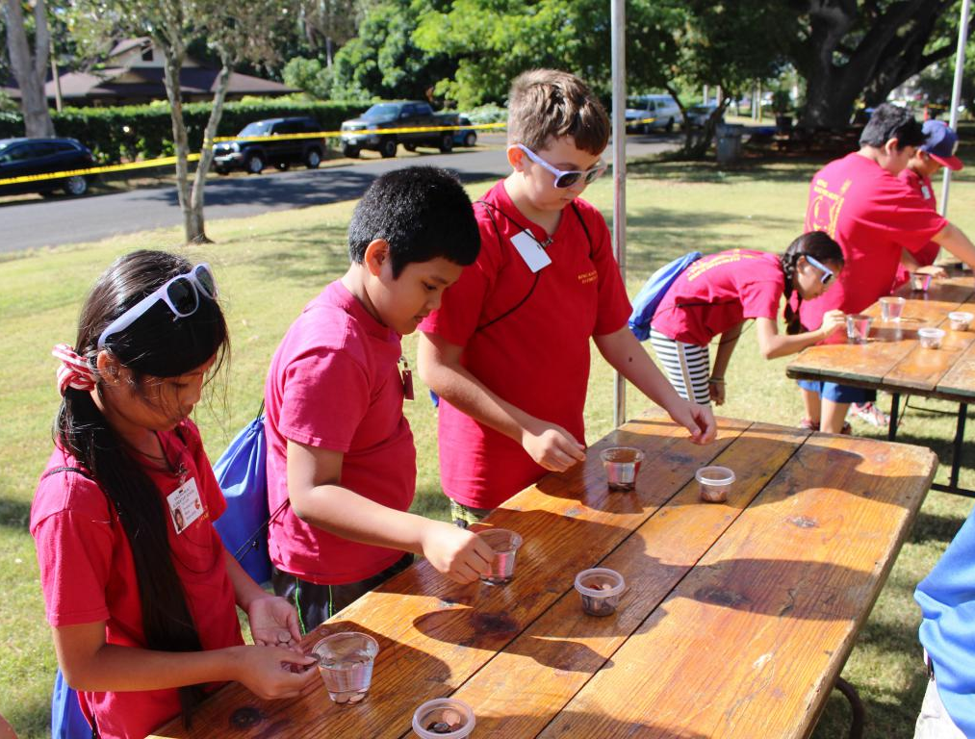
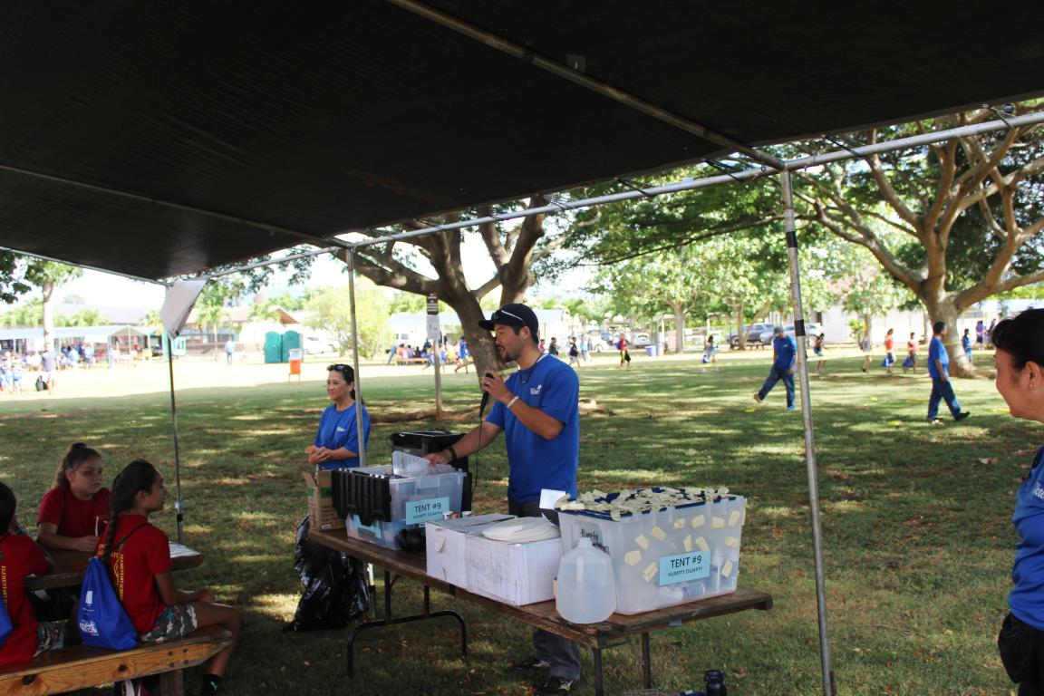
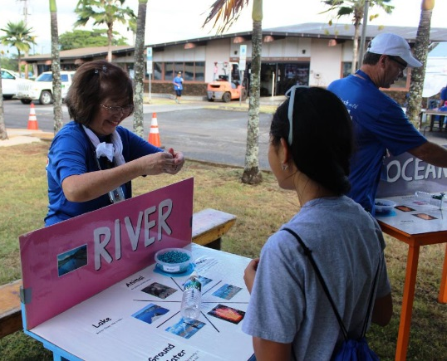
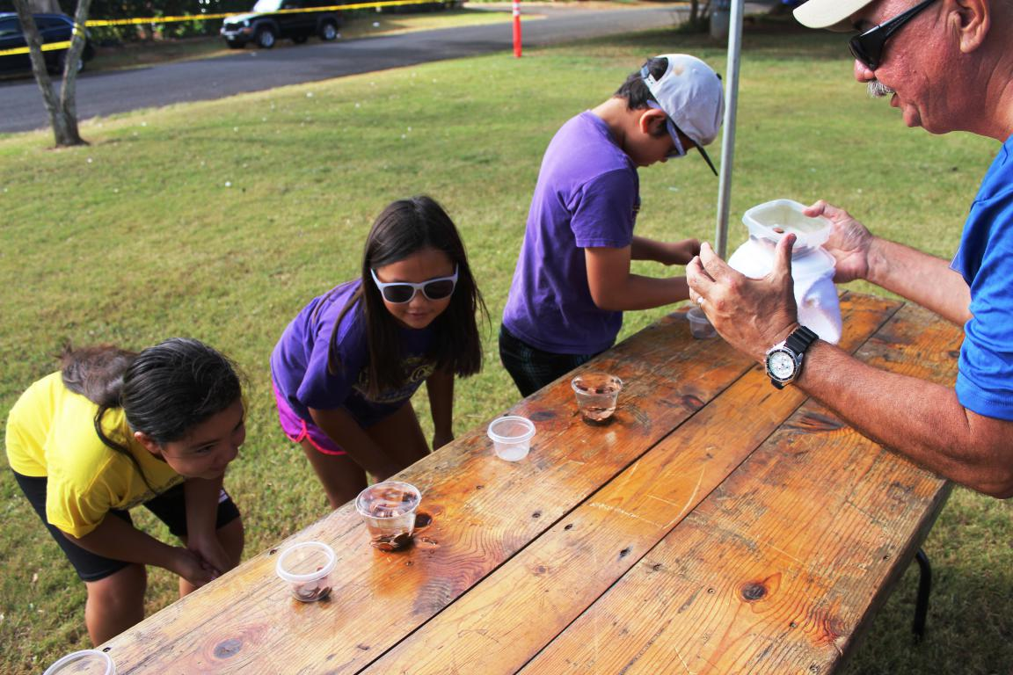
KDOW’s Make a Splash w/ Project WET Festival
Notes:
I will admit that this is a great Public Relation and community outreach event for the Department, but our efforts go beyond that.
We pride ourselves in being able to impact these students with the meaningful lessons and experiences that encourages critical thinking and sound decisions when it comes to their water future.
The students take away a better understanding and appreciation of water and our ecosystems and we see the results of this events through the teacher surveys and “thank you” notes that students send to the Dept. about what they learned.
Next slide - MAS

Slide 21
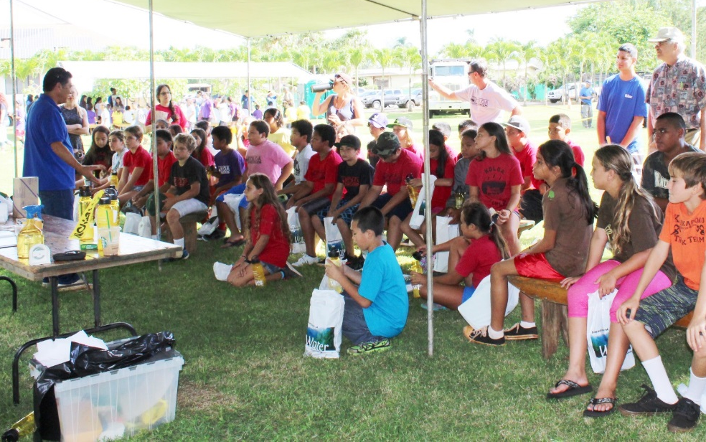
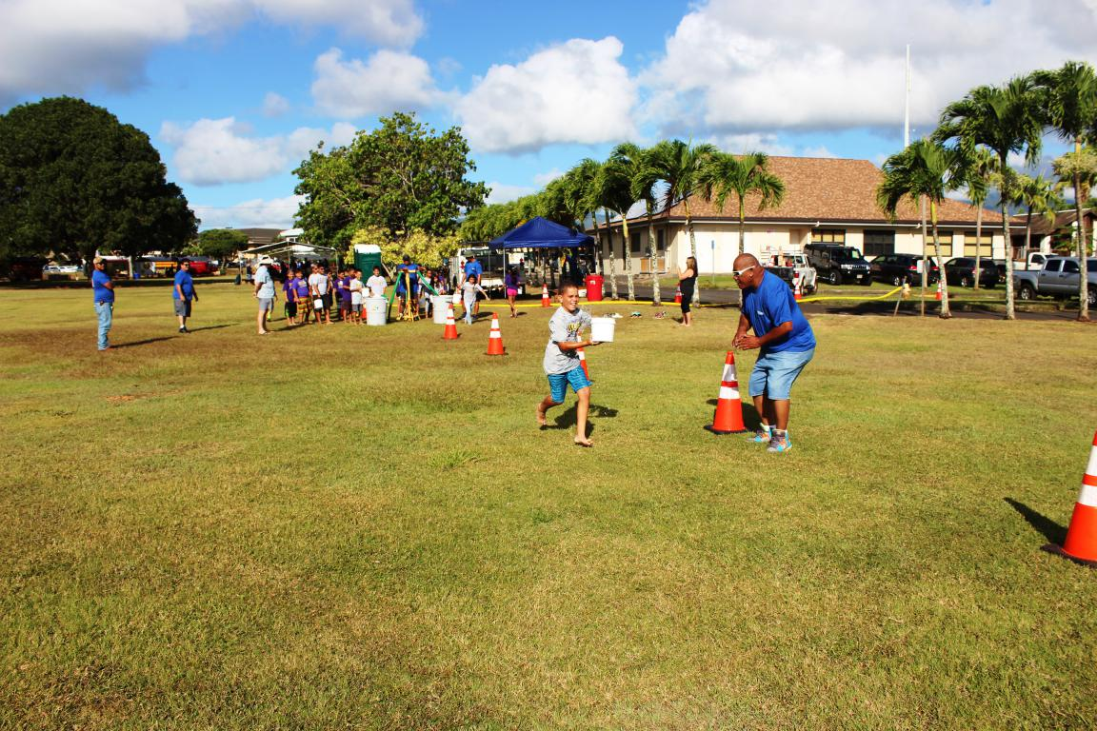
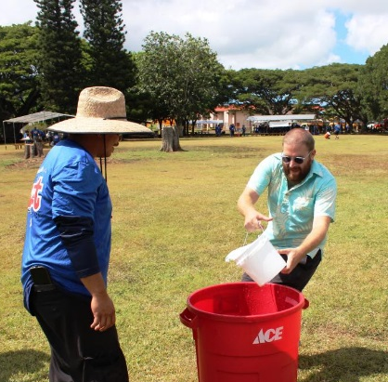
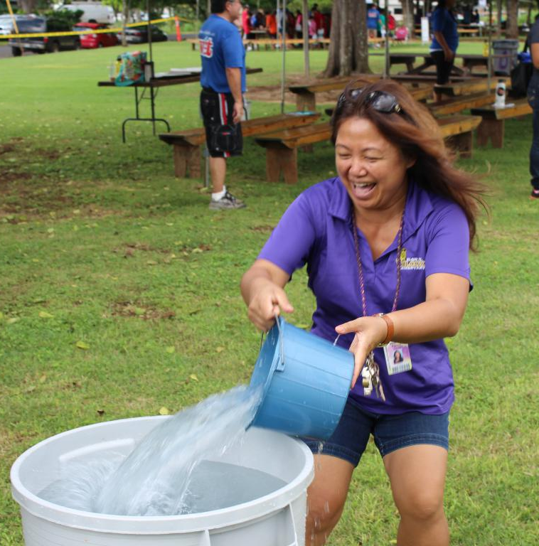
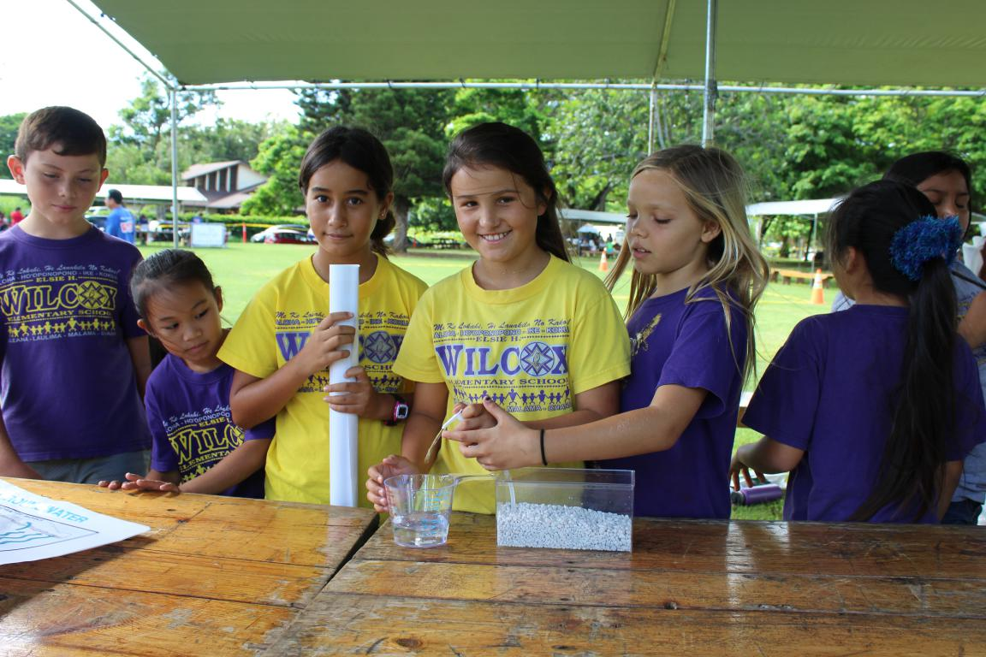
KDOW’s Make a Splash w/ Project WET Festival
Notes:
I may also add that the Teachers who attend our festival, love the hands-on learning activities and the outdoor setting!
Here is one of our popular activities called Long Haul, which teaches students how water is delivered to their homes.
Next slide: MAS –Mini festival

Slide 22
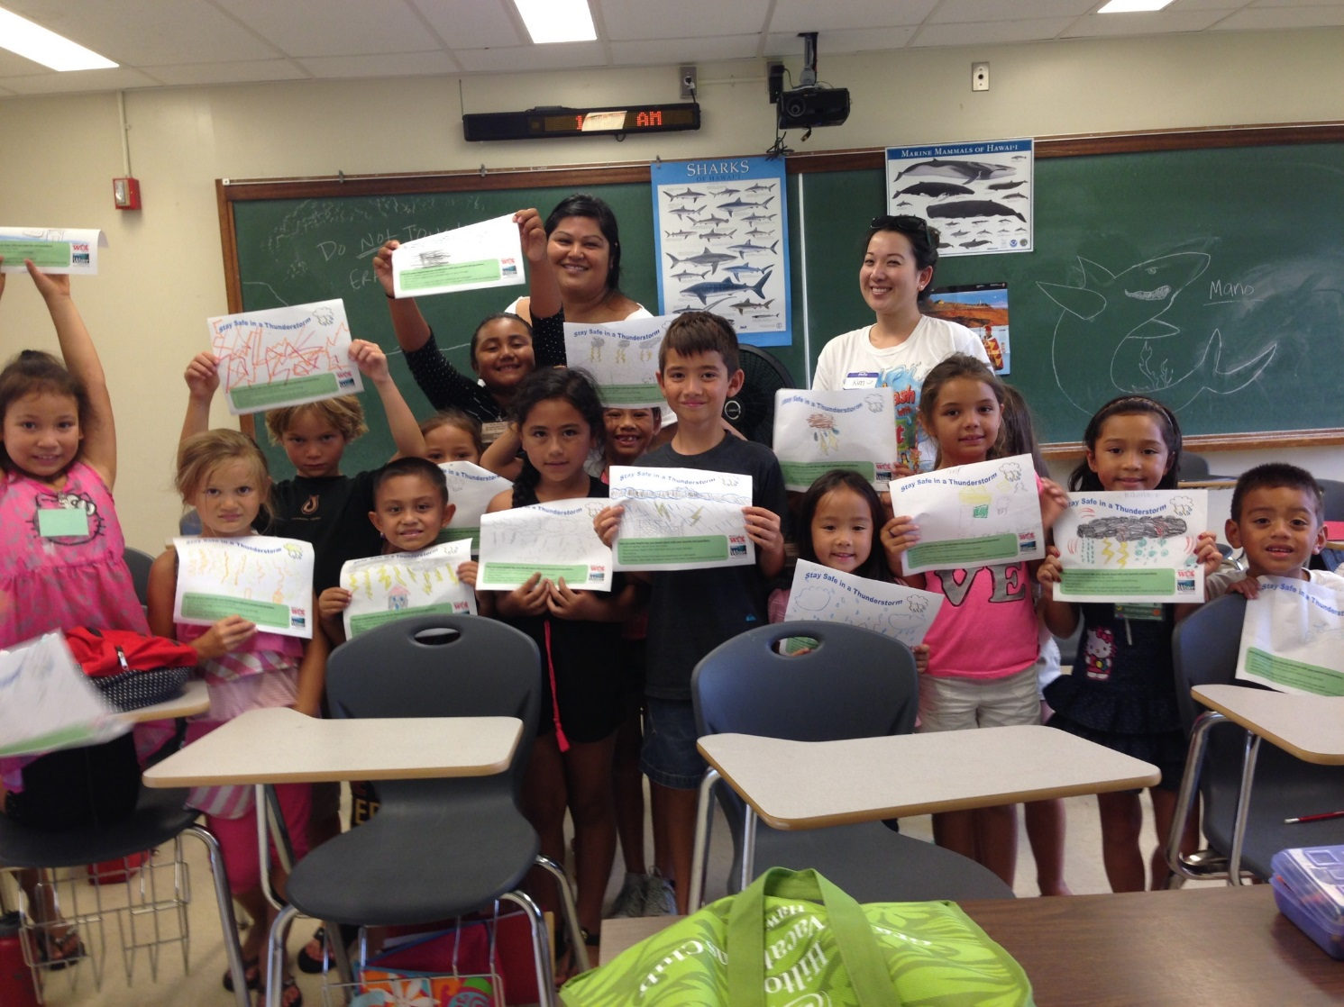
KDOW’s Make a Splash w/ Project WET Mini-Festival
6 water activity sessions
84 students
Offered to grades K – 4
Indoor & outdoor activities
“Thunderstorm” with 1st graders at the Mini-Festival in Hilo
KDOW’s Make a Splash w/ Project WET Festival
Notes:
We also host a mini version of the MAS festival. Where students rotate to different classrooms for activities.
Here is the 1st grade students showing off their artistic interpretations of a Thunderstorm!
Speaking of Activities, let’s get ready for our next one!

Slide 23
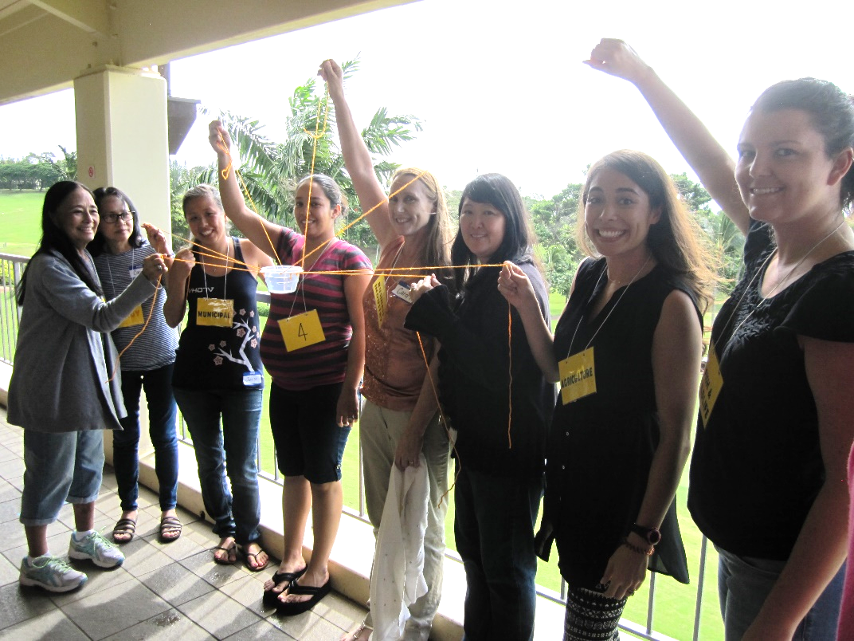
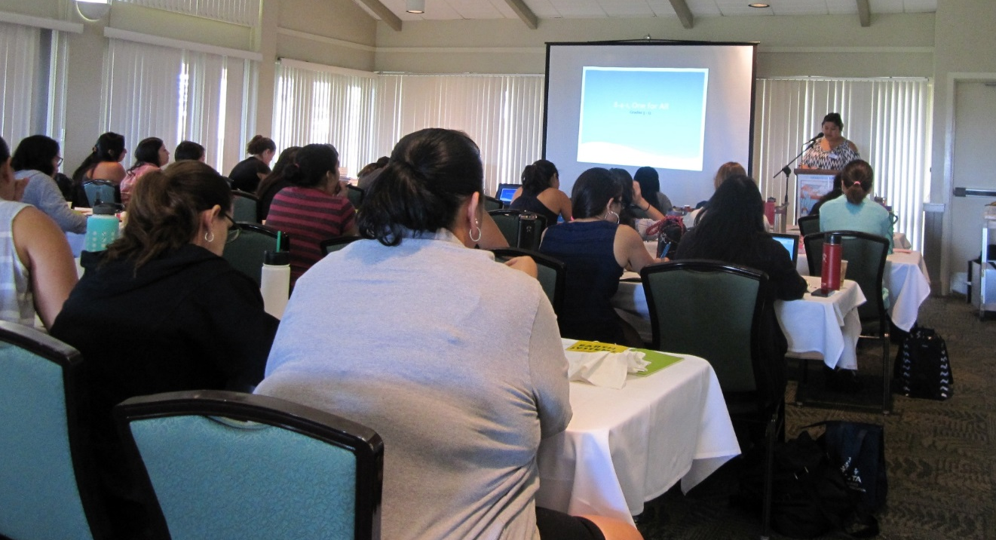
Project WET Hawaii in action!
Sharing Project WET with teachers and non-formal educators
PWET Educator
Workshops
Notes:
Here are a few examples of what our network has done over the past 6 years.
We have trained many teachers over the past few years.

Slide 24
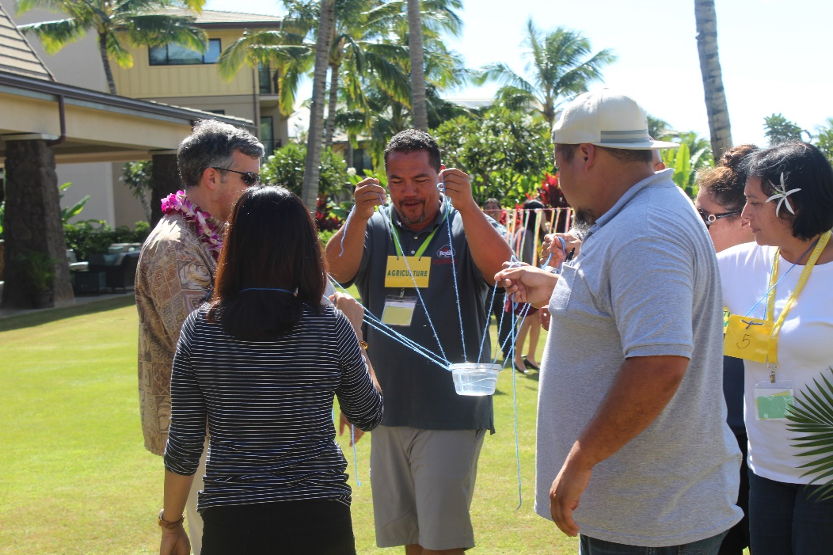
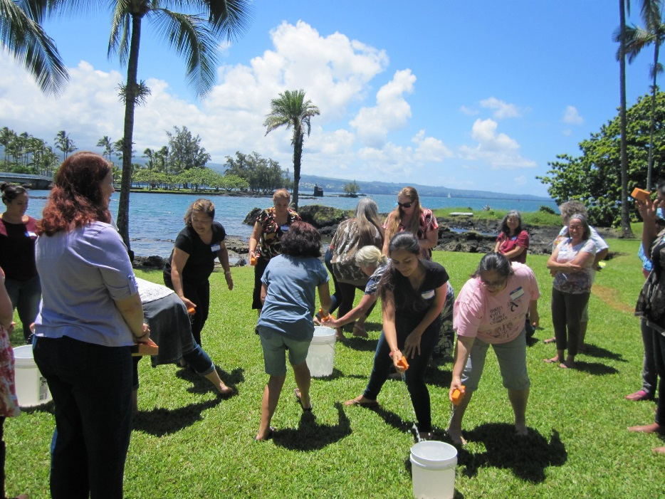
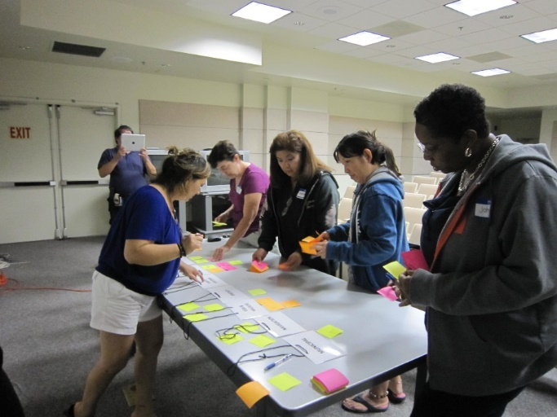
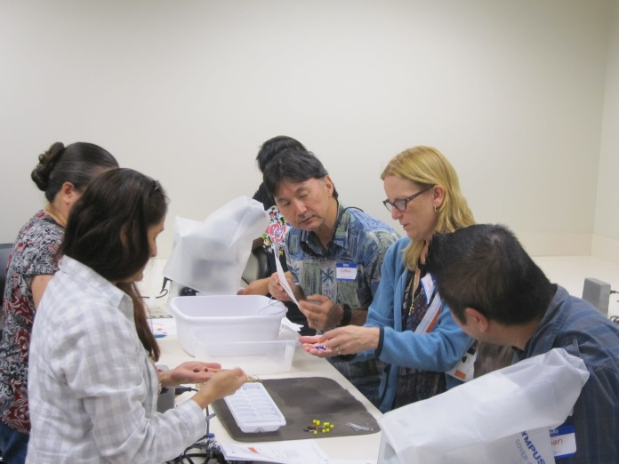
Project WET Facilitator & Educator workshops are held across the state
Project WET Hawaii in action
Notes:
We were able to host educator workshops on Oahu, Big Island, Maui and Kaua’i to help expand the use of Project WET, water education statewide.

Slide 25
HRWA and Project WET
HRWA PROJECT WET ACTIVITIES:
Involved with various Project WET presentations at schools, homeowner associations, professional conferences/events.
Participated in KDOW – Make-A-Splash festival (for 5th graders)
Conducted Project WET educators training at HRWA Conferences, meetings, water workshops and other environmental and water events.
Development of education/outreach curriculum for specific water topics (groundwater and wells, wastewater disposal, source water protection, …).

Slide 26
Hawaii Rural Water Association and
Project wet Hawaii
Development of educational resources

Slide 27
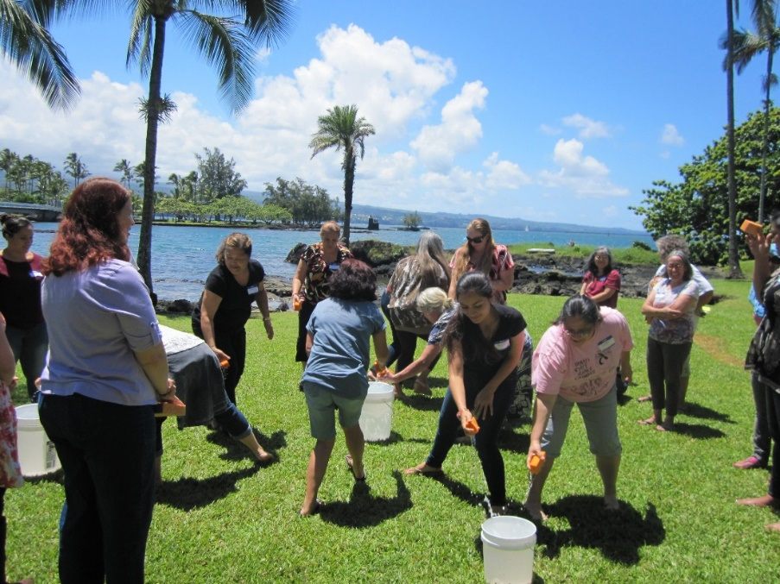
Benefits of Project WET for Educational Outreach
Guide 2.0 provides a clear understanding of water topics, lessons and includes all the information you need!
Learners are engaged when they participate because they are having fun learning through hands-on activities.
It’s a great tool to help launch or enhance your education outreach efforts.
Project WET Hawai’i offers sponsorship of workshop supplies, additional resources and assistance, statewide.
Notes:
We always incorporate Teach Back lessons in our Facilitator training to allow you to dive into the guide and immediately apply what you’ve learned.
The hands-on experience with the Guide also helps to bring up discussions, ideas and benefits of using Project WET in your existing programs.
No need to reinvent the wheel – every activity has a clear lesson plan correlated to our State’s education standards
Learners are engaged when they participate because they are having fun through hands-on activities
If you are looking to fulfill or enhance an educational outreach in your program, Project WET is a great way to start
Your host program, Kaua’i Dept of Water will continue to sponsor workshop Guides and offer additional resources when available, statewide.

Slide 28
ADAPTABLE and FLEXIBLE
“It is the supreme art of the teacher to awaken joy in creative expression and knowledge.” albert einstein

Slide 29
OTHER
SOURCE WATER PROTECTION
Activities
EPA

Slide 30
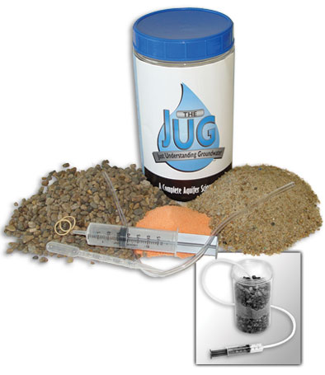
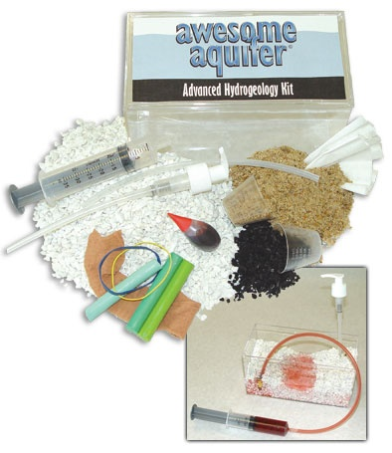
OTHER
SOURCE WATER PROTECTION
Activities
Groundwater foundation

Slide 31
HRWA and Project WET
UTILIZATION OF PROJECT WET IN HRWA’s GRASSROOT SOURCE WATER PROTECTION PROGRAM

Slide 32
Hawaii’s Grassroot
Source Water Protection Program
Source water protection priority areas:
Cesspool upgrades
Abandoned wells
Education and outreach

Slide 33
Cesspool upgrades
88,000 Estimated statewide
How many cesspools are located in source water protection areas?
Upgrades required by 2o50.
33

Slide 34
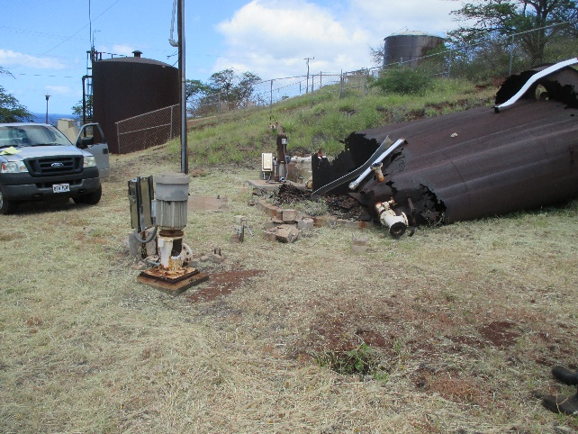
Hawaii’s abandoned wells estimated over 1,500+ (Statewide)
HOW MANY ABANDONED
Wells located in source
Water protection areas?

Slide 35
Hawaii’s source water protection education & outreach program
Education and outreach priority areas:
Water systems and stakeholders
Public and communities
Students and youths

Slide 36
PROJECT WET ACTIVITIES for
SOURCE WATER SOURCE WATER PROTECTION
A-maze-ing water (imagine turning your water tap and having everything you dumped into the gutter flow into your cup.)
Get the groundwater picture (have you ever wished you had a window into the earth so you could see what’s beneath your feet?)
Grave mistake (a few members of your community appears to have contracted a similar illness. The community is blaming a local factory for the contamination of its groundwater. Could the community be making a grave mistake.

Slide 37
PROJECT WET
SOURCE WATER PROTECTION
Activities
PROJECT WET ACTIVITIES
for
SOURCE WATER SOURCE WATER PROTECTION
Poison pump (a killer has swept through the streets of London, and hundreds are dead! Could the accomplice to this terrible crime be something that is used every day?)
Pucker effect (People in your town are suffering from
contaminated drinking water and are experiencing the “pucker
effect’ – pursed lips and sour dispositions. Your mission is to
discover the source of the contamination
(6) Springing into action (Recipe for “spring in a bottle”: layer
gravel, sand, clay, and sod and just add water)

Slide 38
PROJECT WET
SOURCE WATER PROTECTION
Activities
PROJECT WET ACTIVITIES
for
SOURCE WATER SOURCE WATER PROTECTION
Storm water (Where does storm water come from? And where does it go?)
(8) Sum of the part (What do you, your parents, your neighbors, a plant in your home have in common)
(9) Super bowl surge (Where do most people head at halftime?)
(10) Super sleuth (if you like mystery and intrigue, this activity is for you?)

Slide 39
ADAPTABLE and FLEXIBLE
“It is the supreme art of the teacher to awaken joy in creative expression and knowledge.” albert einstein

Slide 40
DEVELOPING RELATIONSHIPS and activities
Through the years, relationships have been developed:
- Kauai Department of Water
- UH-Hilo Earth Day
- City & County of Honolulu – Stormwater Quality
- Maui Department of Water Supply
- UH-Hilo Project WET Development (in-progress)
- Others

Slide 41

PROJECT WET PERFECT
FOR
WATER & WASTEWATER UTILITIES’
WHY WATER AND WASTEWATER UTILITIES SHOULD BE INTERESTED IN PROJECT WET?

Slide 42
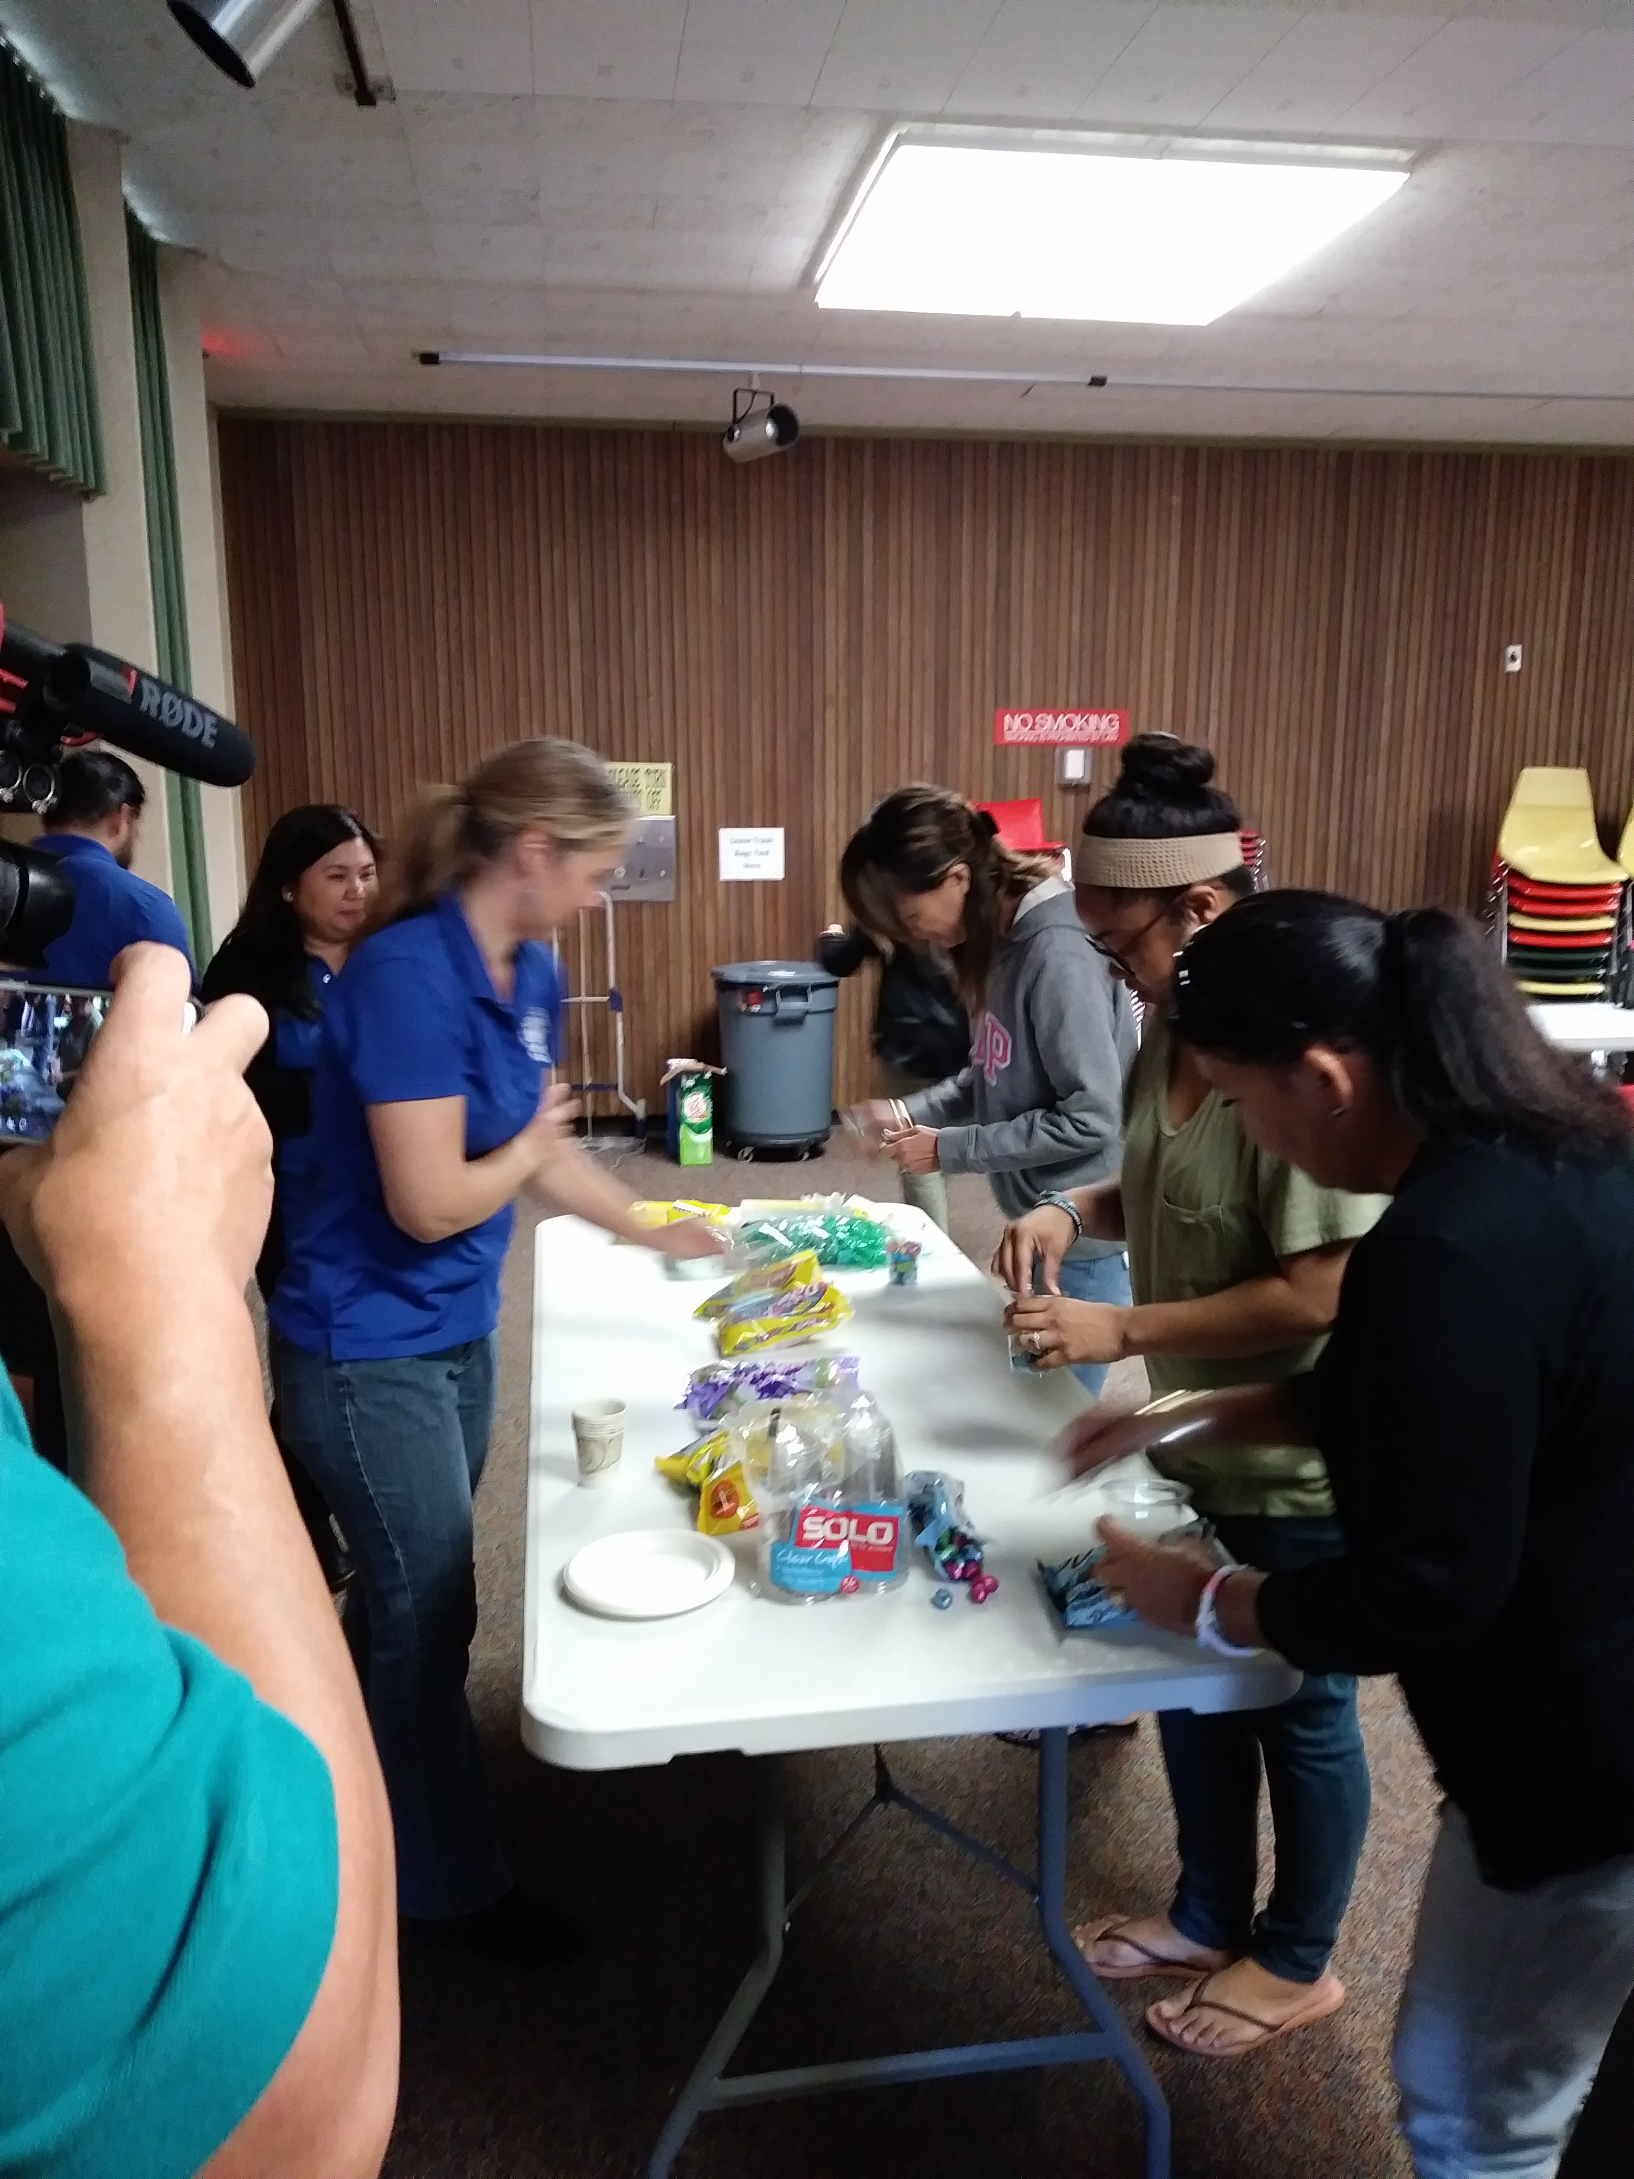
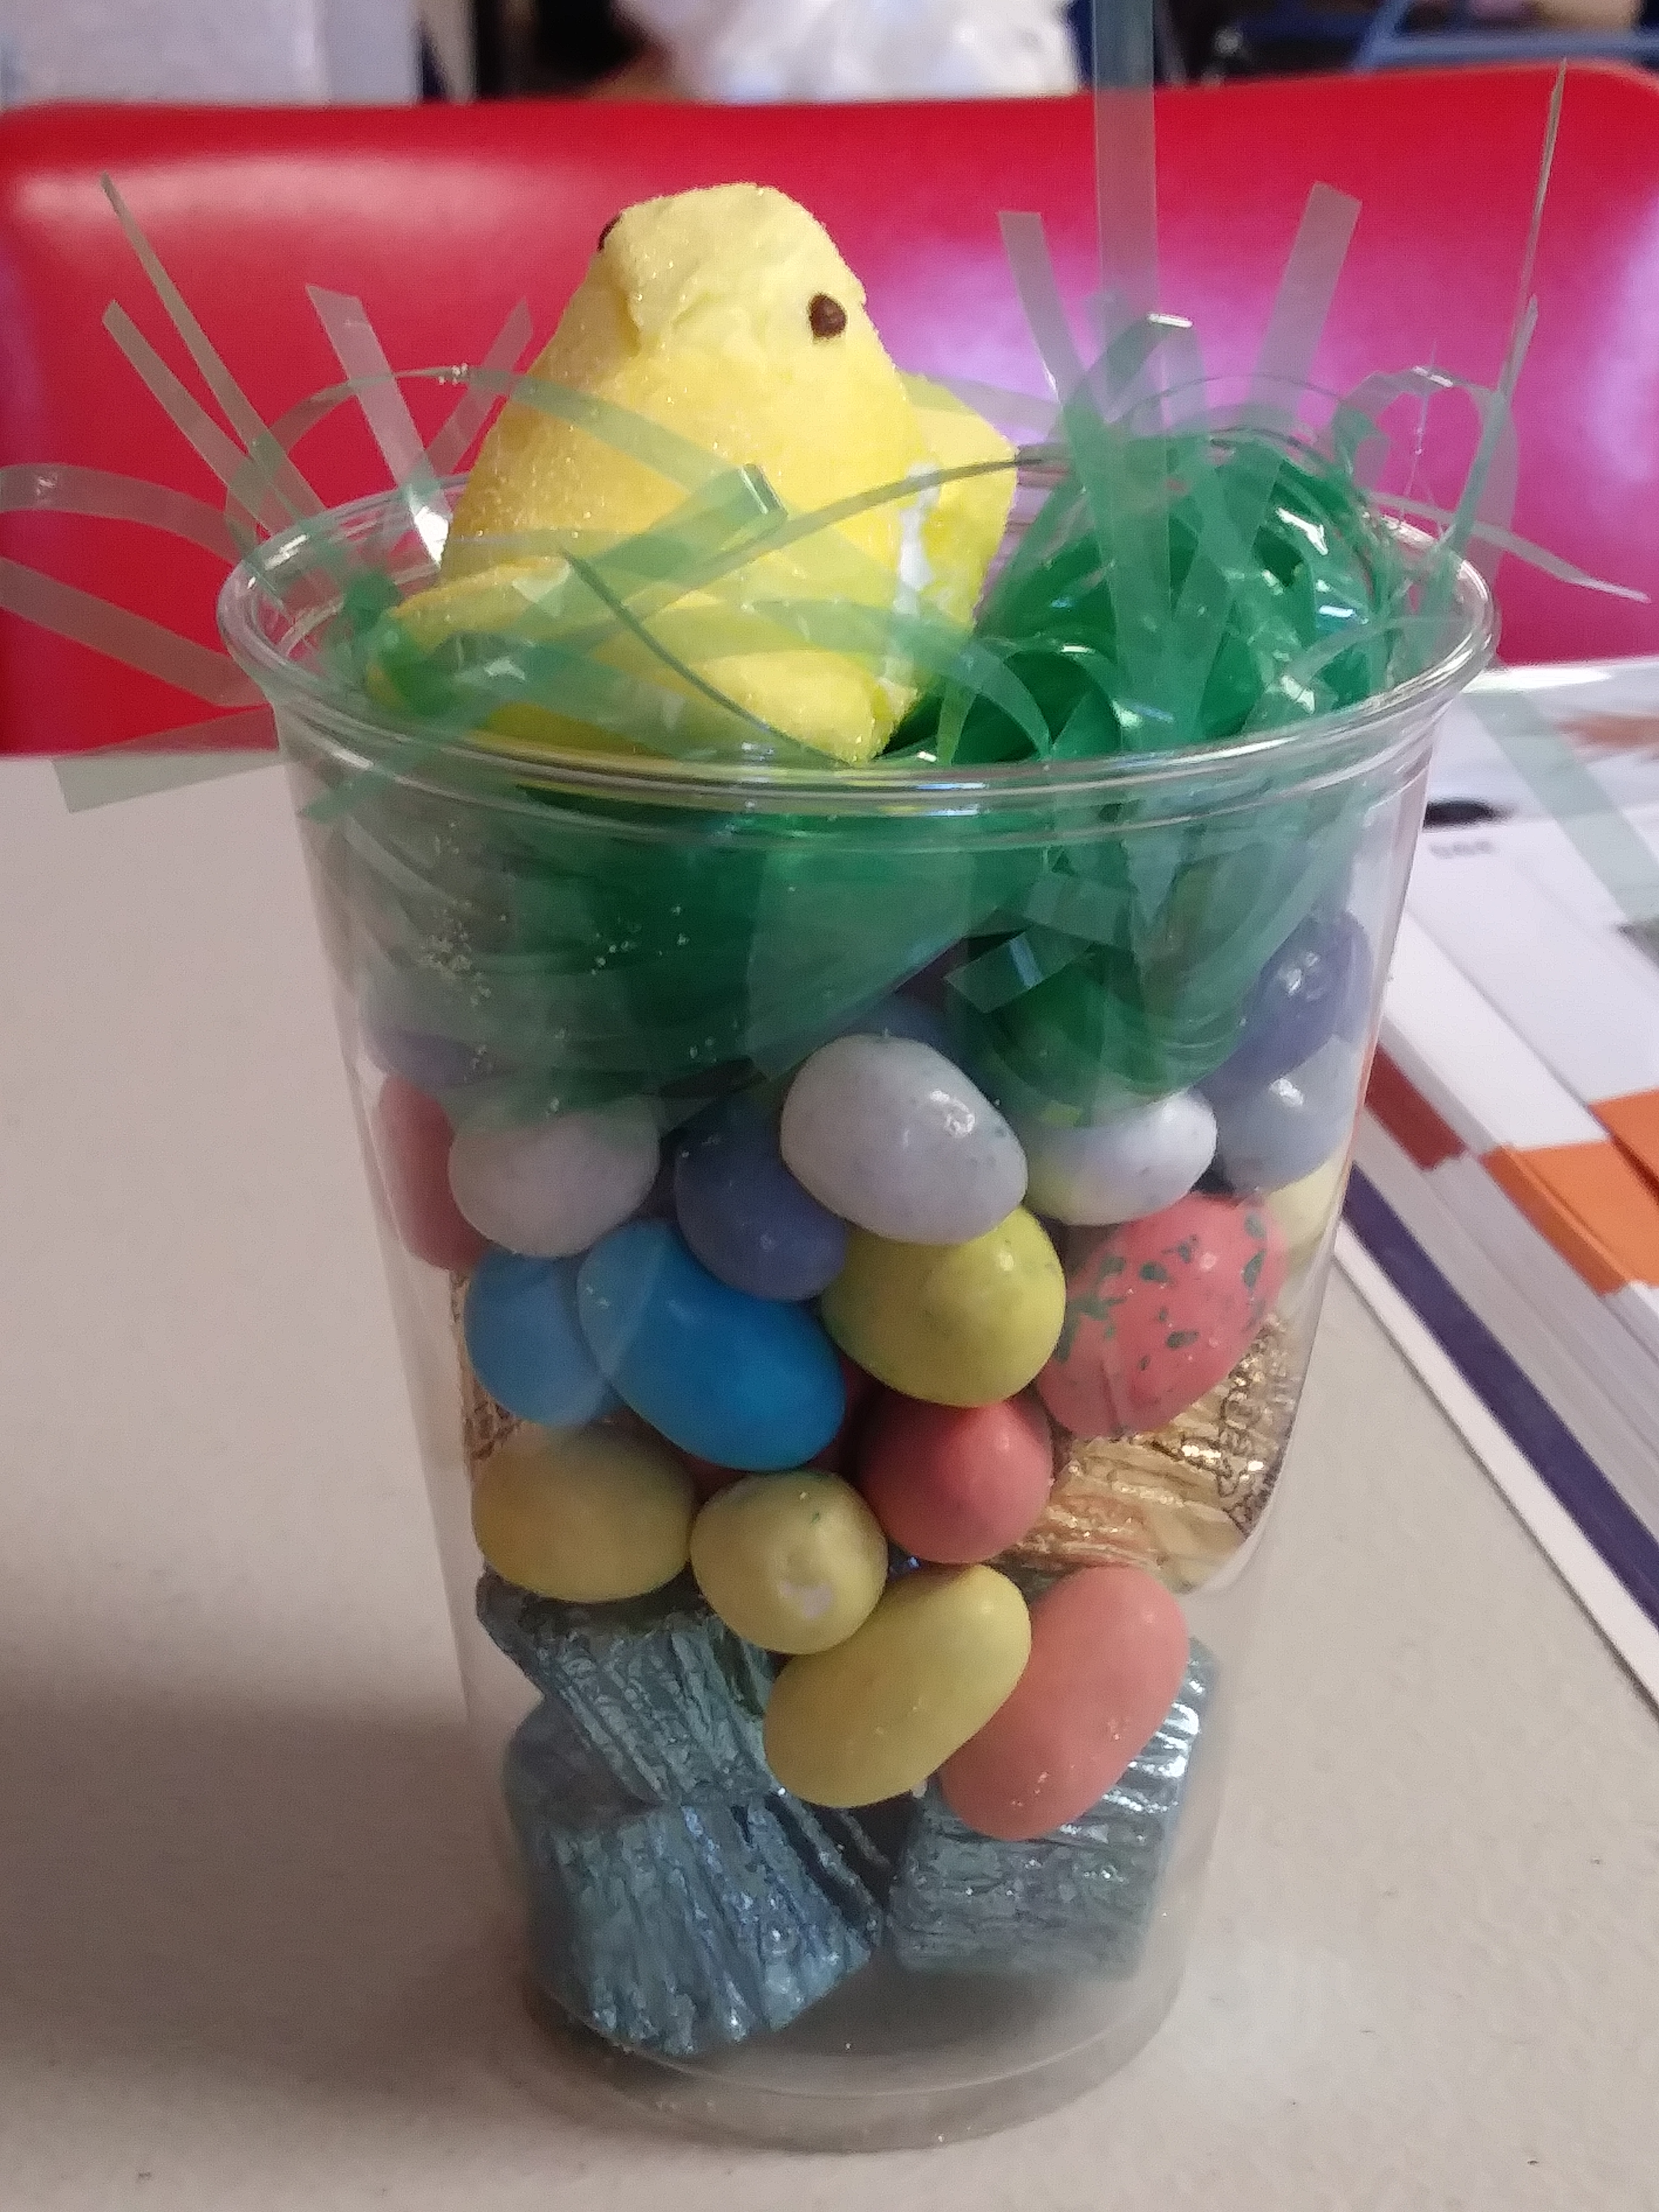
SHOULD BE FUN
“Having fun is the best way to learn.” Albert Einstein
“Even though you’re growing up, you should never stop having fun.” Nian Dobrev

Slide 43
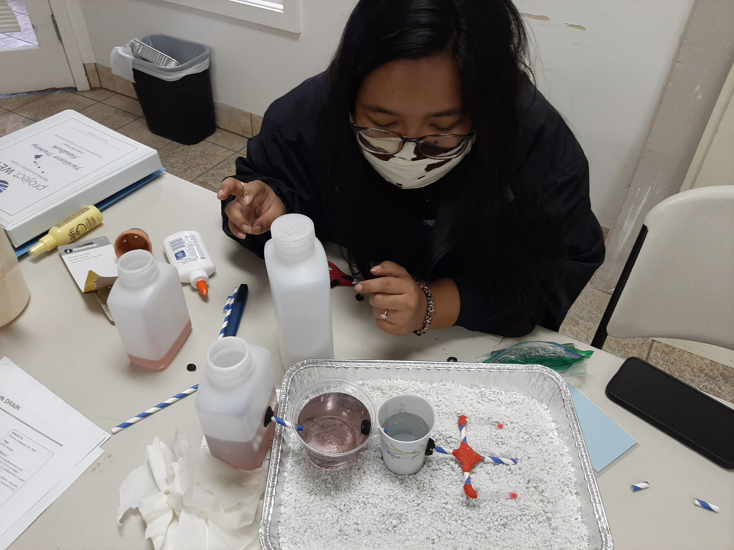
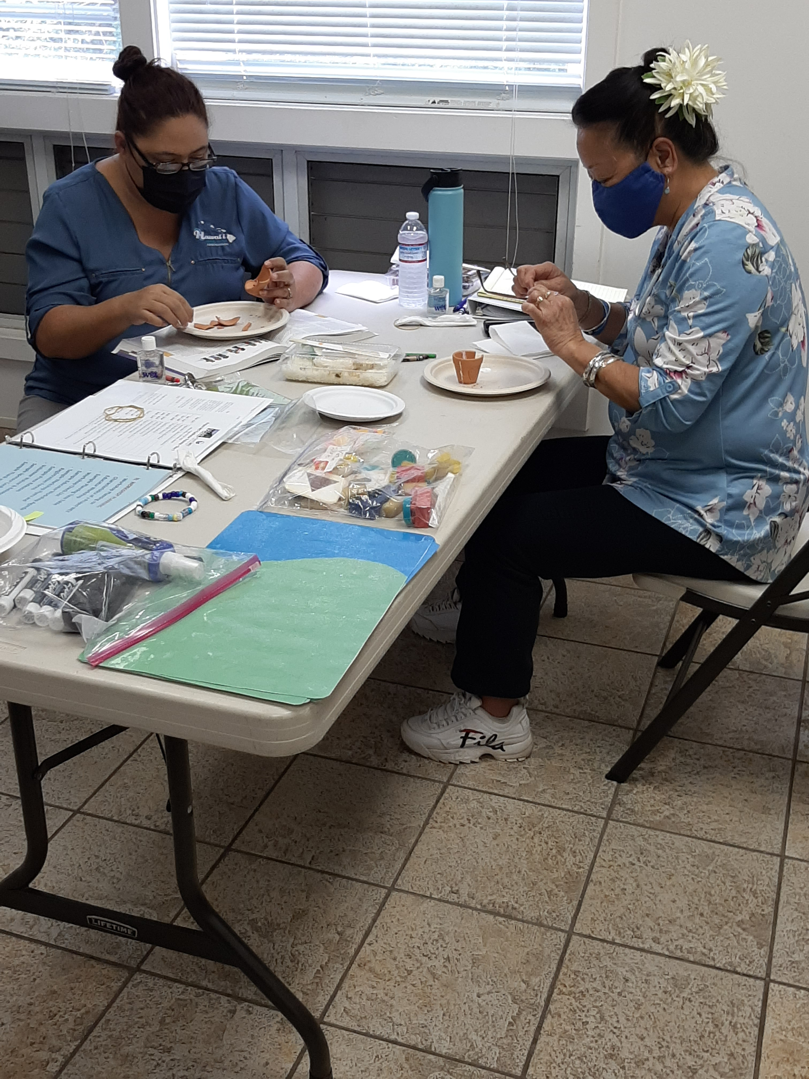
SHOULD BE HANDS-ON
“Tell ME and I Forget, Teach me and I remember, Involve me and I learn”. Benjamin franklin
‘the mediocre teacher tells, the good teacher explains, the superior teacher demonstrate.”

Slide 44
PROJECT WET PERFECT
FOR
WATER and WASTEWATER UTILITIES
UTILITIES:
- work in many areas dealing with water
- facilities located throughout the entire
state serving varying communities
- mission is to provide safe drinking water
and proper management and disposal of
wastewater.
“Those who know, do. Those that understand teach.” Aristotle
”Teaching is the highest form of understanding.” Aristotle
“Everyone, in some respect, is a teacher; some just work harder to do it better.” terry heick

Slide 45
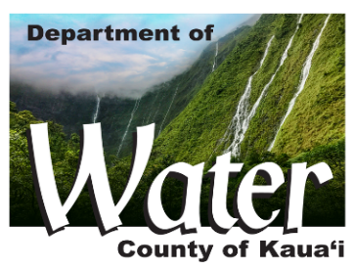
HOW TO BE A PART OF PROJECT WET HAWAII?
CONTACT A PROJECT WET HAWAII FACILITATOR OR COORDINATOR
GET CERTIFIED COMPLETE A PROJECT WET HAWAII CERTIFICATION TRAINING WORKSHOP TO ACCESS THE CURRICULUM
EDUCATE INCLUDE THE PROJECT WET CURRICULUM, RESOURCES TO TEACH WATER EDUCATION!

Slide 46
HOW YOU CAN GET INVOLVED WITH THE PROJECT WET HAWAII PROGRAM
Those interested in becoming involved with project wet may contact the Project WET website:
www.projectwet.org./where-we-are
the online “contact us’ form may be filled out and the inquiry will be directed to the appropriate Project WET staff and/or state coordinator.

Slide 47
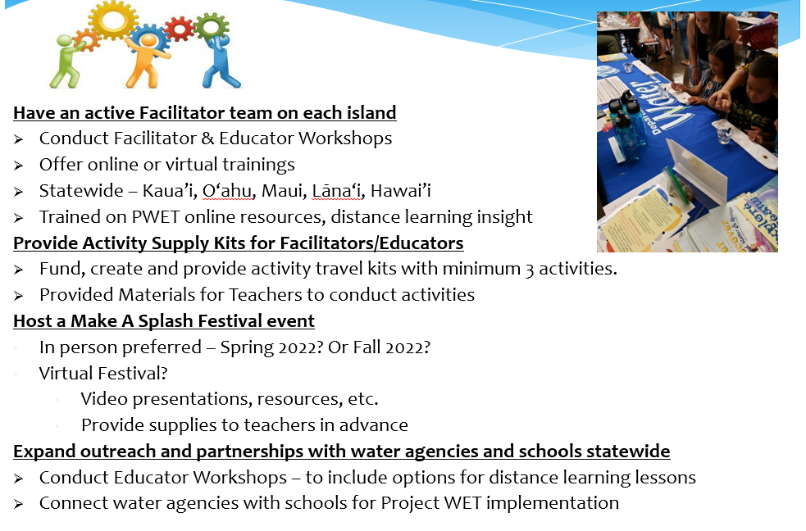
Project WET Hawaii Program
WHERE DO WE GO FROM HERE?
GOALS FOR 2023-2024

Slide 48
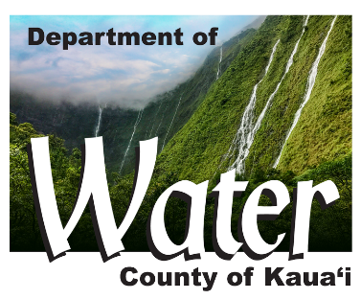
Mahalo!
Contact Us:
Jonell Kaohelauli’i
projectwethawaii@kauaiwater.org
(808) 245-5455
Daniel Chang
Daniel@hawaiirwa.org
(808) 747-4356
Notes:
Mahalo!

