Slide 1
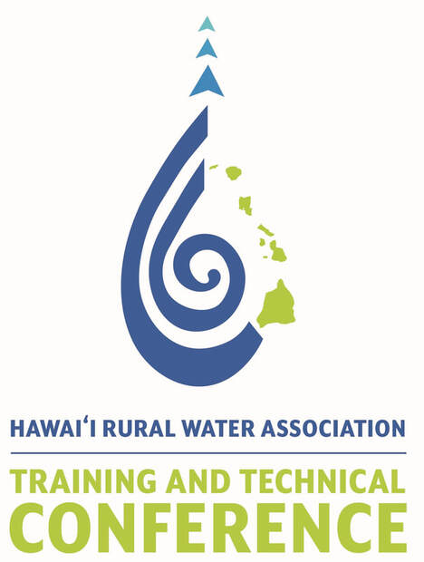
2023 Hawaii Rural Water Association Optimal Application of Pipe Bursting and Trenchless Methods - 9,000 feet of both Water and Sewer Pipeline in the City of Eureka, CA
George Mallakis
TT Technologies, Inc.
Mike Garrett
Underground Solutions, Inc

Slide 2
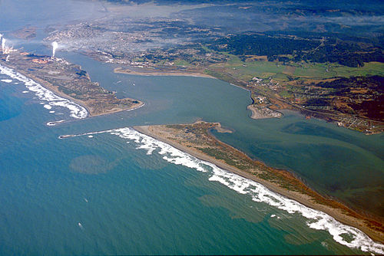
City of Eureka, CA
Largest coastal city between
San Francisco and Portland Oregon
Located on US Route 101 on the shores of Humboldt Bay and adjacent to CA’s Redwood Forest
Population of approximately 28,000

Slide 3
Public Works Department
Engineering and Field Operations
Water Distribution and Wastewater Systems
Designed the Henderson
Water and Sewer
Improvements Project and
Bid November 19, 2020

Slide 4
Project Design Details
3,600 feet of sewer mains and 41 sewer service laterals
5,000 feet of water mains and 34 water service laterals
“Open Cut” existing water mains and install new Ductile Iron Pipe
“Open Cut” existing sewer mains and install new PVC Pipe
Use “Trenchless” to replace water and sewer service laterals

Slide 5
Bid Results
Mercer Fraser Co - $3,025,882
Bidder #2 - $3,825,213
Bidder #3 - $3,889,783
Mercer Fraser planned to use pipe bursting which cost less saving the city $800,000 or 25% over next lowest bidder

Slide 6
Pipe Bursting Line Items Open Cut Pricing
Mercer Fraser Bidder #2 Bidder #3
8-inch water per lf $75 $158 $178
8-inch sewer per lf $105 $180 $198

Slide 7
Post Bid Details
Contractor and City had experience using Pipe Bursting
Benefits: Pipe Bursting will minimize disruption, reduce carbon emissions,
increase productivity and save money.
Pipe Bursting Scope became…
3,600’ of existing 8” VCP sewer pulling in new 8” HDPE
5,000’ of existing 8” ACP and CIP pipe pulling in new 8” FPVC

Slide 8
Construction
New Pipe Materials used:
Water Mains – Fusible PVC (FPVC)
Sewer Mains – High Density Polyethene (HDPE)
Both great materials – city was familiar with each of these
pipe products used in past water and sewer projects

Slide 9
Construction
Equipment Choices
TT Technologies, Inc. Grundoburst Static Pipe Bursting System
Contractor familiar and experienced with this equipment used on previous projects
Accommodates all existing and new pipe materials
Compact, quiet, and productive

Slide 10
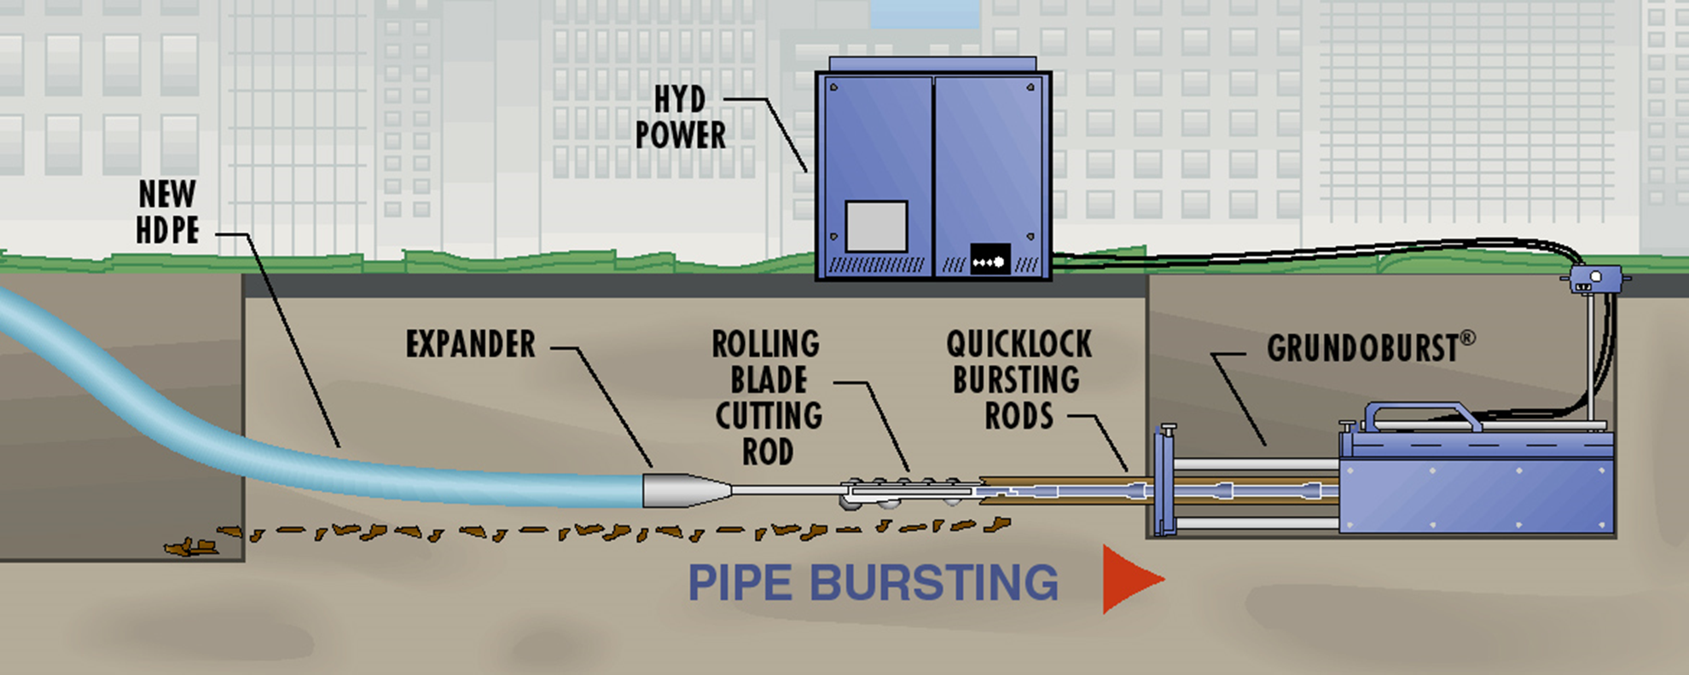
Equipment

Slide 11
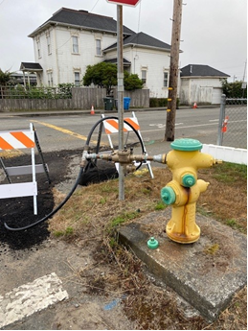
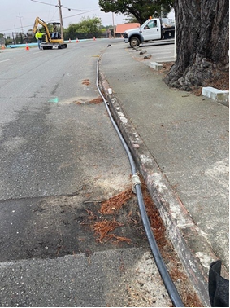
Construction – Water Mains
Temporary Bypass System (Sideline) for Services

Slide 12
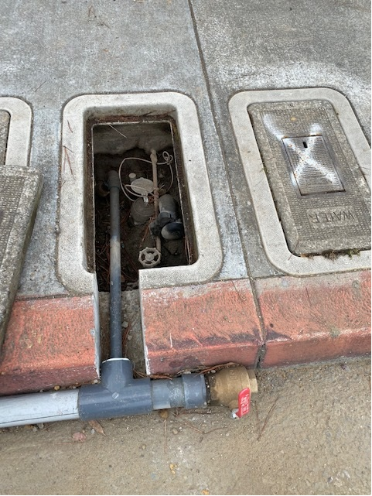
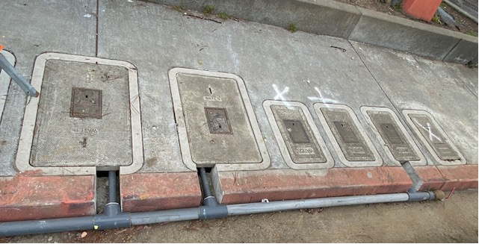
Construction – Water Mains
Temporary Bypass System (Sideline) for Services

Slide 13
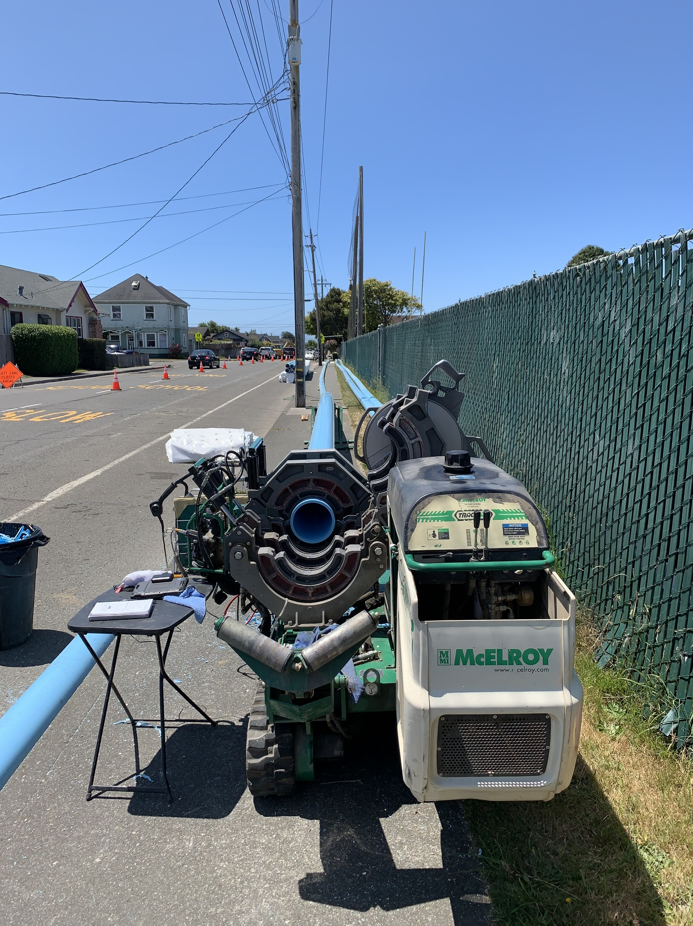
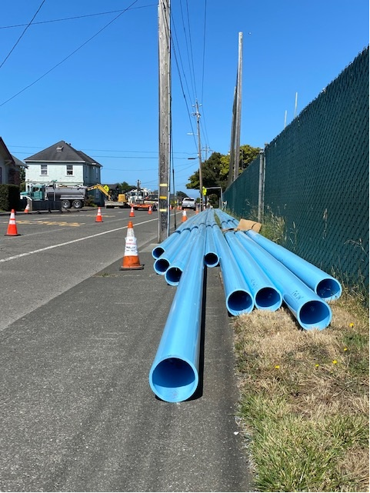
Construction – Water Mains
FPVC Pipe Fusion

Slide 14
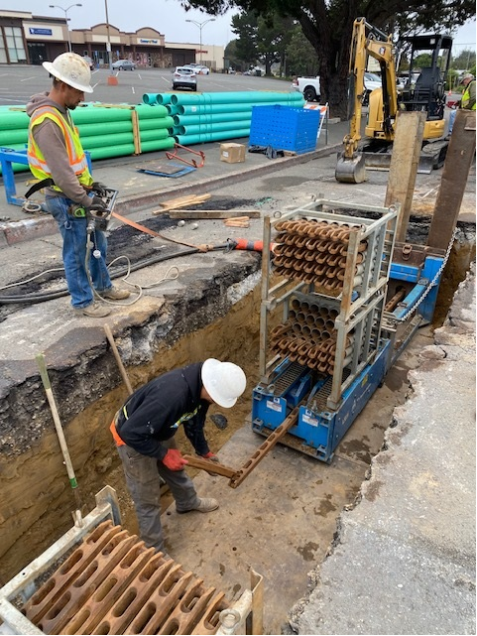
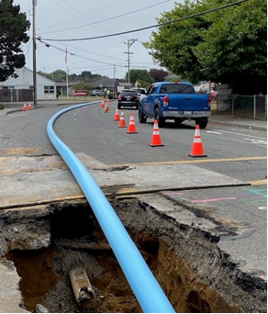
Excavations and Pipe Bursting
Set Up - Water

Slide 15
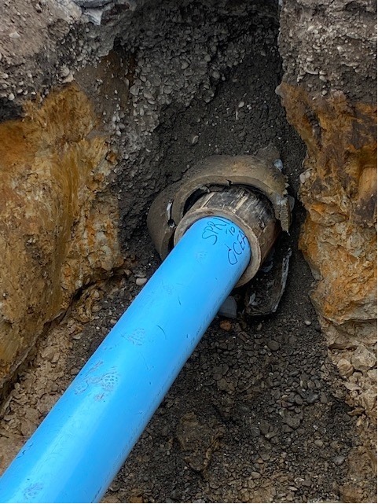
Pipe Bursting - Water

Slide 16
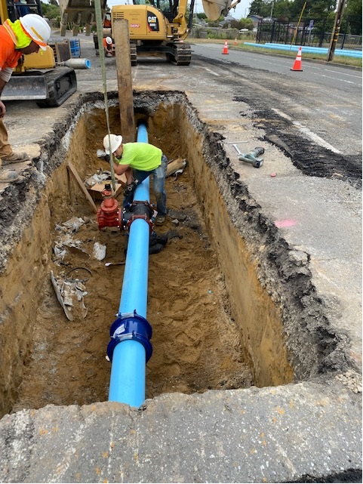
Water Main - reconnects

Slide 17
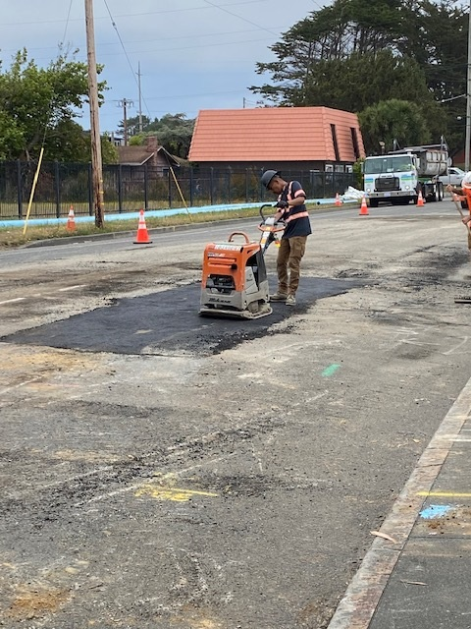
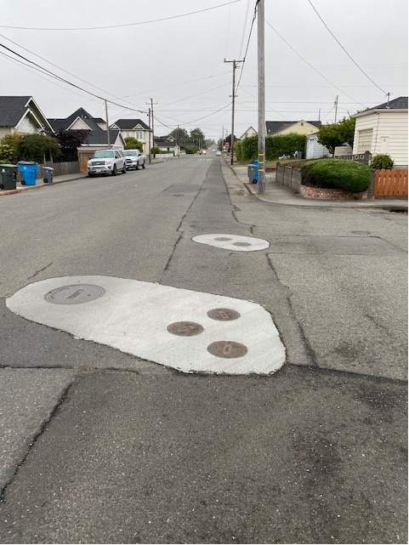
Water Main - resurfacing
Open Cut
Pipe Bursting

Slide 18
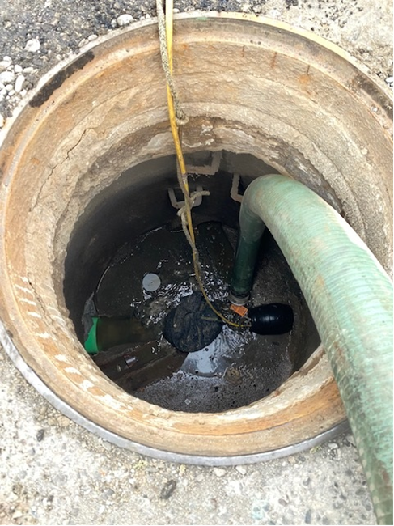
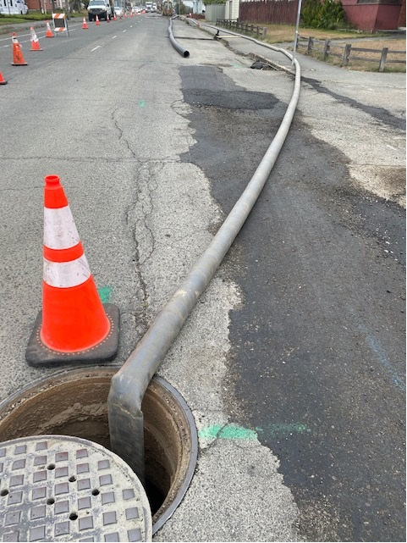
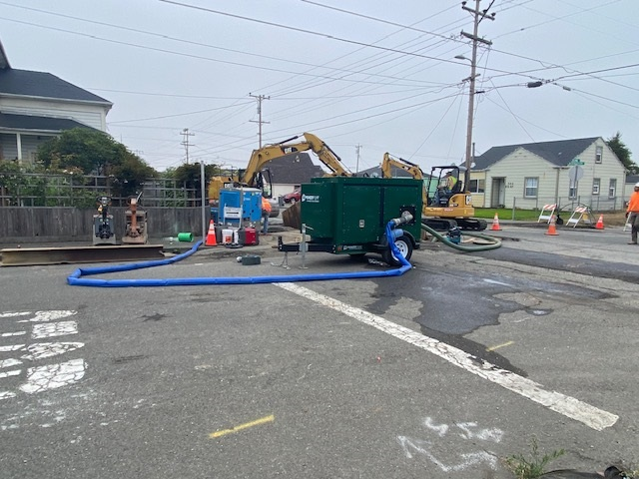
Construction – Sewer Mains
Temporary Bypass System

Slide 19
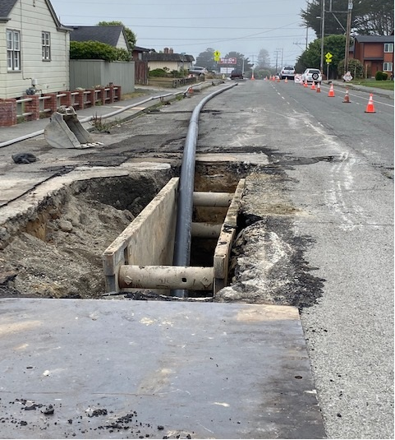
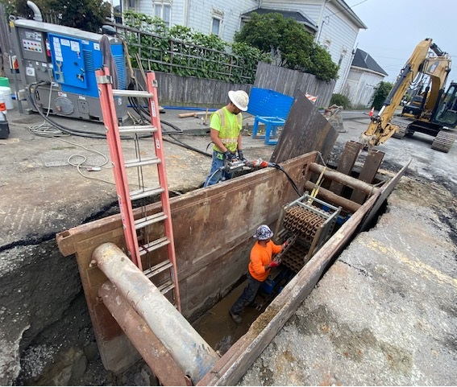
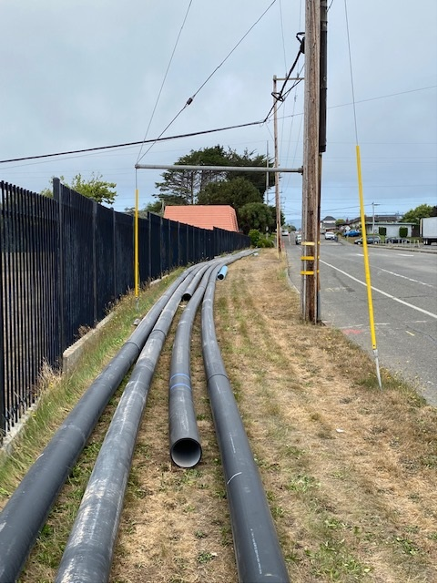
Excavations and Pipe Bursting Set Up – Sewer

Slide 20
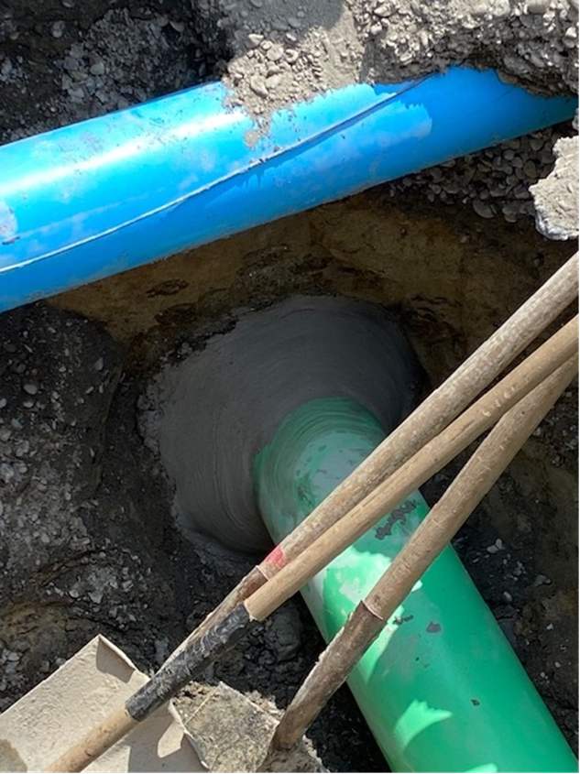
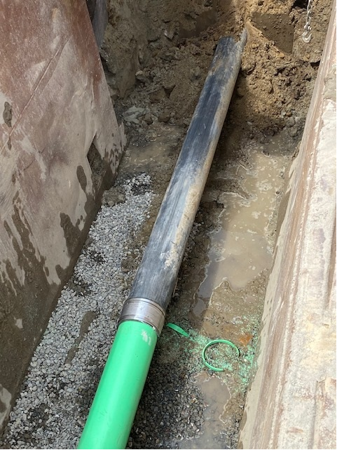
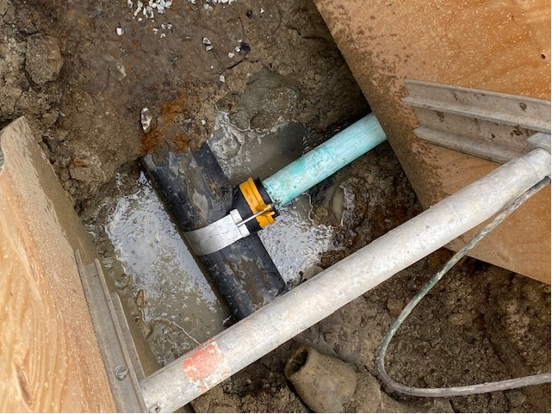
Sewer main - reconnects

Slide 21
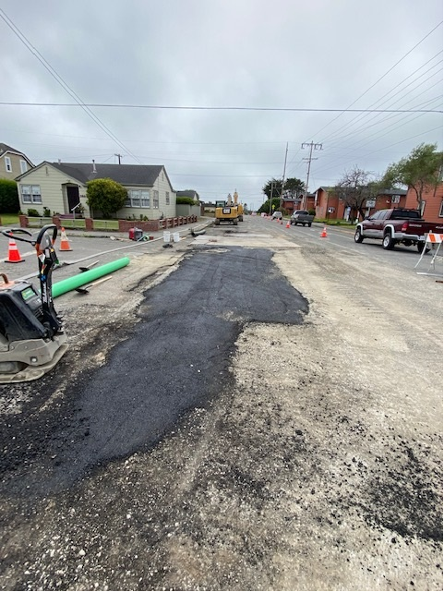
Sewer Main - resurfacing

Slide 22
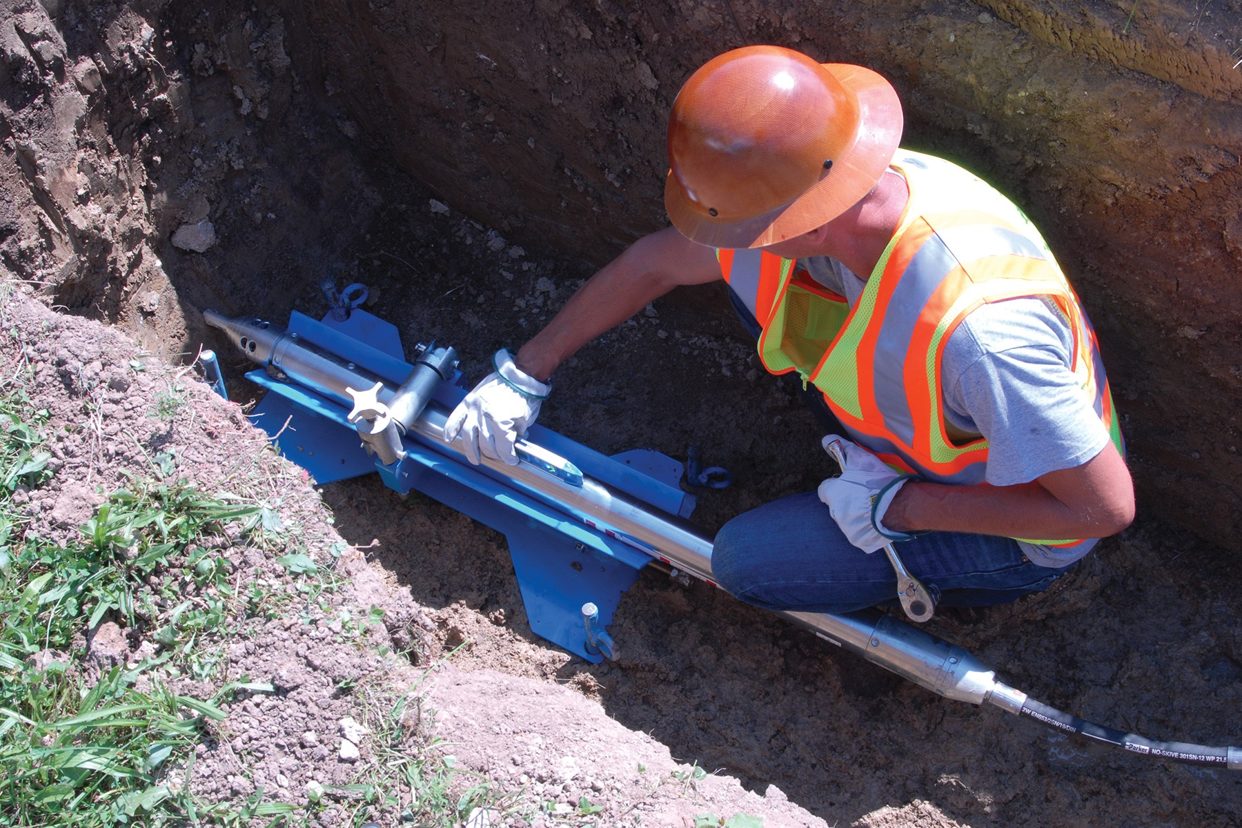
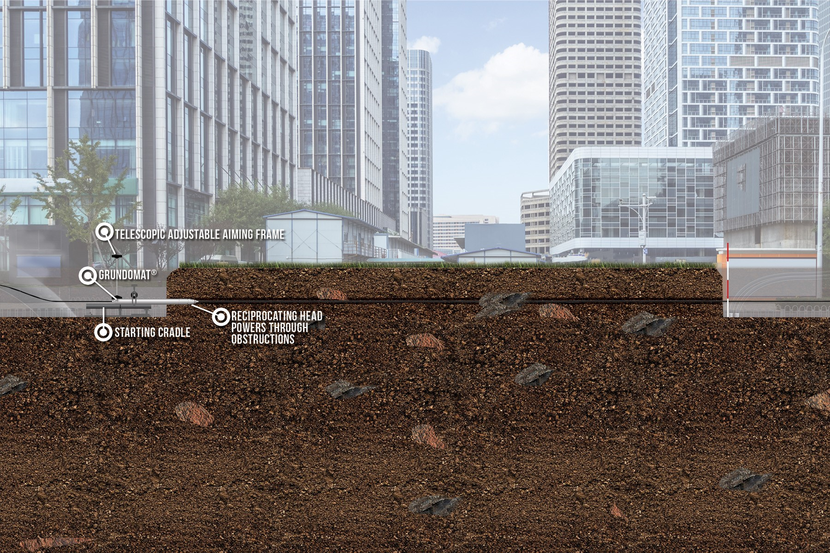
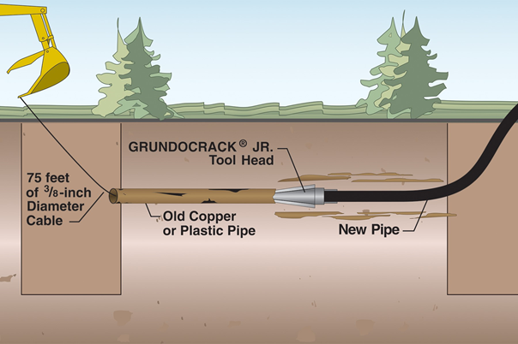
Trenchless Water Service Replacements

Slide 23
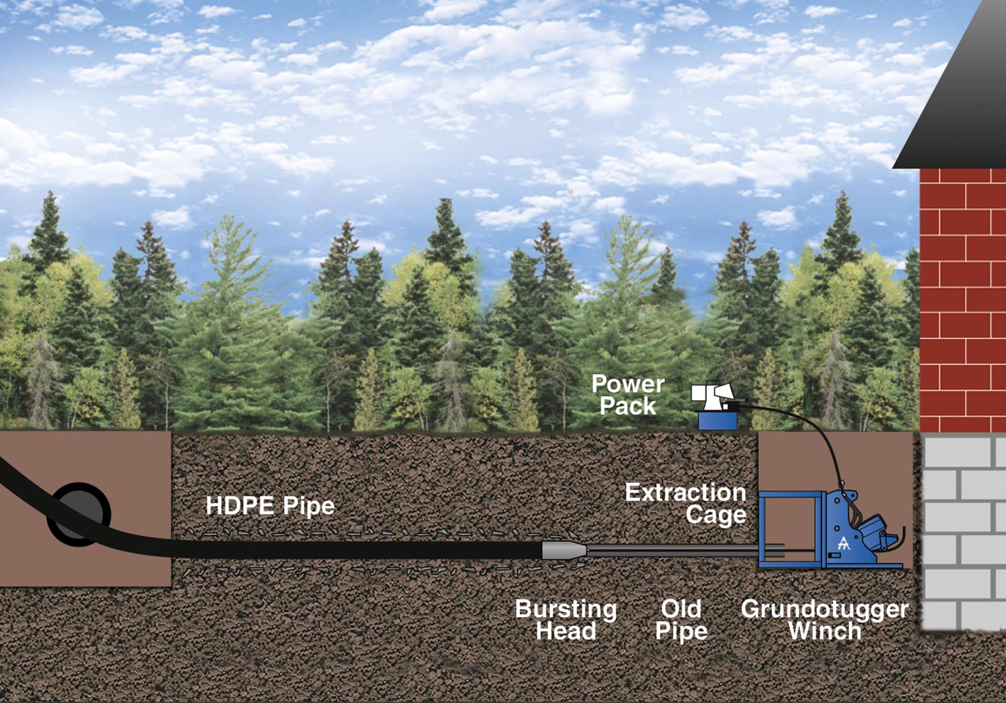
Trenchless Sewer Service Replacements

Slide 24
Pipe Bursting Productions
Pipe Runs: 180-feet to 350-feet lengths of pipe
1 to 2 runs per day
About 3 hours to push out rod and pull back 300 feet
Reconnect, backfill, and pave each day
8 - person crew (3 - persons Pipe Burst, others prep & close)
7:30 am to 3:30 pm (8 - hour workdays)
Extremely efficient Contractor and Crew

Slide 25
Summary
Trenchless method of Pipe Bursting:
Applicable to both water and sewer
Apply to not only mainlines but, also service laterals
Choices available for new pipe materials and fittings
Productive, less disruptive, less emissions, and less expensive than open cut
Savings of 25% - $800,000 in this case

Slide 26
Questions?
George Mallakis
TT Technologies, Inc.
Mike Garrett
Underground Solutions, Inc

