Slide 1
Introducing iHydrant®
Powerful Analytics. Actionable Insights.

Slide 2
Why Pressure and Temperature Monitoring is Important
ASCE’s 2021 Infrastructure Report Card
There is a water main break every two minutes, and an estimated 6 billion gallons of treated water lost each day in the U.S.
That is 2.19 Trillion Gallons Lost Annually
The U.S. lost an estimated $7.6 Billion of treated water in 2019 due to leaks
AWWA Study
Minor breaks sit in the ground, on average, for a year and a half.
Writing in the journal Nature Sustainability
An international team of researchers says thieves steal between 30% and 50% of the planet’s water supply every year

Slide 3
Who is iHydrant®?

Slide 4
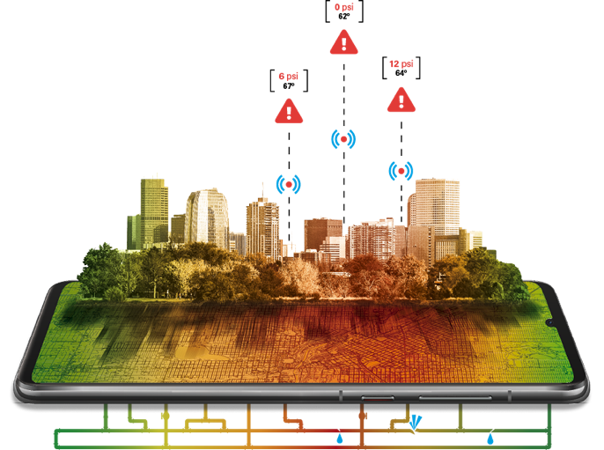
iHydrant® is a subsidiary of McWane, Inc.
About iHydrant®
“
Leading global manufacturer of ductile iron pipe, valves, hydrants and fittings
Founded in 1871
2012 Enters Technology Markets (Smart City Infrastructure)
iHydrant® sister companies include:

Slide 5
About the Technology
Remote Pressure and Temperature Monitoring
Wet and Dry Barrel Hydrants
Robust Hosted Interface
Detailed Records
Alerts
Mapping of Remote Hydrant Monitors
iHydrant Return on Investment
Prevents and/or Alerts of Water Loss Events in Real Time
Operational Optimization
“

Slide 7
Benefits & Solutions
Reduce Non-Revenue Water and Water Loss
Nighttime main breaks
Water theft
Contractor breakage
24/7 alerts and alarms
Operational Optimization
Pump patterns
Energy cost savings
Line stress and transient – extended life
“
Main break, OR

Slide 8
Benefits & Solutions
Identify and repair/replace malfunctioning valves/components
Actuators
Throttled/broken valves
PRVs
Improved customer service
Decrease response time
Water-loss reduction
Reliability of repairs
Decrease liability
Road and property damage
Flooding
“
Installation, NY

Slide 9
iHydrant® Benefits & Solutions
Hydraulic modeling
Increased accuracy with calibration
Data availability
Temperature monitoring
Water source optimization
Reduce necessary flushing due to water quality
Fire events
Pressure availability confirmation
Operational performance
iHydrant® impact for LADWP in first 9 months:
Over 3.5 million pressure samples
4,210 pressure alarm events (LADWP defined thresholds)
725 alarm events over 200 PSI; 432 alarm events below 30 PSI

Slide 10
Procurement Strategies
Contracts and Specifications
Engineering contracts
Eliminate need for manual reads
Incorporate technology into contracts
Specifications and repair contracts
Hydrant replacement contracts
CIP projects
Standard specifications

Slide 11
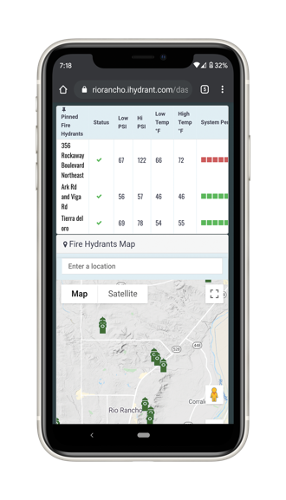
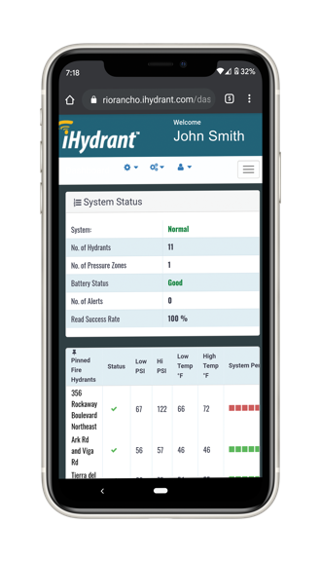
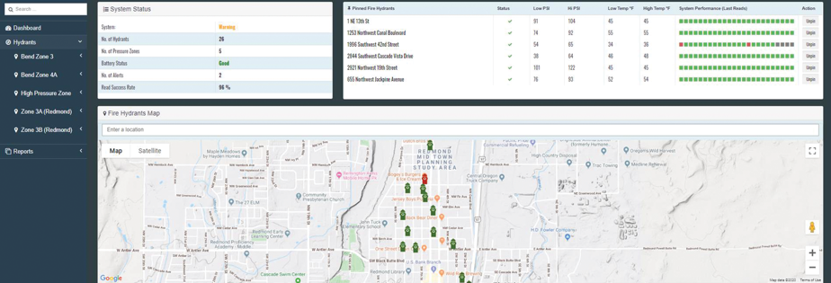
iHydrant® Mobile Compatibility
Compatible on desktop, laptop, tablet or mobile device

Slide 12
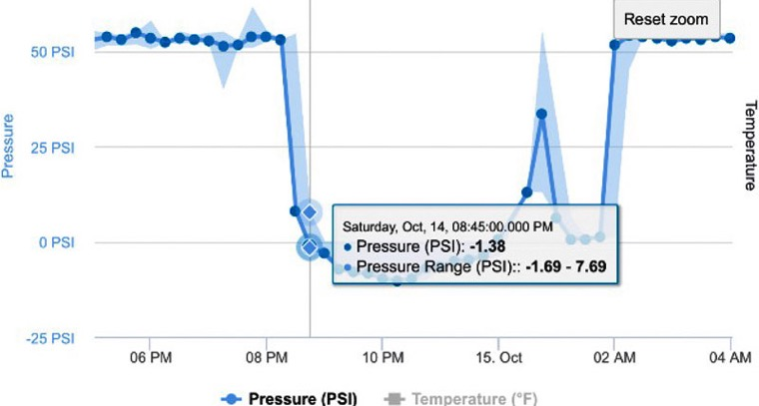
iHydrant® San Francisco Main Break
San Francisco, CA Main Break
Oct 14, 2017, with negative pressure

Slide 13
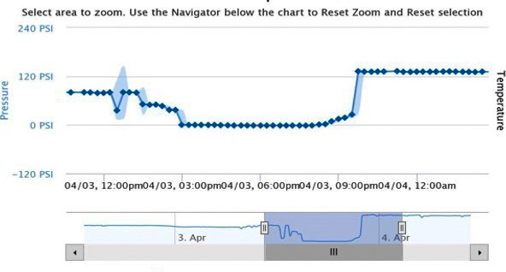
iHydrant® West Springfield Case Study
West Springfield PRV Failure
April 03, 2020, PRV failure

Slide 14
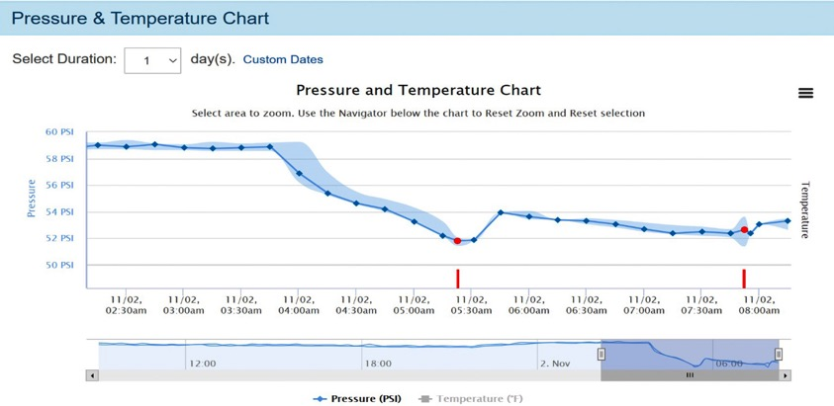
iHydrant® Indiana Main Break

Slide 15
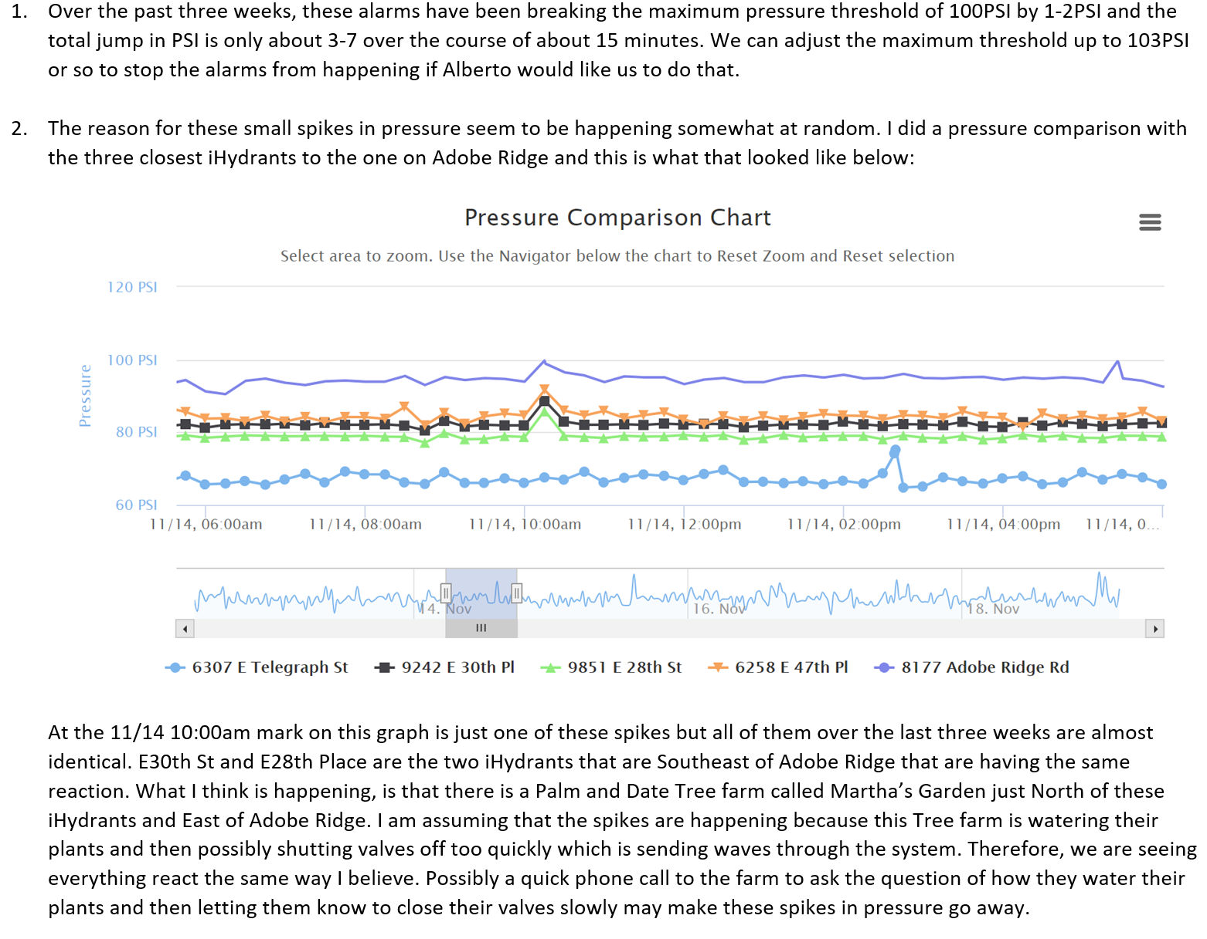

Slide 16
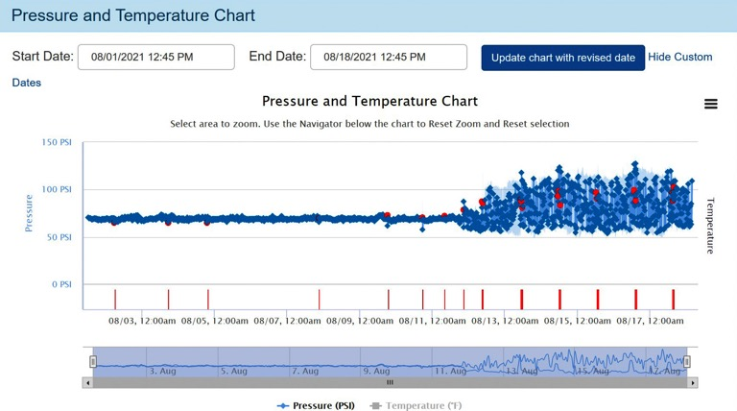
iHydrant® PRV Failure – w/ Transient Data

Slide 17
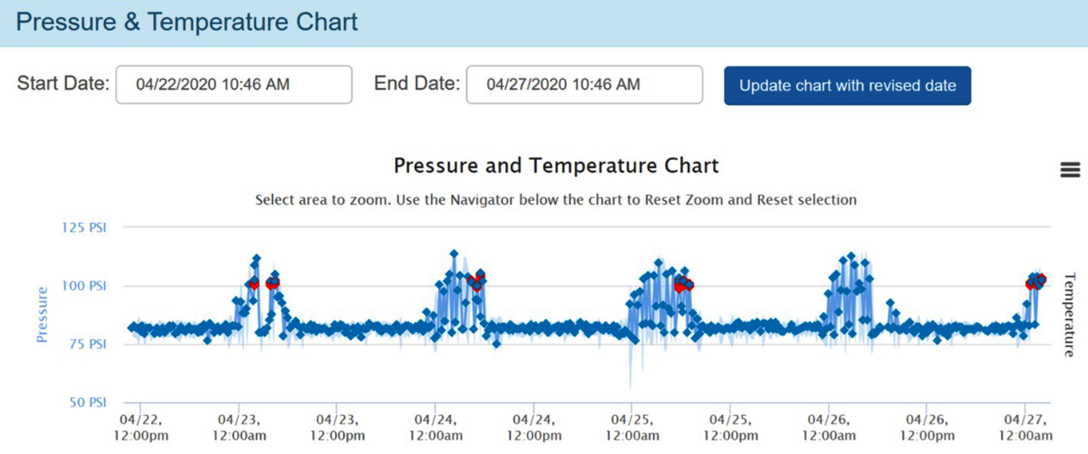
iHydrant® Massachusetts Case Study

Slide 18
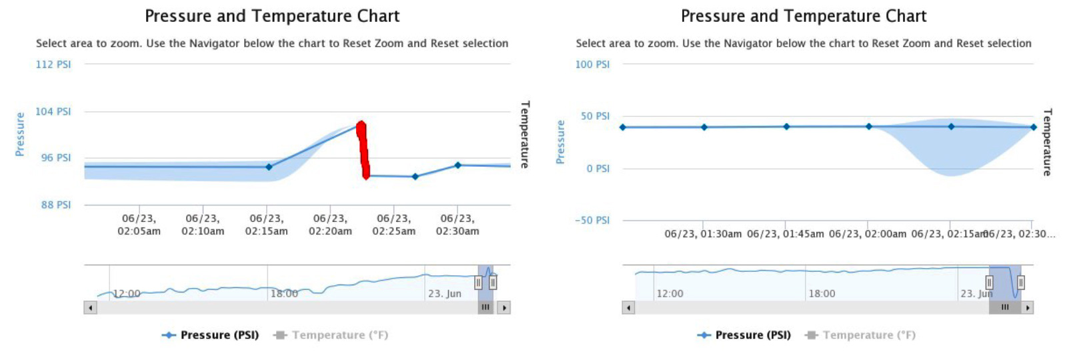
iHydrant® Vermont Case Study

Slide 19
iHydrant® Vermont Case Study

Slide 20
The iHydrant® Difference

Slide 21
The iHydrant® Difference
Maintenance
Battery access
Access Points
No digging or tapping
No depth limitation
Utilizes distribution system components
Existing hydrants – retrofit kits
New hydrant – complete factory kits
Mechanical
Sensors located in lower valve plate (dry barrel)
Patented OEM design
Normal hydrant operation
No impact to fire department or operations
No reduction in flow

Slide 22
The iHydrant® Difference
Accuracy
iHydrant +/- 1%
Certifications
ULFM and NSF
Alerts
24/7 alerts via text or email
Transient Detection
Samples multiple times per second
Data captured pre- and post-event
Data Backhaul
Zero infrastructure required
iHydrant CAT M1
Verizon & AT&T
Expandability
Additional batteries
Future technology

Slide 23
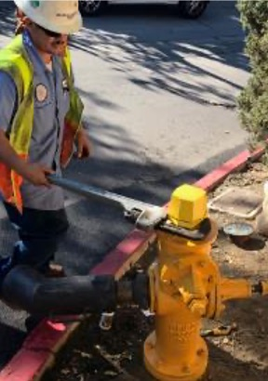
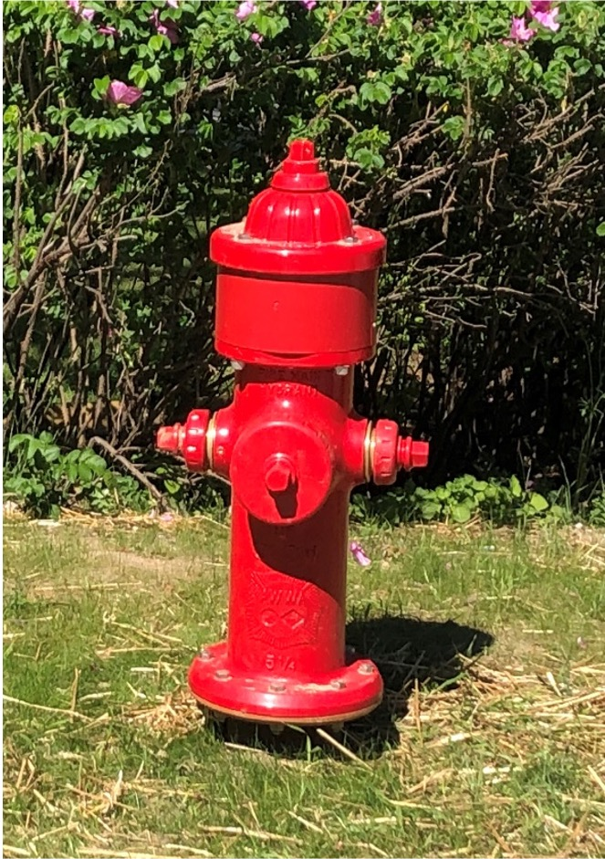
About the Solution
Normal hydrant operation
iHydrant installation
No pipeline taps required
Wet barrel – 15 minutes
Dry barrel – 45 minutes
iHYDRANT® | INSTALLATION, LADWP
iHYDRANT® | INSTALLATION, VERMONT

Slide 24
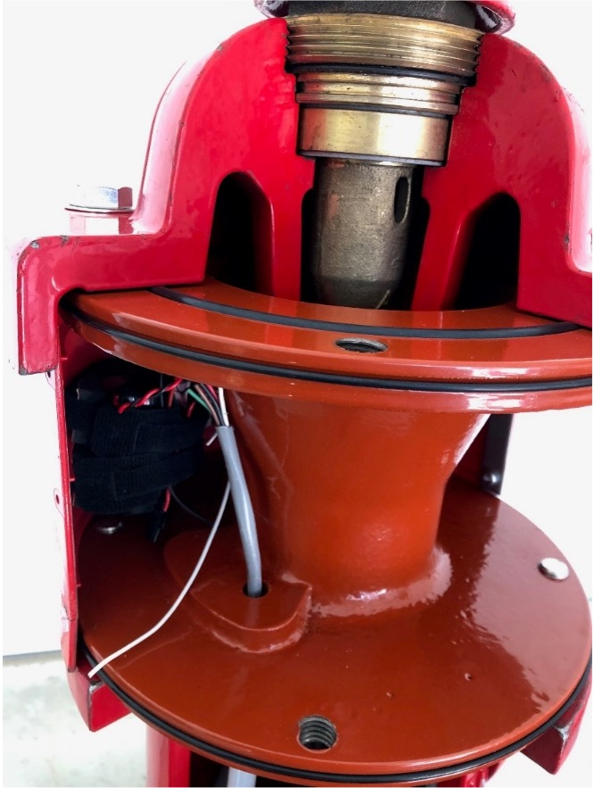
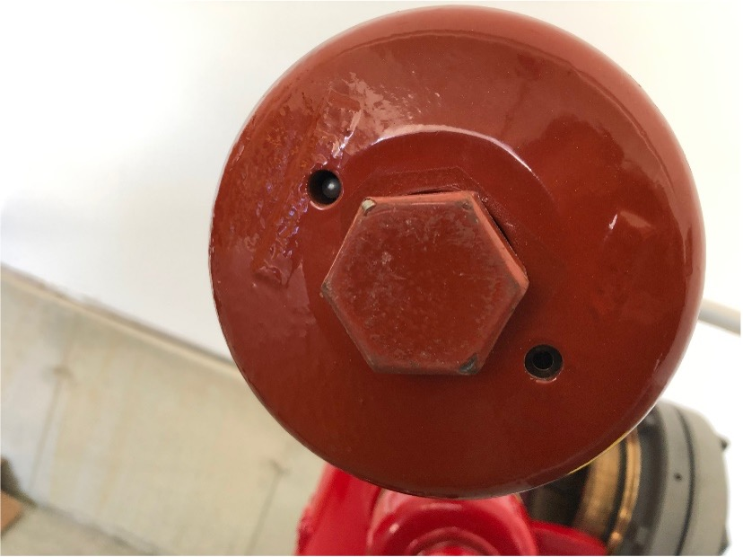
About the Solution
Normal hydrant operation
iHydrant installation
No pipeline taps required
Wet barrel – 15 minutes
Dry barrel – 45 minutes

Slide 25
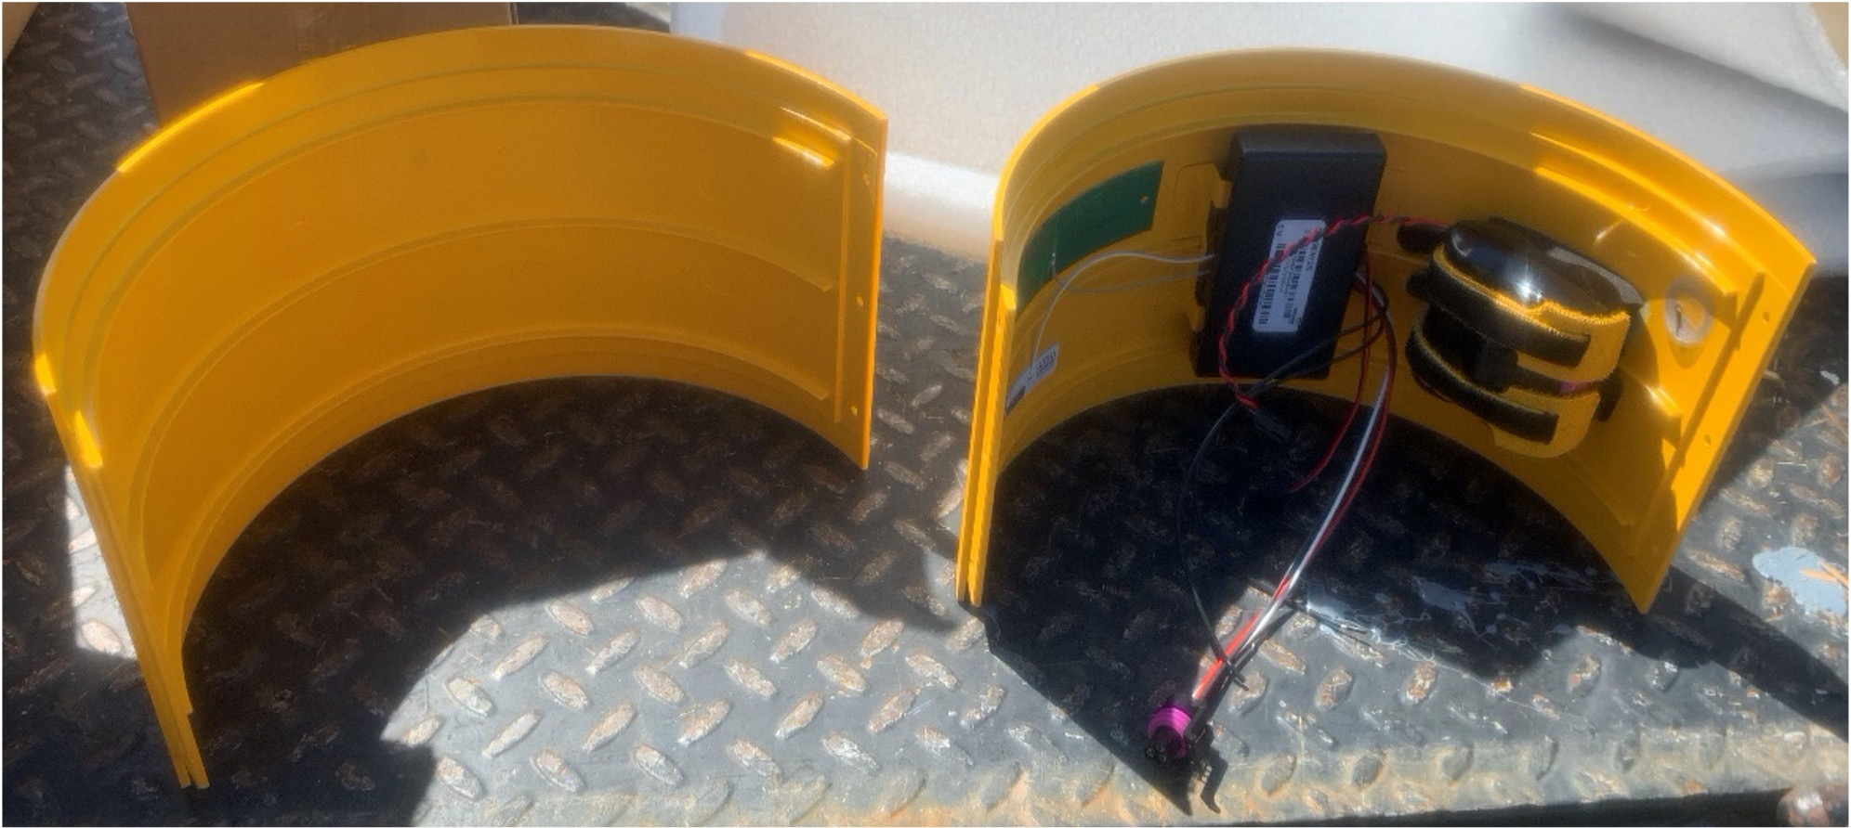
iHydrant® Interior View
iHYDRANT® | INSIDE SHELL VIEW

Slide 26
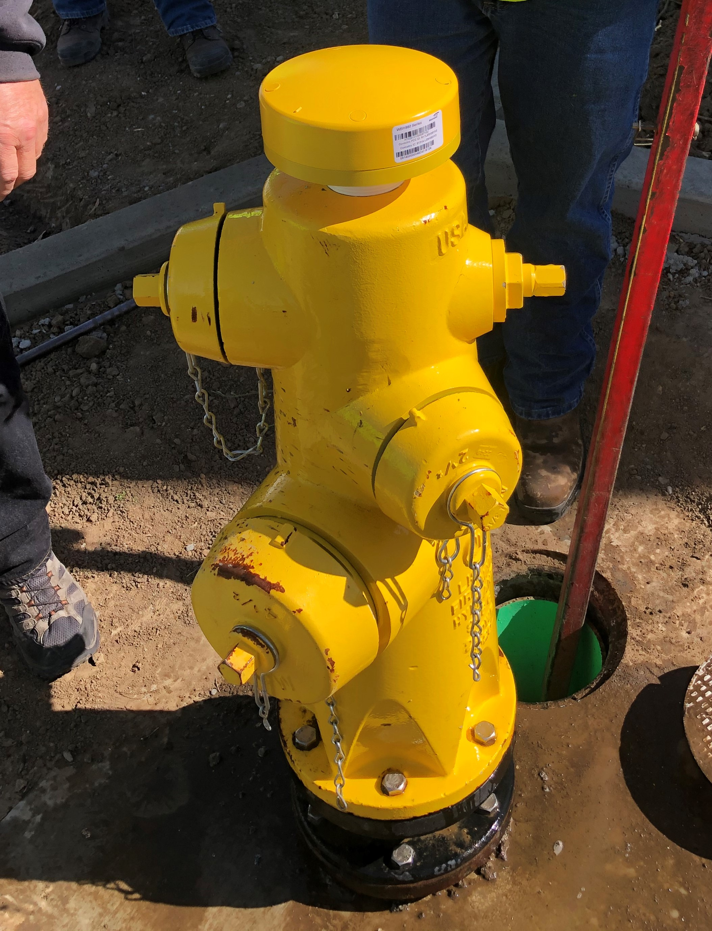
iHydrant® Round Wet Barrel Unit

Slide 27
Data Availability
Desktop and Mobile User Interface
API
Import into SCADA
FTP
Flat file upload

Slide 28
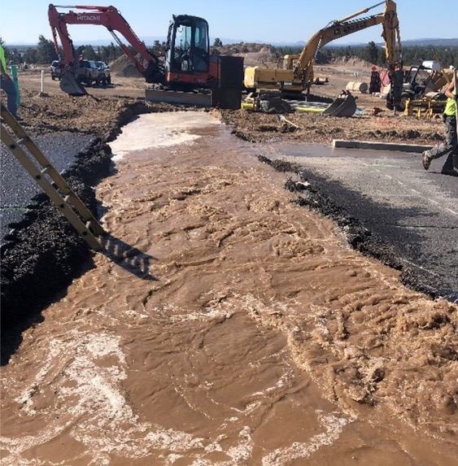
Event Detection and Identification
Advanced Software Analytics
Triangulation and pinpointing
Transient detection
Pressure data
Leak detection
Leak and pressure data
Shading on map post-event
System troubleshooting for customers
Propagation map of system

Slide 29
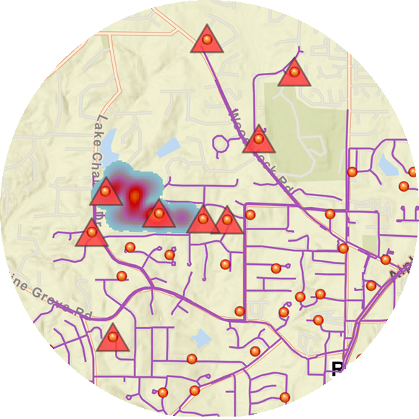
Heat Map
How does the Heat Map work?
Requires minimum of 3 alarming iHydrants in close proximity to each other to detect an event (full system coverage)
Uses time synchronization between the alarming hydrants to triangulate and formulate an approximate area for origination of event

Slide 30
Thank you.
Colin Reardon| Field Service Engineer Colin.reardon@ihydrant.com 330.502.1270

