Slide 2

Chlorine Options…
What’s Best for You?
May 25, 2023
Dan Mohr

Slide 3
3 Major Sources of Chlorine
Gas Chlorine
Sodium Hypochlorite
Calcium Hypochlorite

Slide 4
Chlorine Disinfectants:
Chlorine gas:
Cl₂ + H₂O HCl + HOCl
Liquid Soda Bleach:
NaOCl + H₂O NaOH + HOCl
Calcium Hypochlorite:
Ca(OCl)₂ + 2 H₂O Ca(OH)₂ + 2 HOCl
(All three produce the same active sanitizer. HOCl Disinfects, Sanitizes and Residual Protection)

Slide 5
Chlorine Disinfection Technologies
Chlorine Gas
Sodium Hypochlorite Liquid
On-site Generation (OSG)
Calcium Hypochlorite Tablets

Slide 6
Chlorine System Applications
Primary Treatment
Remote Well Sites
Supplement for Ozone
Booster Stations for large networks
Wastewater Disinfection
Backup to UV

Slide 7
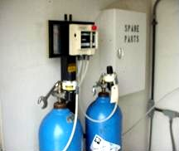
Chlorine Gas
100% Available Chlorine
pH = 0.2
Cl₂ (gas)
Stored in cylinders
Liquefied gas cooled under pressure

Slide 8
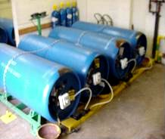
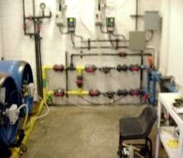
Chlorine Gas
Advantages
Excellent Residual Protection
Taste and odor control
Effective and accurate application
Lowest cost on per pound basis
No degradation upon storage

Slide 9
Chlorine Gas Disadvantages
Safety concerns
Public awareness
Expensive auxiliary equipment
PSM/RMP administrative requirements
Manpower Costs
Liability
SCBA, Leak Detector, Automatic Shutoff Valves, Scrubbers, Annual
training.

Slide 10
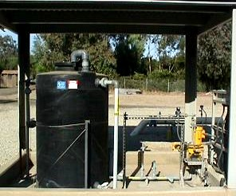
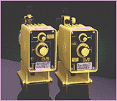
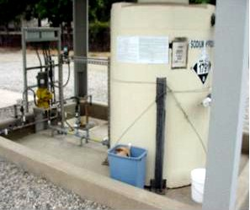
Sodium Hypochlorite

Slide 11
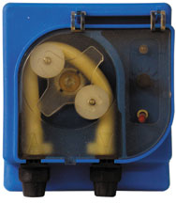
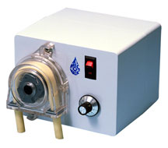
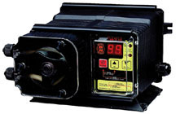
Chlorine Delivered via Peristaltic
Metering Pump

Slide 12
Sodium Hypochlorite
Disadvantages
Safe handling concerns- leaks, splash, & spills
Corrosive liquid & fumes – pH 13
Requires double containment
Scaling of injector due to high pH
Cumbersome to transport – 55 Gal Drum – 550Lbs
Off-gassing can cause vapor lock of pump
Higher material cost than gas chorine, $2.20 to $4.50 per gallon (Lb)

Slide 13
Temperature Effects on the
Decomposition of Liquid Bleach

Slide 14
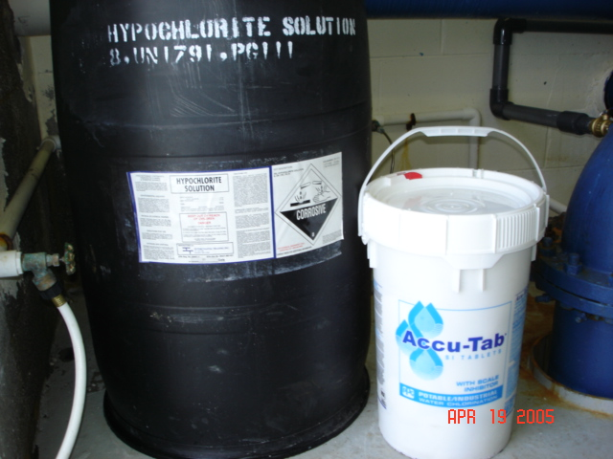
Drum vs Pail

Slide 15
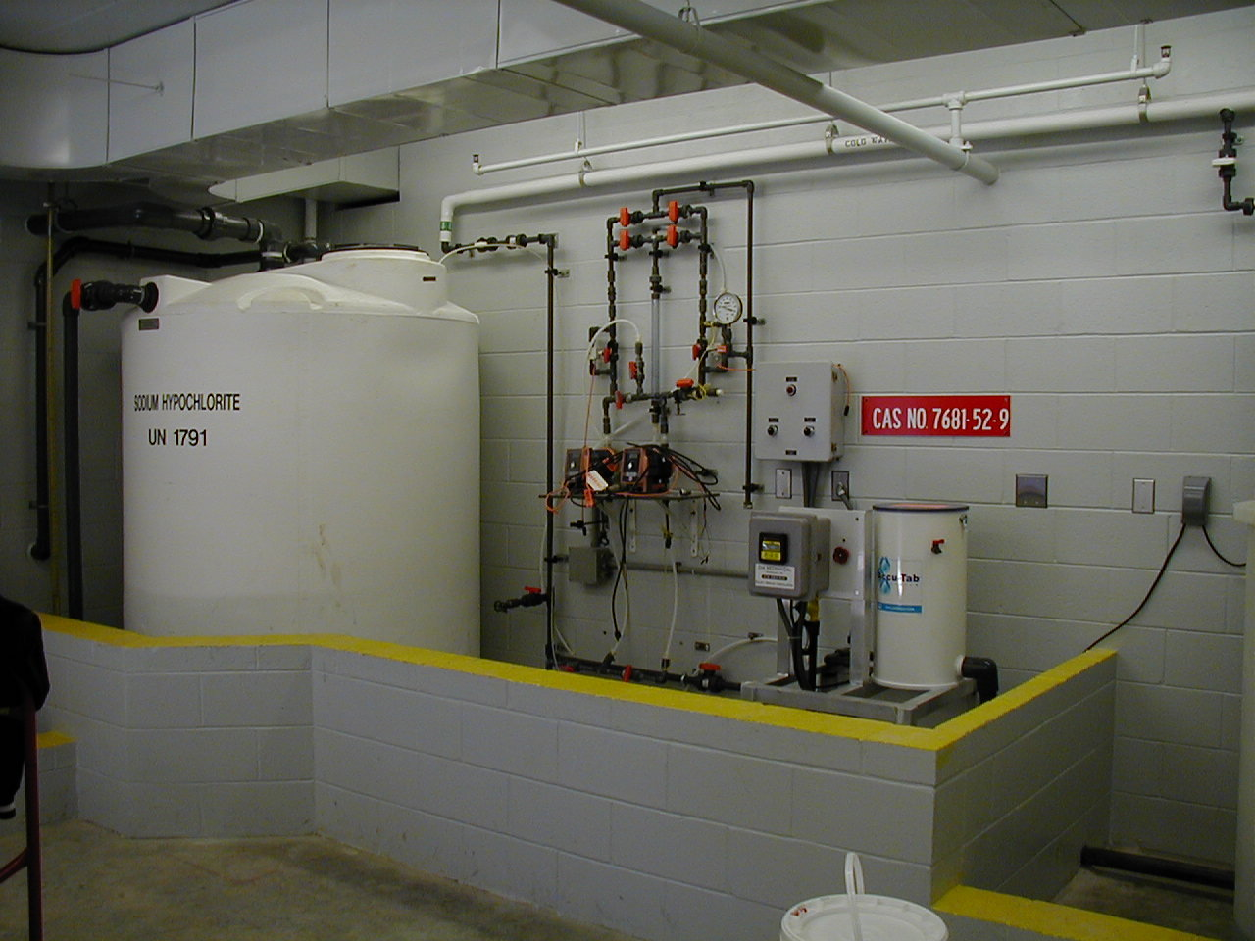
Bleach vs. Cal-Hypo:
3 MGD Treatment Plant

Slide 16
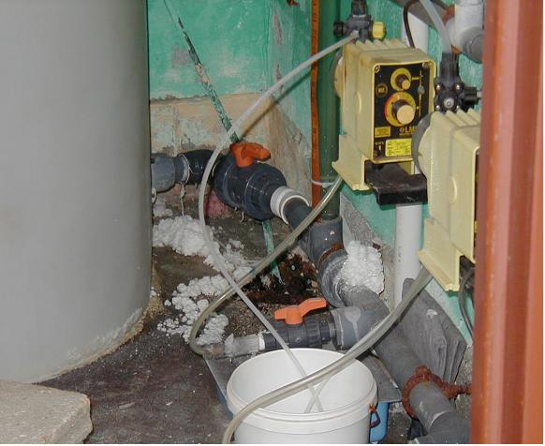
Cracked Plastic Tubing

Slide 17
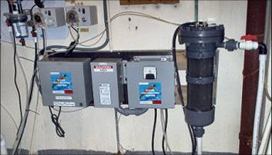
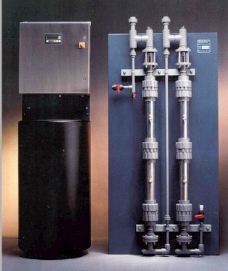
On-site Hypochlorite Generation

Slide 18
On-Site Hypo. Generator
Advantages
Low hazards chlorine solution, 0.8% Cl₂
No RMP reporting requirements
State-of-the-Art technology
No special emergency response training required

Slide 19
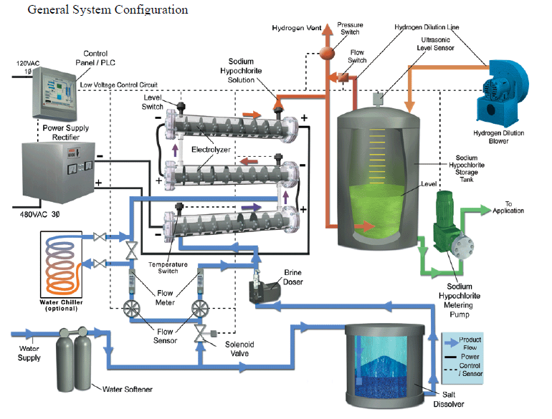

Slide 20
On-Site Hypo. Generation
Disadvantages
High capital cost, $20,000 for a 12#/day Unit
Requires salt storage; 3.5 lb/lb Cl2
Requires softening treatment of dilution water
Hydrogen gas off requires forced ventilation
System repair time could be lengthy depending on custom parts and problems, may need a back up chlorination system
Complex system requires high level of technical expertise
Cell efficiency is critical to operation

Slide 21
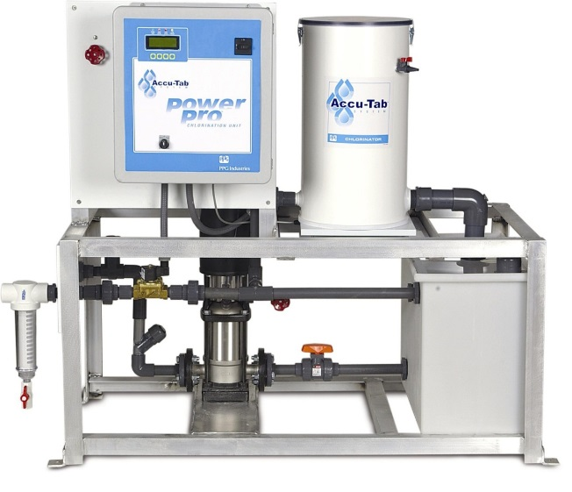
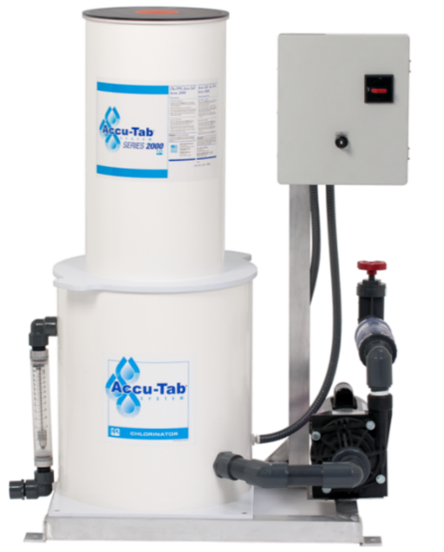
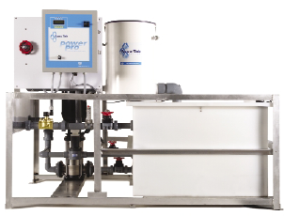
Accu-Tab® System – Tablet Chlorination
PowerPro System 2075P System
MD System

Slide 22
Accu-Tab® System
Accu-Tab® Tablet (calcium hypochlorite)
Accu-Tab® Chlorinator (erosion chamber)
Accu-Tab® PowerPro™ ,MD, or P System

Slide 23
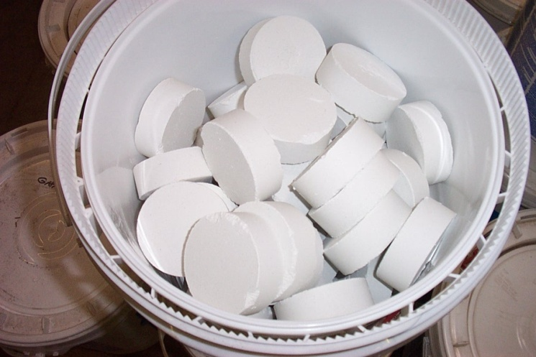
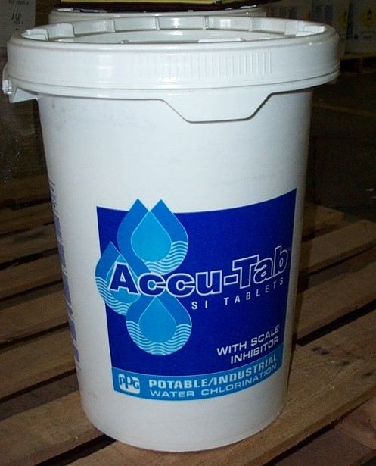
The Tablets - Accu-Tab® Tablets
Calcium Hypochlorite, 68.5% Cl₂
325 grams
3 1/8” in diameter
Manufactured for controlled erosion
Scale Inhibitor (SI) - Phosphate
60 lb...Plastic Drums

Slide 24

Accu-Tab Tablets
NSF 60 listed
Compact chemical storage
Dry, stable chlorine source
More neutral pH, less corrosive
No secondary containment
No risk management plans required

Slide 25
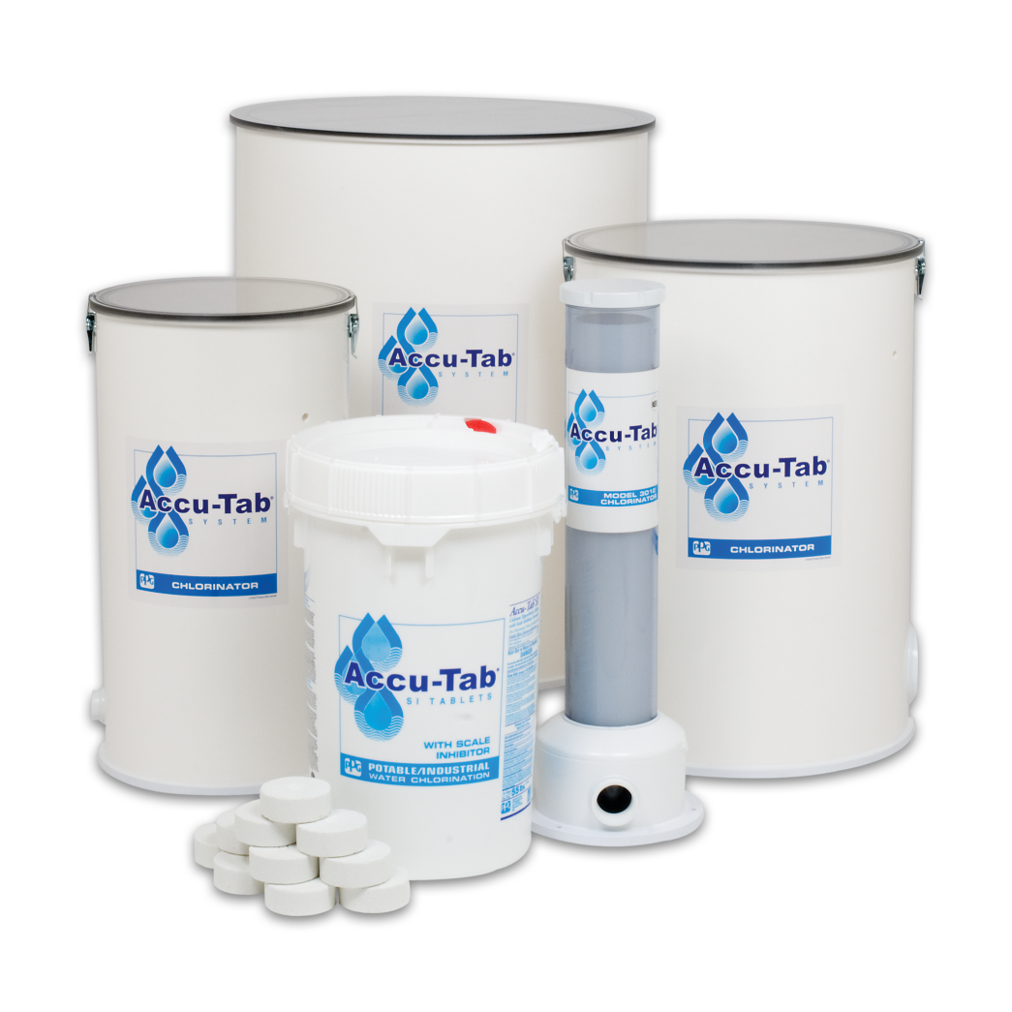
The Chlorinator - Accu-Tab Chlorinators

Slide 26
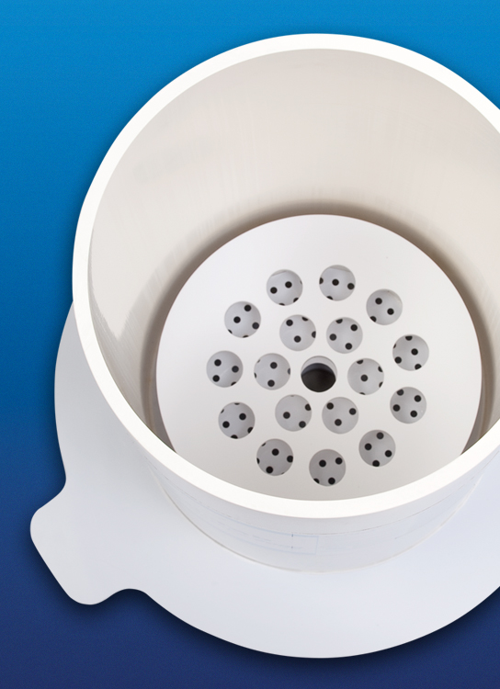
Accu-Tab Chlorinators
    The Accu-Tab® Chlorinator Advantage
    Engineered with rigid PVC
    Available in a variety of sizes
    Low maintenance
    Integrates easily with existing
    systems
    Durable Construction
    Accurate chlorine delivery

Slide 27
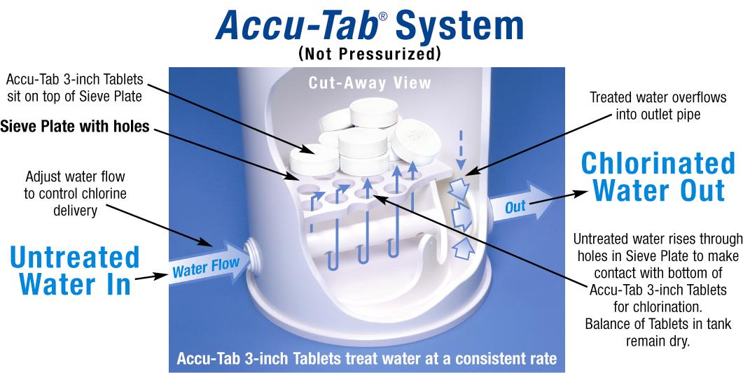
How is the Chlorine delivered…

Slide 28
Reduced Maintenance…Why?
Large orifices
Principal of dilution
Tablet technology
  Scale inhibitor
  Hard tablet
Self-flushing chlorinator design
Add no more than 1 week supply of tablets to chlorinator

Slide 29
Setting Chlorine Dosage - Example
GPM X PPM X 0.0005 = lbs. Cl2/hr
Lbs. Cl2/hr X 1.5 = lbs. Tablets/hr
1500 gpm flow, 1.5 ppm total Cl₂
1500gpm x 1.5ppm x 0.0005 = 1.12 lbs/hr Cl₂
Go to 1.12 on the rate delivery chart ≈ 12 gpm of water through the chlorinator

Slide 30
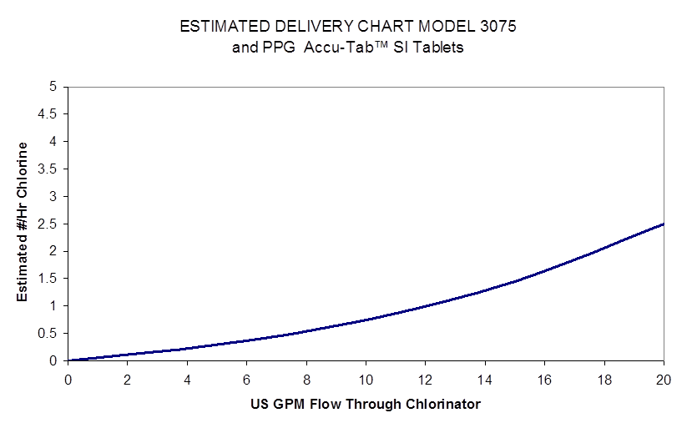
Chlorine Delivery Rate Chart

Slide 31
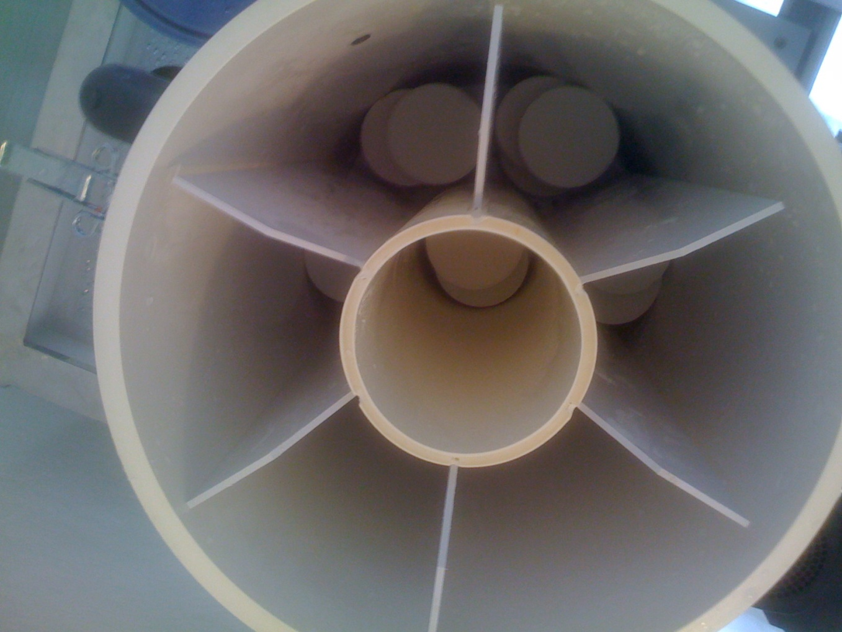
Stacking Insert

Slide 32
Delivery Rate with Stacking Cartridge

Slide 33

PowerPro System

Slide 34
SYSTEM DESCRIPTION – POWERPRO®
ATC 1000
3 Phase
Disconnect
Chlorinator
Electrical Box
And Panel
Flow Meters and
Flow Control
Gate Valves
HOA Switch
Pressure
Regulator
Chlorine
Solution
Out
Water
Supply
Weight Scale
W/Low Tablet Alarm
Pump
Prime
Valve
Solenoid
Valve
Hi Level
Sensor
Discharge Flow
Gate Valve
Discharge
Check Valve
Float
Valve
Inlet
Filter
Lo Level
Sensor
Solution tank
Discharge
Pump

Slide 35
SYSTEM DESCRIPTION – POWERPRO®
ATC 1000
3 Phase
Disconnect
Chlorinator
Electrical Box
And Panel
Flow Meters and
Flow Control
Gate Valves
HOA Switch
Pressure
Regulator
Chlorine
Solution
Out
Water
Supply
Weight Scale
W/Low Tablet Alarm
Pump
Prime
Valve
Solenoid
Valve
Hi Level
Sensor
Discharge Flow
Gate Valve
Discharge
Check Valve
Float
Valve
Inlet
Filter
Lo Level
Sensor
Solution tank
Discharge
Pump

Slide 36
Power Pro® System Options
Controller Integrated
  Flow pacing control
  Residual control
  Compound loop control
SCADA ready
Tablet scale*
Low tablet scale alarm*

Slide 37
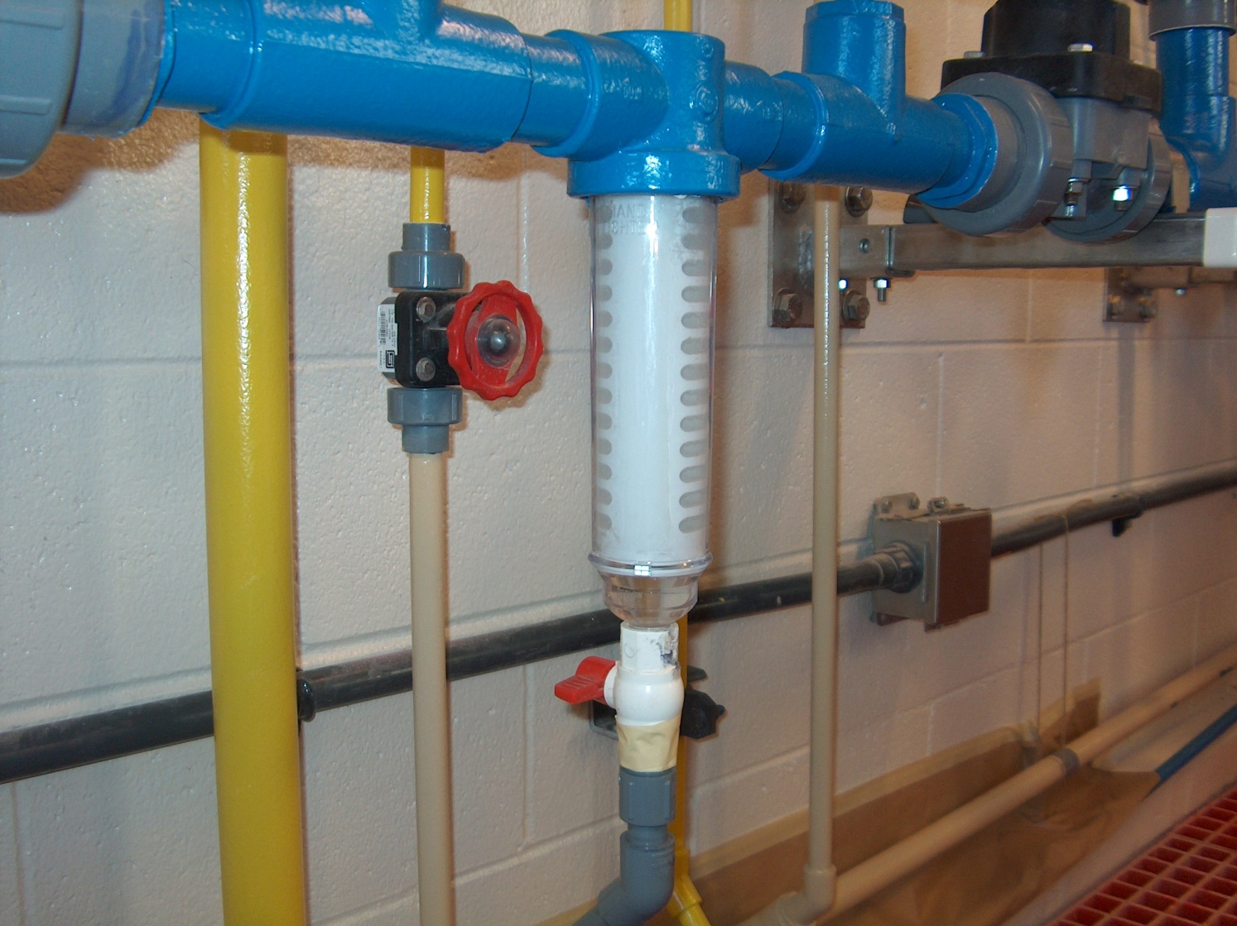
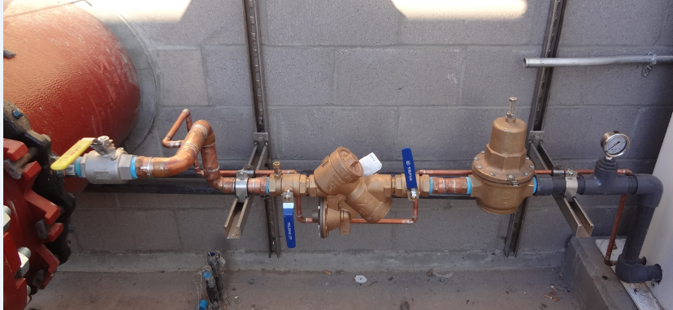
Detailed Component Description
Accu-Tab® PowerPro® System
Supply Water Line - Inlet Strainer
Pressure Regulator

Slide 38
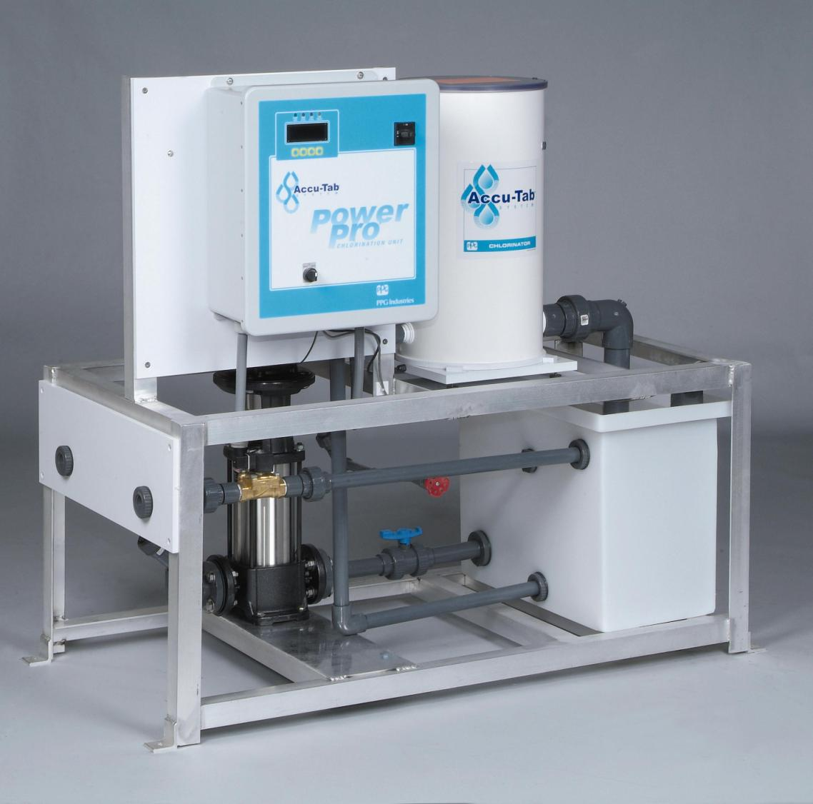
PowerPro System
Process
Controller
Cl2 Feed to System
Diluted Hypochlorite Solution Tank
Supply Water In
Notes:
Simple. Water in Water out.

Slide 39
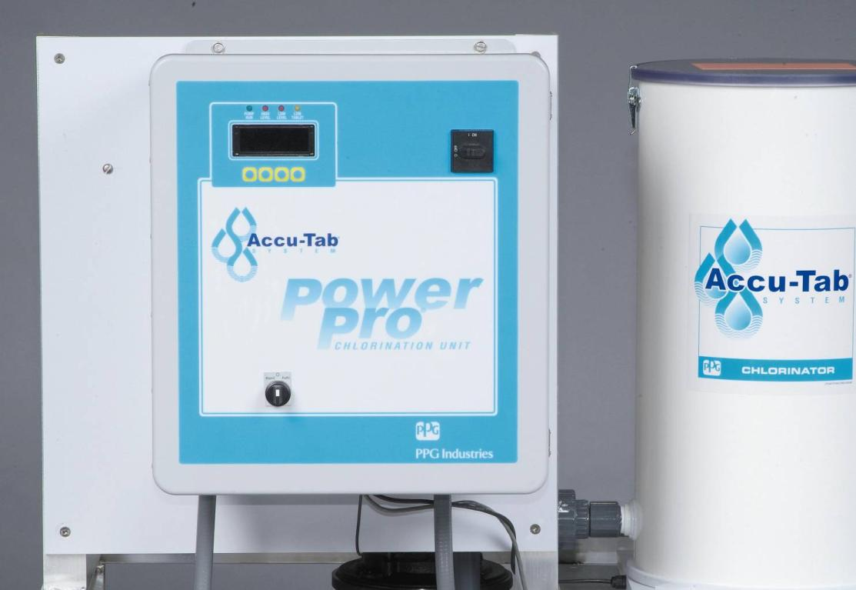
PowerPro System
Digital
Readout
Disconnect
Switch
Hand/Off/Auto
Switch

Slide 40
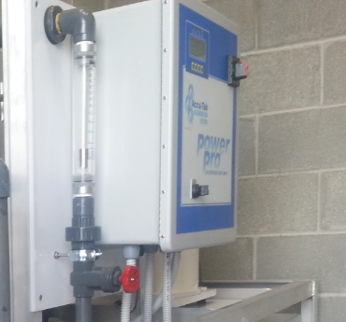
Chlorine Dosage Adjustment
Inlet Flow Meter
Flow Control Valve
Notes:
40
Simple. Water in Water out.

Slide 41
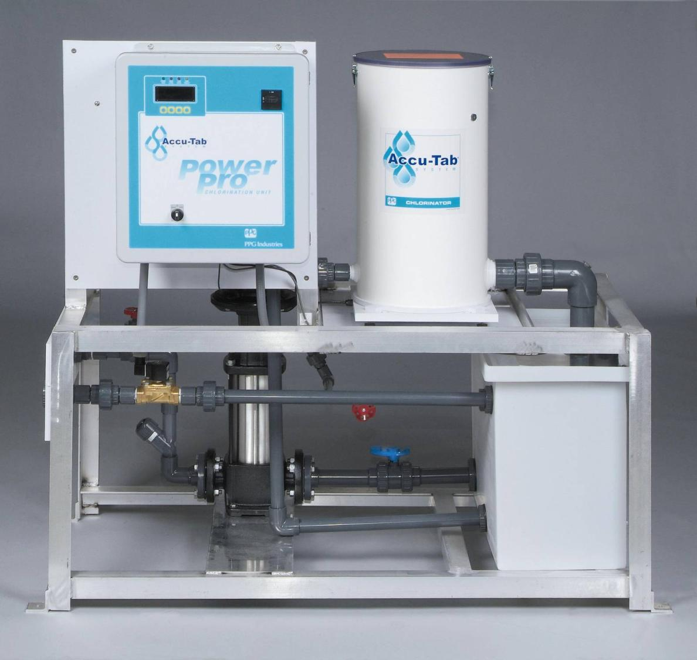
3” Calcium Hypochlorite Tablet Eroder
Aluminum
Frame
Injection Pump
Brass
Solenoid
Valve

Slide 42
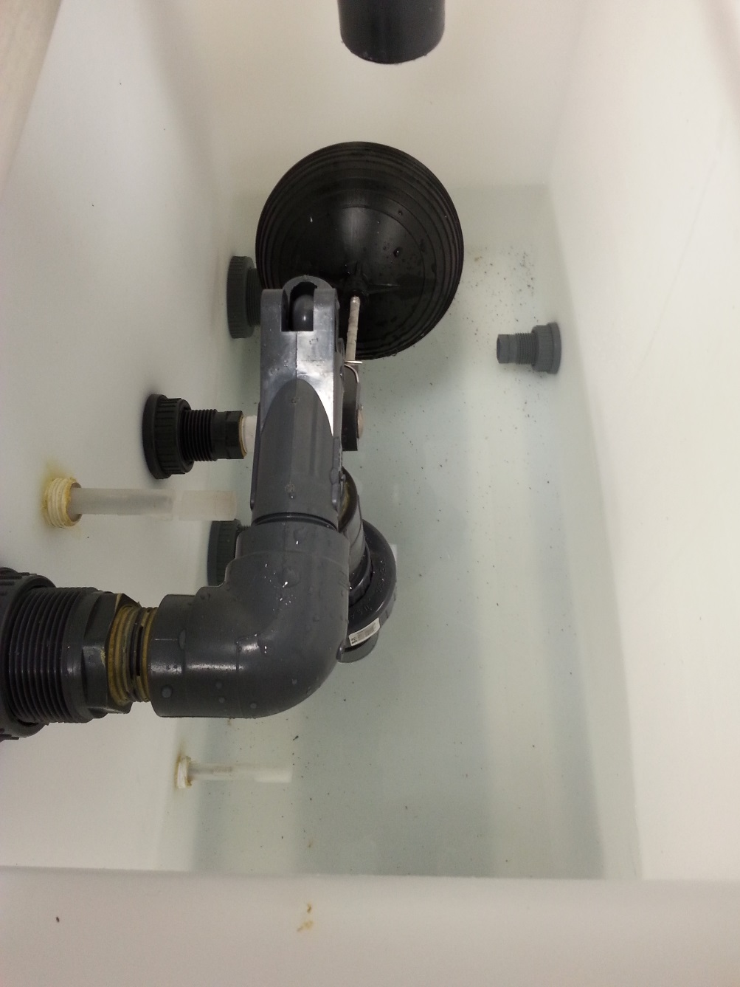
Solution Tank Internals
Hi Level
Solenoid
Shutoff
Tank Drain
Float Valve
Lo Level
Pump
Shutoff

Slide 43
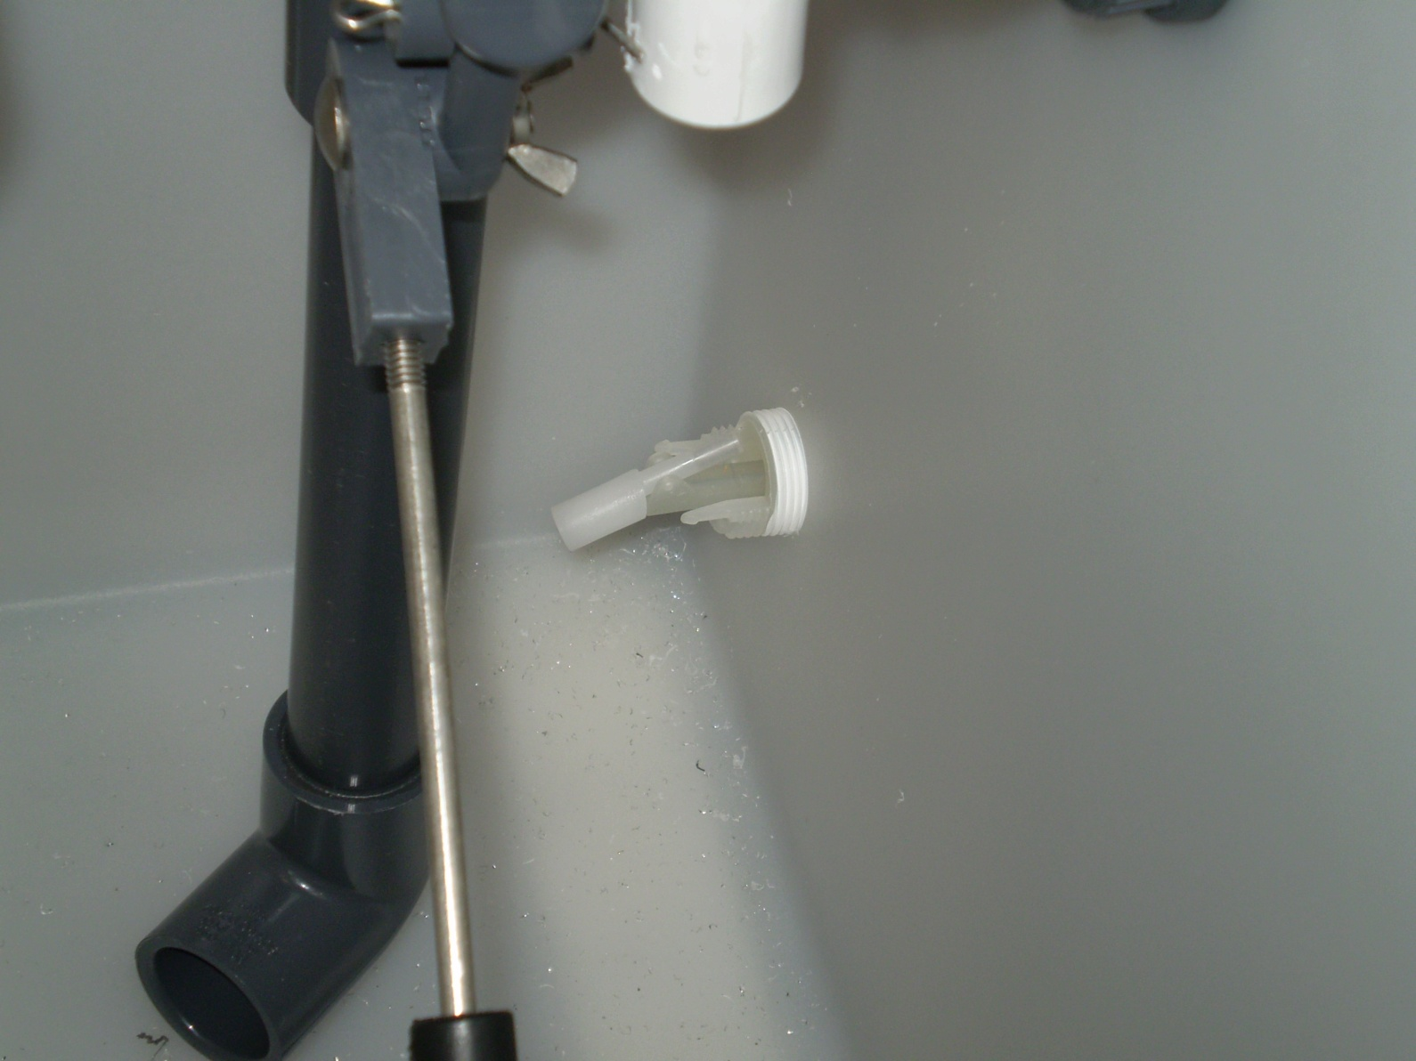
PowerPro Dilution Water Inlet

Slide 44
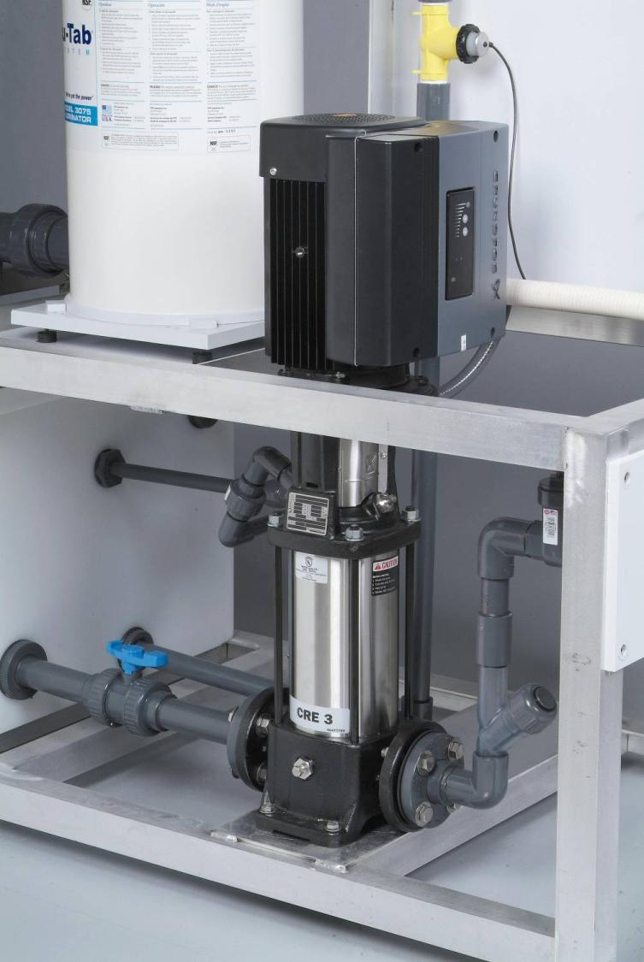
Vertically Mounted Grundfos
Pump with VFD
Tablet
Scale

Slide 45
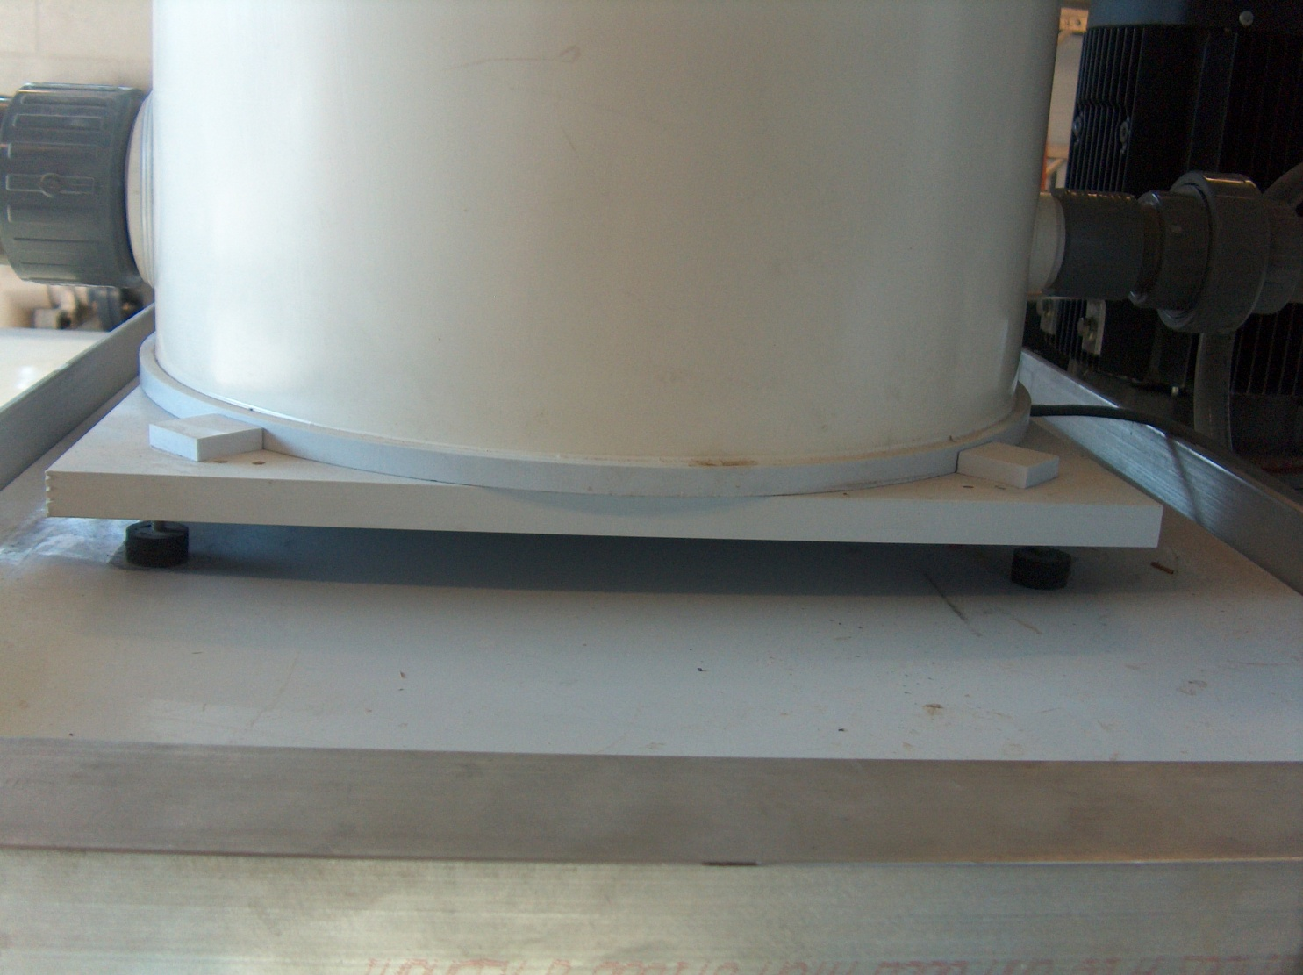
Digital Weigh Scale

Slide 46
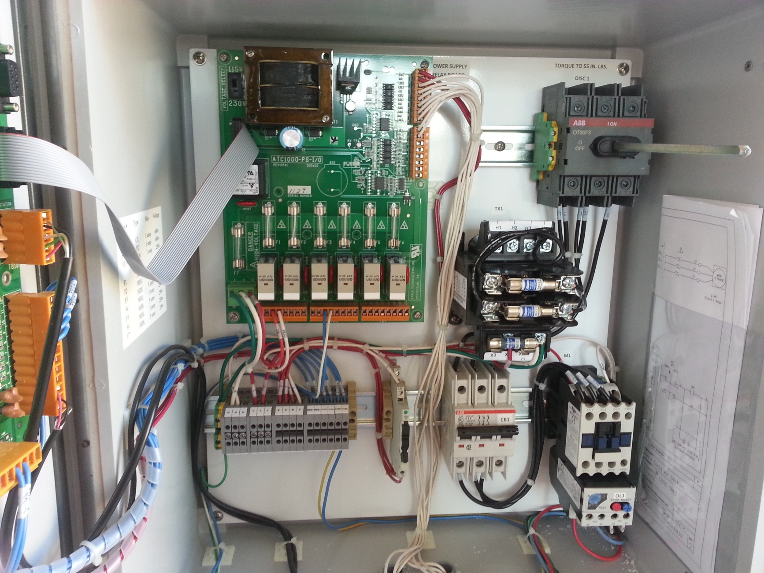
PowerPro Power Board

Slide 47
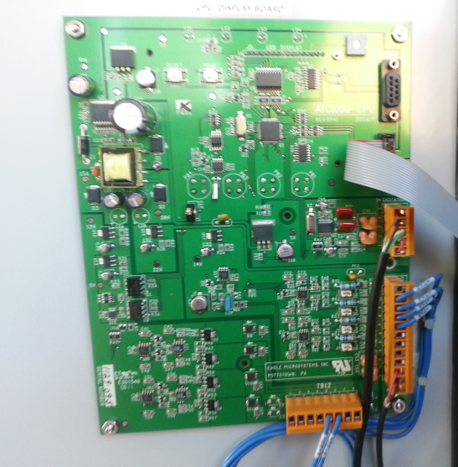
PowerPro Display Board

Slide 48
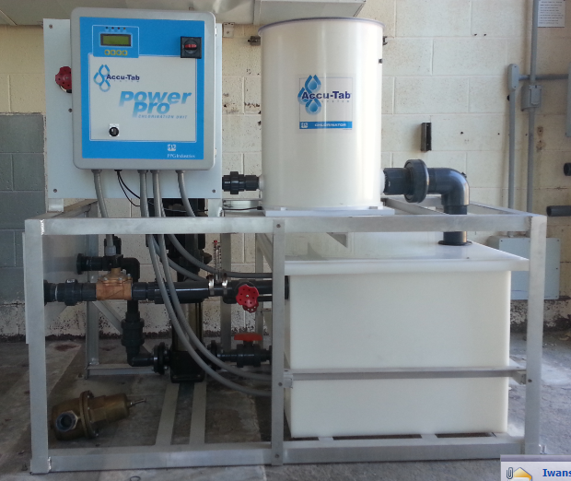
Accu-Tab® PowerPro MD System
Batch System
Constant Solution
Strength
Multiple Injection
Points Available
Very High Turn
Down Ratio

Slide 49
SYSTEM DESCRIPTION – POWERPRO® MD
ATC 1000
3 Phase
Disconnect
Chlorinator
Electrical Box
And Panel
Flow Meters and
Flow Control
Gate Valves
HOA Switch
Discharge Flow Meter
Field Installed
Pressure
Regulator
Ultrasonic
Level Sensor
Chlorine
Solution
Out
FM
Water
Supply
Weight Scale
W/Low Tablet Alarm
Pump
Prime
Valve
Solenoid
Valve
Hi Hi Level Sensor
Discharge Flow
Control Gate Valve
Discharge
Check Valve
Hi Level Sensor
Lo Level Sensor
Inlet
Filter
Solution tank
Lo Lo Level Sensor
Discharge
Pump

Slide 50
PowerPro MD System
Chlorine Flow
Control Valve
Chlorinator Flow
Indicator
By-pass flow meter
By-pass Water Flow
Control Valve

Slide 51
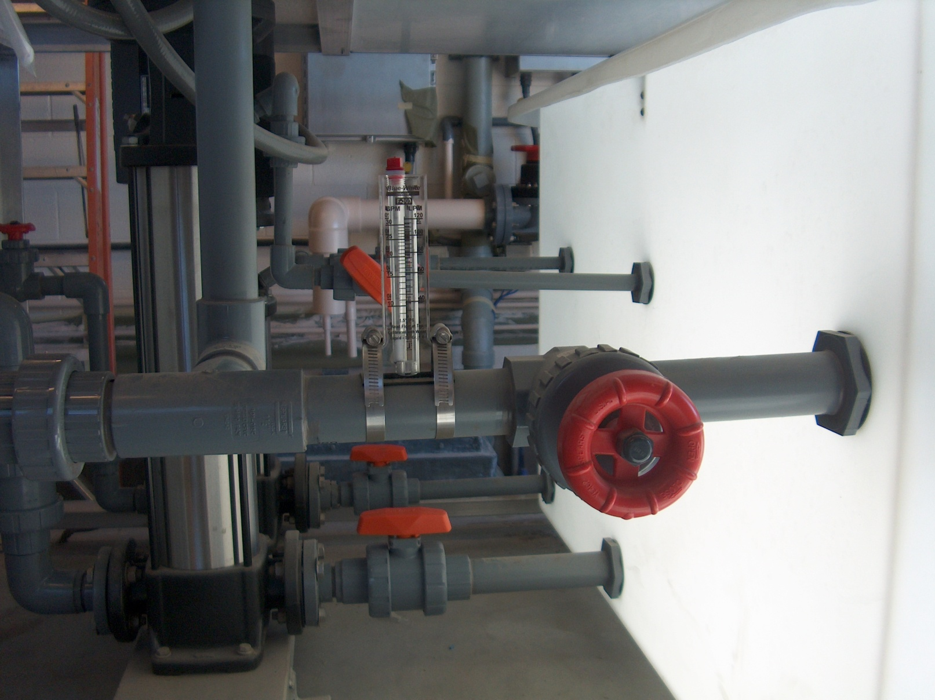
By-pass flowmeter and flow control valve

Slide 52
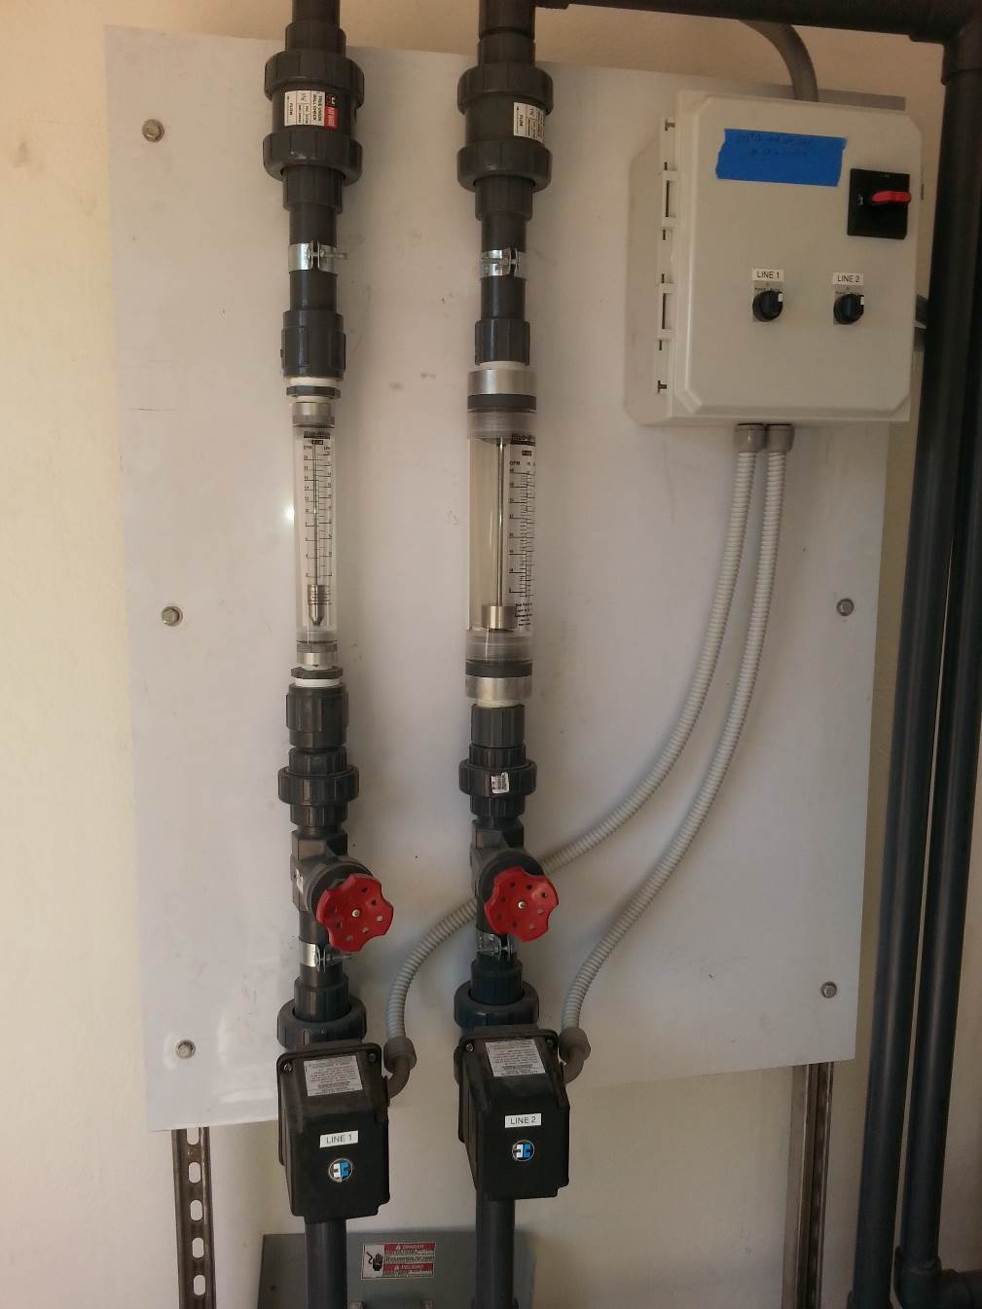
PowerPro MD
Outlet Discharge
Manifold
Discharge Check Valves
Discharge Flow Meters
Discharge Flow
Control Valves
Discharge Automatic
On/Off Valves

Slide 53
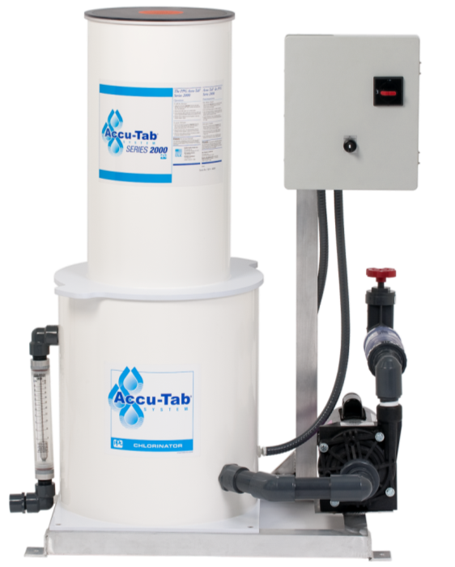
Accu-Tab 2000P System
Skid-mounted
Simple ‘plug-and-play’ installation
Provides efficient, controllable chlorine delivery
Low capital costs
Minimal maintenance
Notes:
Custom build to meet the requirements of the system.

Slide 54
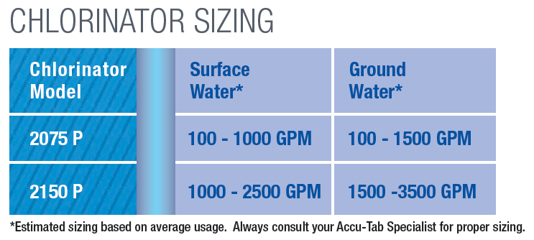
Accu-Tab 2000P Models
2075P– up to 2.5 lbs/hr
2150P – up to 10.5 lbs/hr

Slide 55
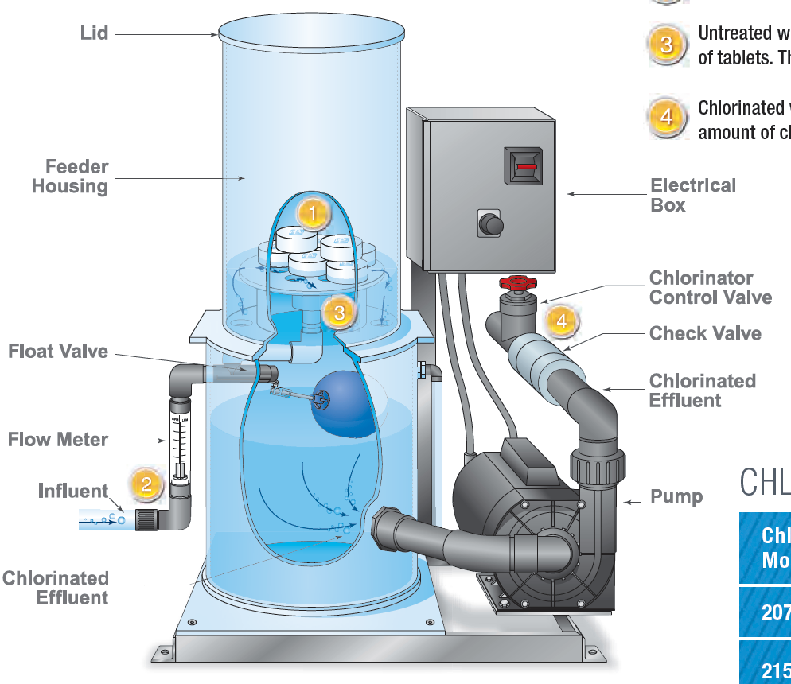
Accu-Tab 2000P Diagram

Slide 56
2000P Options
WEG VFD for…
  Flow pacing
  Residual control
  Compound loop control
2000 Series Controller
Tablet Weigh Scale

Slide 57
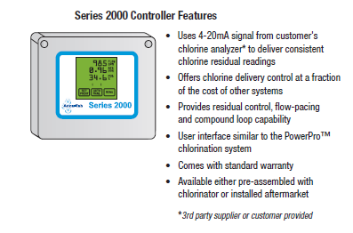
Accu-Tab 2000 Controller

Slide 58
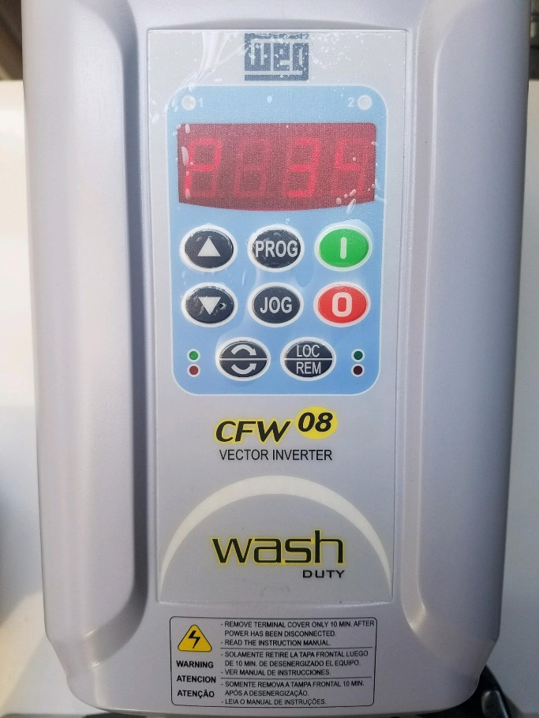
WEG Stand Alone VFD

Slide 59
Chlorine Residual Results
Residual Control

Slide 60
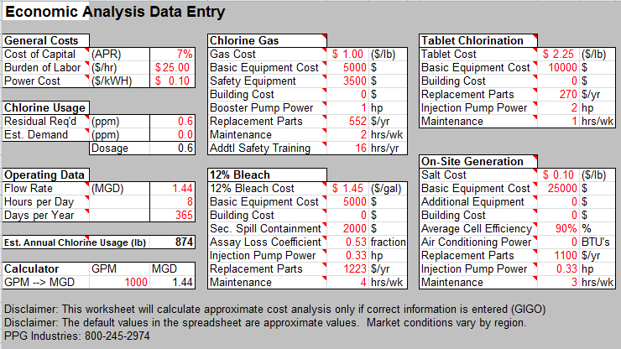
Economic Analysis Tool

Slide 61
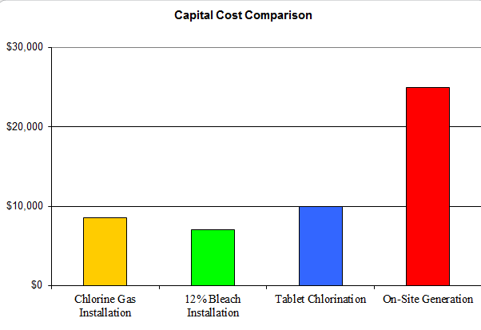
Initial Capital Cost Comparison

Slide 62
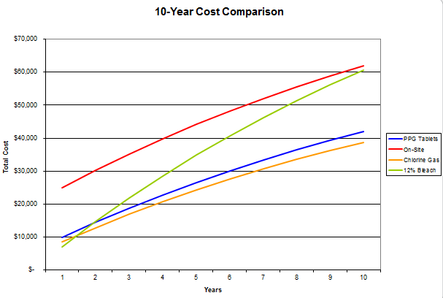
Total Cost Comparison

Slide 63
In Review
Cal Hypo Tablets are a solid alternative
Reduces safety and handling concerns
Eliminate hidden chlorination costs
Provide safe, accurate, and reliable
chlorination
Cost effective – Use economic analysis tool

Slide 64

System Capabilities
Flow pacing control
Residual control
Compound loop control
SCADA ready
Hi/Lo level alarms
Tablet scale
Low tablet alarm
220 single/three Phase or 460 3 phase power
Multiple Cl2 Injection Points

Slide 65
Approvals & Standards:
NSF Standard 60/61 (drinking water) certified
USDA approved uses:
  G-4, G-5, G-7, D-2, and Q-4
Meets AWWA Standard B-300
EPA Registration #748-295

Slide 66
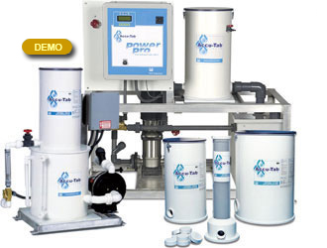

www.accu-tab.com

Slide 67
Water Solutions
Questions ?
Dan Mohr
713-299-8641
dmohr@Westlake.com

